Slide 1
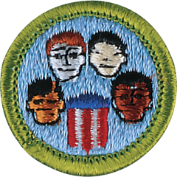
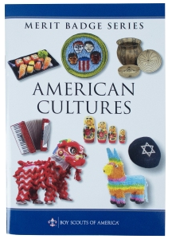
American Cultures Merit Badge
Merit Badge Counselor:
Mrs. Erin Nimmo
Scout Ryan Bertrand; cell: 757.418.2388
Mr. Robert Bertrand: cell: 910.9160755

Slide 2
1. Do TWO of the following, choosing a different group for each:
(b) Go to a place of worship, school, or other institution identified with one of the groups. Report on what you see and learn.
(c) Talk with a person from one of the groups about the heritage and traditions of the group. Report on what you learn.
.
2. Imagine that one of the groups had always lived alone in a city or country to which no other groups ever came. Tell what you think the city or country might be like today. Now tell what you think it might be like if the three groups you chose lived there at the same time.
3. Tell about some differences between the religious and social customs of the three groups. Tell about some ideas or ways of doing things that are similar in the three groups.
4. Tell about a contribution made to our country by three different people, each from a different racial, ethnic, or religious background.
5. Give a talk to your Scout unit or class at school on how people from different groups have gotten along together. Lead a discussion on what can be done to help various groups understand one another better.

Slide 3
DEC 13, 2025
1. Do TWO of the following, choosing a different group for each:
(c) Talk with a person from one of the groups about the heritage and traditions of the group. Report on what you learn.
Palestinian-American: 1st Generation: Ms. Tina Stimson
To understand a group's heritage, ask open-ended questions about
Family origins- Near Jordan, the west bank; Her mom is Ramalleah; and dad was Hammal
Daily life
food, -- Mediterranean- breads, cheeses, olives, grape leaves and lamb
dress, Long dresses, did not cover their faces, but conservative, never shorts or slevesless shirts
recreation- women cooked…no recreation…men rested, played
Celebrations
holidays, : Baby births, holidays were big celebrations every holiday…
rites of passage like weddings/births– school was difficult in Jordan but easier in USA…school for boys and not so much for girls
Values
respect, is everything…everthing…death followed being disrespectful --
community --- was everyting, every day we had visitors at home in Jordan and growning up in Michigan…community and family is everyting
History
migration, -- came though ellis Island to Detroit Michigan…for work and other family; their family changed their names from Jordan to Amierican
historical events), and
How traditions are passed down, -- big family dinners, always offer food, tea, rest…respect elders and quite children…

Slide 4
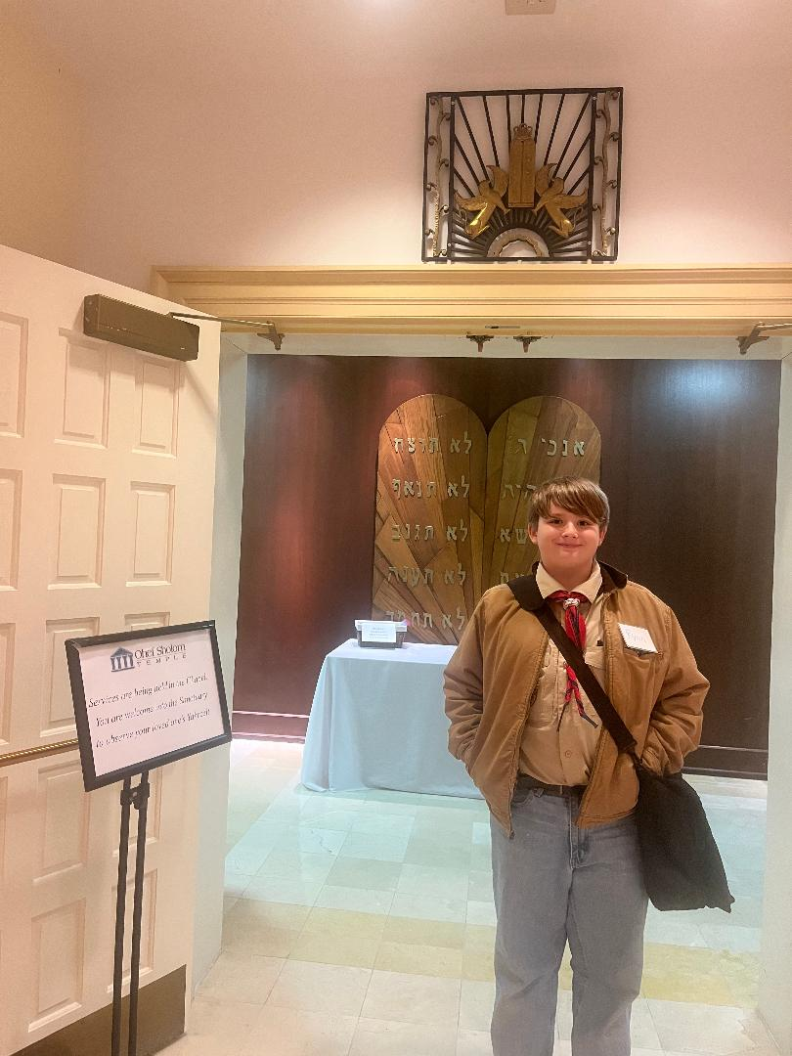
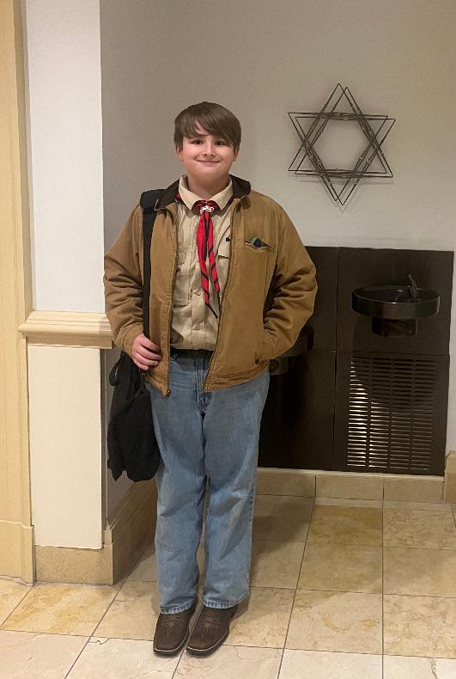
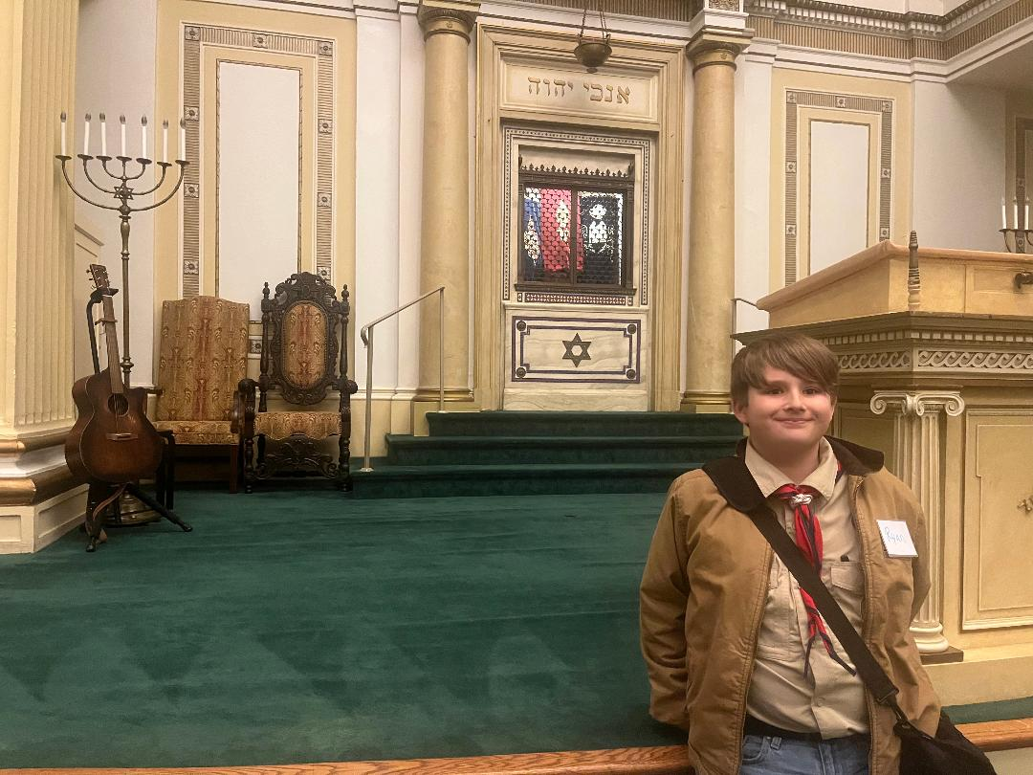
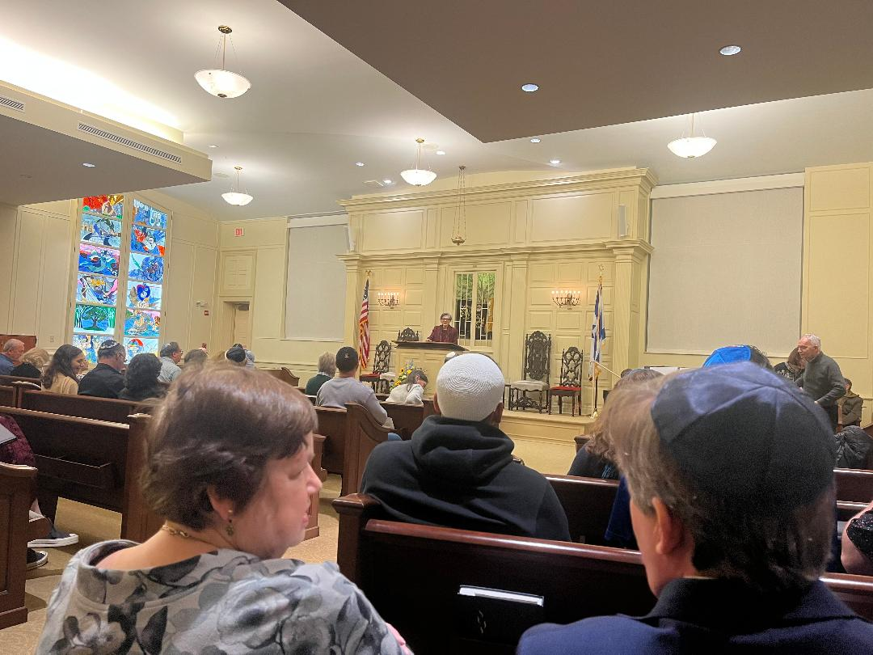
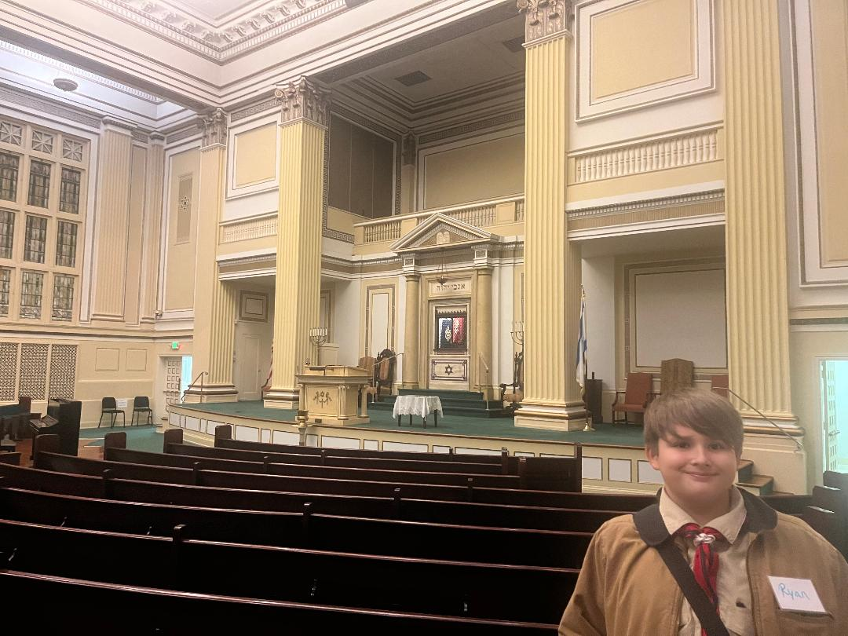
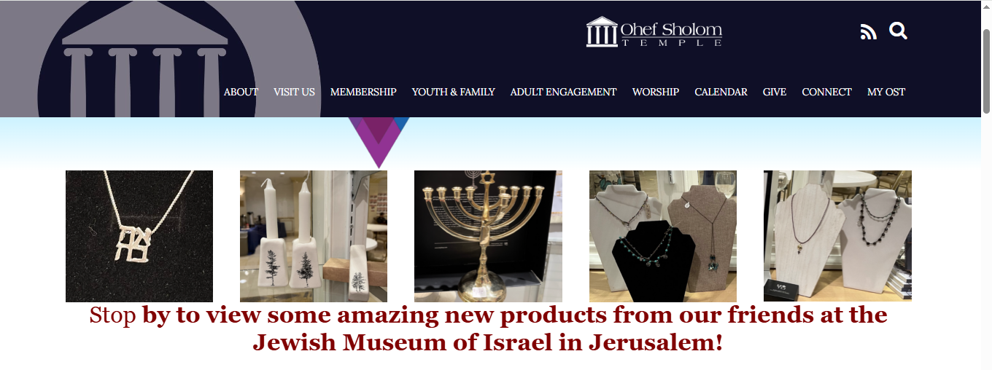
1. Do TWO of the following, choosing a different group for each:
((b) Go to a place of worship, school, or other institution identified with one of the groups. Report on what you see and learn.
Jewish - American
Ohef Sholom Temple
530 Raleigh Avenue
Norfolk, VA 23507
DEC 26, 2025

Slide 5
2. Imagine that one of the groups had always lived alone in a city or country to which no other groups ever came. Tell what you think the city or country might be like today.
If one group had always lived alone in a city or country where no one else ever came, I think the city might be quiet and peaceful, with its own traditions, buildings, and schools. People would know each other really well and follow their own rules and ways of living. As a Christian in Jordan, I imagine they would celebrate their own holidays, go to church, and take care of their community just like we do here.

Slide 6
2. Now tell what you think it might be like if the three groups you chose lived there at the same time.
If Jews, Palestinians, and Americans all lived in the same city at the same time, I think it would be busy and interesting:
There would be different foods, like falafel, bagels, and hamburgers, all in the same neighborhoods.
People might celebrate different holidays, but they could also learn about each other.
There could be disagreements because of different beliefs, but if everyone talked and respected each other, the city could be a place where people learn to live together peacefully.

Slide 7
3. Tell about some differences between the religious and social customs of the three groups.
American: Many Americans celebrate Christmas, Thanksgiving, and go to church or other places of worship. They like big parties, family dinners, and holidays.
Jewish: Jewish people celebrate Hanukkah, Passover, and go to the synagogue. They have special foods and traditions for each holiday.
Palestinian/ Jordan (Christian): Christians in Jordan celebrate Christmas and Easter and go to church. They also have family gatherings and special meals for holidays.
Each group follows their own traditions, but all of them value family, community, and helping others.
Tell about some ideas or ways of doing things that are similar in the three groups.
  Even though the groups are different, they have some things in common:
  All celebrate holidays with family and friends.
  All go to their places of worship to pray and learn.
  All help their communities and try to be good citizens.
  All value family, respect, and traditions in daily life.

Slide 8
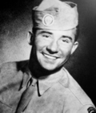
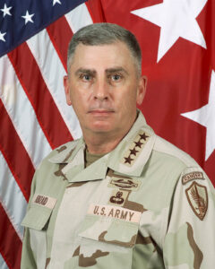
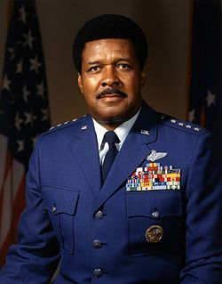
4. Tell about a contribution made to our country by three different people, each from a different racial, ethnic, or religious background.
Isadore Siegfried Jachman (December 14, 1922 – January 4, 1945) was a United States Army staff sergeant who was killed in World War II after defending the town of Flamierge in Belgium from a German attack on January 4, 1945, for which he received the Medal of Honor.
Jewish-American
John Philip Abizaid (born April 1, 1951) is a retired United States Army General and former U.S. Central Command (CENTCOM) commander, overseeing American military operations in a 27-country region, from the Horn of Africa, the Arabian Peninsula, to South and Central Asia, covering much of the Middle East. CENTCOM oversees 250,000 US troops. Abizaid succeeded General Tommy Franks as Commander, USCENTCOM, on July 7, 2003, and was also elevated to the rank of four-star general the same week. He was succeeded by Admiral William J. Fallon on March 16, 2007.
Abizaid retired from the military on May 1, 2007 after 34 years of service. As of 2007, Abizaid is employed as a fellow of the Hoover Institution at Stanford University. He assumed the Distinguished Chair of the Combating Terrorism Center at West Point in December 2007. Abizaid was appointed to the board of directors of RPM International on January 24, 2008, and also sits on the board of directors of the Defense Ventures Group. In 2008 he was selected as a Montgomery Fellow at Dartmouth College.
Arab-American
Tuskegee Airman: On September 1, 1975, James was promoted to the four-star rank of general (O-10), becoming the highest ranking African-American in the history of the United States military to that date.^{[5]} He was assigned as commander in chief of NORAD/ADCOM at Peterson Air Force Base, Colorado. In these dual capacities, he had operational command of all United States and Canadian strategic aerospace defense forces. On December 6, 1977, he assumed duty as special assistant to the Chief of Staff, U.S. Air Force.^{[11]}
African-American

Slide 9
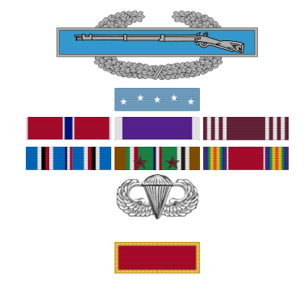
Sergeant Jachman, Company B, 513th Parachute Infantry Regiment and his company were pinned down by enemy artillery, mortar, small arms fire and two hostile tanks that attacked the unit, inflicting heavy casualties. Sergeant Jachman left his place of cover, dashed across open ground, through a hail of fire and grabbed a bazooka from a fallen comrade. He then advanced on the tanks, which concentrated their fire on him. Firing his weapon, he damaged one and forced both of them to retire.^{[2]}
Some years later the village of Flamierge erected a statue where an unknown American soldier had stood fighting to save the village. Later, a search of Army records established that this indeed was Staff Sgt. Jachman, and his name was added to the statue. Today, the Staff Sgt. Isadore Jachman Armory is located at 12100 Greenspring Avenue, Owings Mills, Maryland.^{[3]} His Medal of Honor was awarded to his family in June 1950.00
STAFF SERGEANT ISADORE S. JACHMAN
UNITED STATES ARMY
For conspicuous gallantry and intrepidity above and beyond the call of duty at Flamierge, Belgium, on 4 January 1945, when his company was pinned down by enemy artillery, mortar, and small arms fire, 2 hostile tanks attacked the unit, inflicting heavy. casualties. S/Sergeant. Jachman, seeing the desperate plight of his comrades, left his place of cover and with total disregard for his own safety dashed across open ground through a hail of fire and seizing a bazooka from a fallen comrade advanced on the tanks, which concentrated their fire on him. Firing the weapon alone, he damaged one and forced both to retire. S/Sergeant. Jachman's heroic action, in which he suffered fatal wounds, disrupted the entire enemy attack, reflecting the highest credit upon himself and the parachute infantry.

Slide 10
5. Give a talk to your Scout unit on how people from different groups have gotten along together. Lead a discussion on what can be done to help various groups understand one another better.
Outline
1. Introduction: The Scout Connection (1 mins)
Hook: "We all wear the same uniform, but we come from different families, beliefs, and backgrounds. Today, let's talk about how Scouting brings us together, and how we can learn from each other."
Personal Story (Your Own): Briefly share a time you connected with someone different from you (e.g., a new Scout, someone at a community service project) and what you learned.
2. How People Get Along: A Scout Example (3 mins)
Scenario (Use Nate & Devon): "Imagine Nate (history buff) and Devon (tech whiz). For the American Cultures badge, Nate researches history, Devon finds stats online, but they both learn each other's skills. Nate learns tech; Devon learns history."
Key Idea: They focused on a common goal (earning the badge) and respected their different strengths.
Broader Example: Mention how Scouts from different faiths can meet to discuss community needs, finding common ground.
3. Discussion: Building Bridges (5 mins)
Facilitate: "Now, let's talk about our school and community. What can we do?"
  "What's one new custom from another culture you'd be willing to learn about?" (e.g., different greetings, food).
  "How can we be like Nate and Devon and share our skills?" (e.g., tech help for history, story sharing for tech).
  "What small act of kindness can we do this week to understand someone better?" (e.g., listening without interrupting, trying their lunch).
  "How can we show more 'good turns' to people different from us?" (Connecting to the Scout Law).
4. Conclusion: (3 mins)
Summarize: "We learned that patience, kindness, and focusing on shared goals help us understand each other."
Call to Action: "Let's challenge ourselves to live the Scout Oath and Law by building bridges, not walls, every day. Let's make our unit and school a place where everyone feels they belong

Slide 11
5x minute Speech
Introduction: The Scout Connection
  Good evening Scouts, leaders, and parents.
  We all wear the same uniform, but we come from different families, beliefs, and backgrounds. Some of us like sports, some like video games, and some like history or camping. Today, I want to talk about how Scouting brings us together and how learning from different cultures makes America stronger.
  When I first joined Scouts, I was nervous. I didn’t know everyone, and some Scouts were very different from me. One time at a community service project, I worked with a Scout who had different traditions at home and celebrated different holidays. At first, it felt awkward, but as we worked together, we started talking and laughing. I learned that even if we are different, we still care about the same things—helping others and being good Scouts.
How People Get Along: A Scout Example
  Imagine two Scouts named Nate and Devon. Nate loves history and knows a lot about the past. Devon is really good with technology and computers. They are working on the American Cultures merit badge.
  Nate researches the history part, and Devon looks up statistics and information online. At first, they stick to what they know best. But then something cool happens. Nate asks Devon to teach him how to search better online, and Devon asks Nate to explain some history. By the end, they both learn new skills.
  They earned the badge not because they were the same, but because they were different. They had a common goal and respected each other’s strengths. That’s how people get along—by working together and learning from each other.
  This happens in Scouting all the time. Scouts from different faiths, cultures, and backgrounds come together to help the community. Even if we believe different things, we can still find common ground, like helping others and making our town a better place.
Building Bridges
  Now let’s think about our school and community. What can we do?
  What’s one new custom from another culture you’d be willing to learn about? Maybe it’s a different greeting, food, or holiday tradition. Trying something new helps us understand others better.
  How can we be like Nate and Devon and share our skills? Maybe you’re good at technology and can help someone with a project. Or maybe you’re good at storytelling or history and can teach someone else.
  What’s one small act of kindness we can do this week? Maybe listen without interrupting, invite someone new to sit with you, or even try their lunch. Small actions can make a big difference.
  How can we show more “good turns” to people who are different from us? This connects directly to the Scout Law—being kind, helpful, friendly, and respectful.
Conclusion
  Today we learned that patience, kindness, and focusing on shared goals help us understand each other. America is like a melting pot, where different cultures mix together, and that makes us stronger. Let’s challenge ourselves to live the Scout Oath and Scout Law by building bridges, not walls, every day. Let’s make our troop, our school, and our community a place where everyone feels welcome and belongs.
  Thank you

