Slide 1
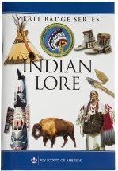

American Indian Culture (AIC)
Merit Badge
American Indian Culture
Merit Badge
14-16 August 2026
Merit Badge Counselor: Mr. Robert Bertrand

Slide 2
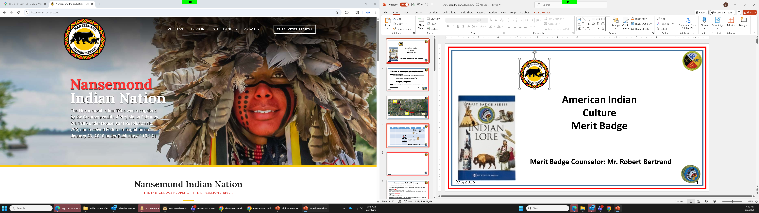
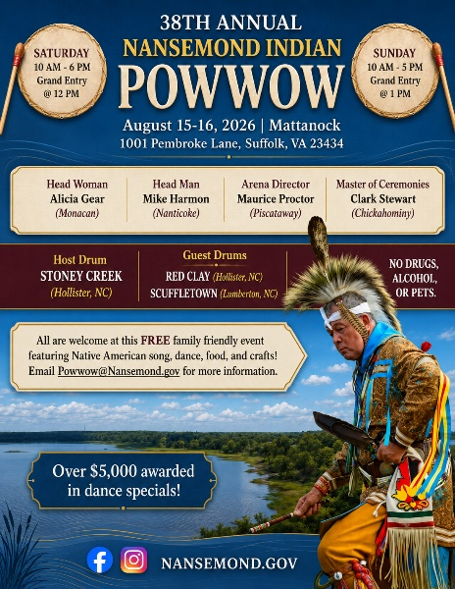

Slide 3
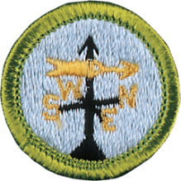
Situation: Scouts learning about native American Indian Culture while working on MB, Camping MB
Mission: Scout Troops 259/5259 conducts 2-night native American Indian immersion camping weekend to appreciate, learn, and earn the American Indian Culture MB August 14-16, 2026.
Execution: American Indian Culture MBC Lead weekend of events
Scheme of Maneuver Planning (Learning about Native American Indians indigenous to our region)
Scouts research, build tri-folds of information, learn languages, games, and cooking
Individuals and Teams Cooking native foods and meals ISO (MB)
Scouts teach each other, learn from one another, discuss each others' presentations
48x total hours from beginning to completion
Attend Nasemond Indian Nation Annual POWWOW
Weather planning (MB opportunities)
Logistics: Coordinate for camping location; coordinate for canoes or seats in cars, grub masters, Dutch ovens, food purchases
Command and Control: Broken into patrols with leadership for accountability and oversight

Slide 4

13AUG Thurs | 14AUG FRI | 15AUG SAT | 16 AUG Sunday
 |  | 6:30:Native Breakfast 8am canoe prep / Training | 06:30-0830 Breakfast + tear down
 | 6pm Arrive and immediately each patrol establish their own camp and build patrol cooking fire | 9am: depart ½ Canoe & ½ drive to POWWOW vic ‘Mattanock Town’ | 0830: Scouts-Own --Each patrol runs their own IOT allow scouts to lead (Communications MB)
Scout MTG 7-8:30pm: American Indian Culture (AIC) MB MTG Requirements 1-3 (broken into Patrols for presentations) | 7-9pm: Requirement --cook dinner over open fire -- 4(c)-game-patrol-level *Canoes arrive | Lunch at POWWOW: Requirement #5 | 0900-0915: trash pick-up by patrol, supervised by SPLs 0915-0930 MBC Discussion
 | 9-10pm Req 4(a-b) Troop level Open Pit Fire- troop | Dinner at Camp: Each Patrol Cooks open-fire style | 0930: Pick-up kids from weekend
 |  | Open Pit Fire | *Return Canoes + Trailer
Scout Dress Shirt
Scout Dress Shirt
Depart at 2:30pm from Powwow

Slide 5

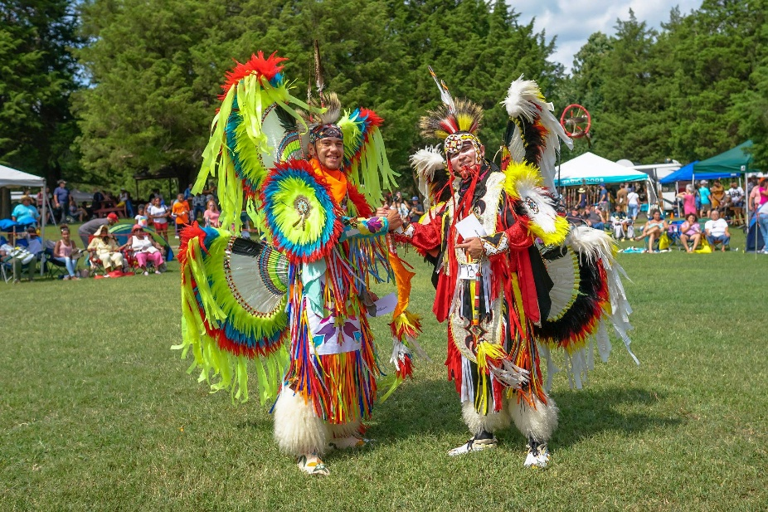
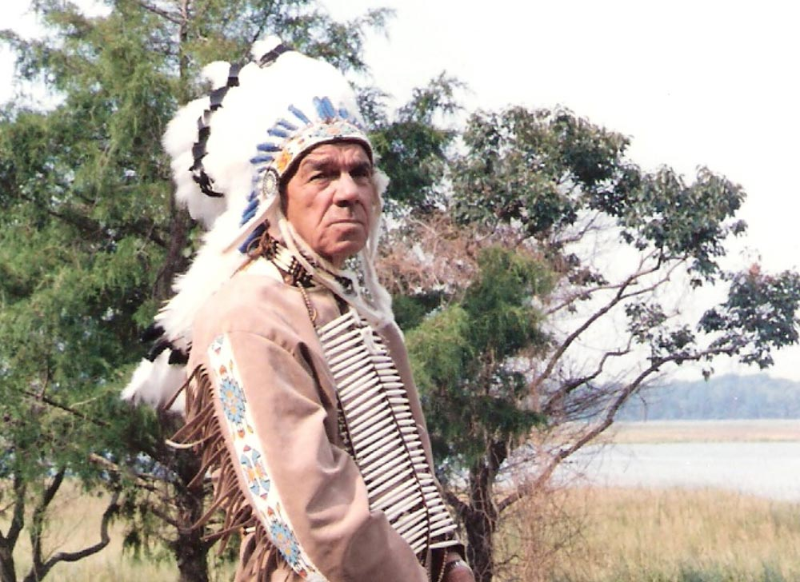
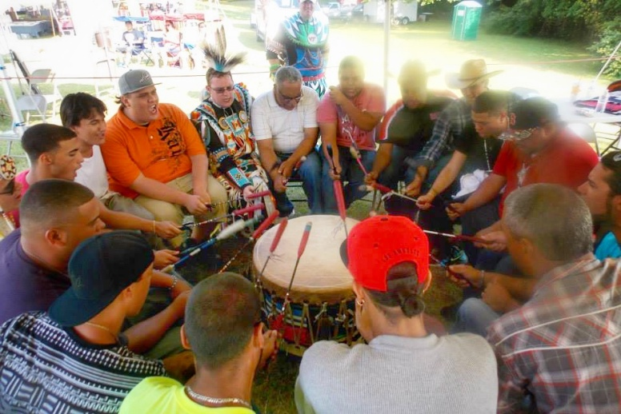
Saturday
Event
‘In 1988 our tribe held its first pow wow on ancestral land. It was called the “Nansemond Indian Homecoming” in celebration of our return to the Nansemond River after centuries of colonial displacement. Each year, in mid-August, we hold a “Nansemond Indian Homecoming” to welcome Nansemond descendants, family, and friends to our home. Though we hold our pow wow within the state of Virginia, state borders came long after us. Our history and our relationships have no borders.’ Tribal Chief
Recommend providing Cash to your Scout to buy food, treats, or Native American souvenirs at Saturday’s Powwow

Slide 6
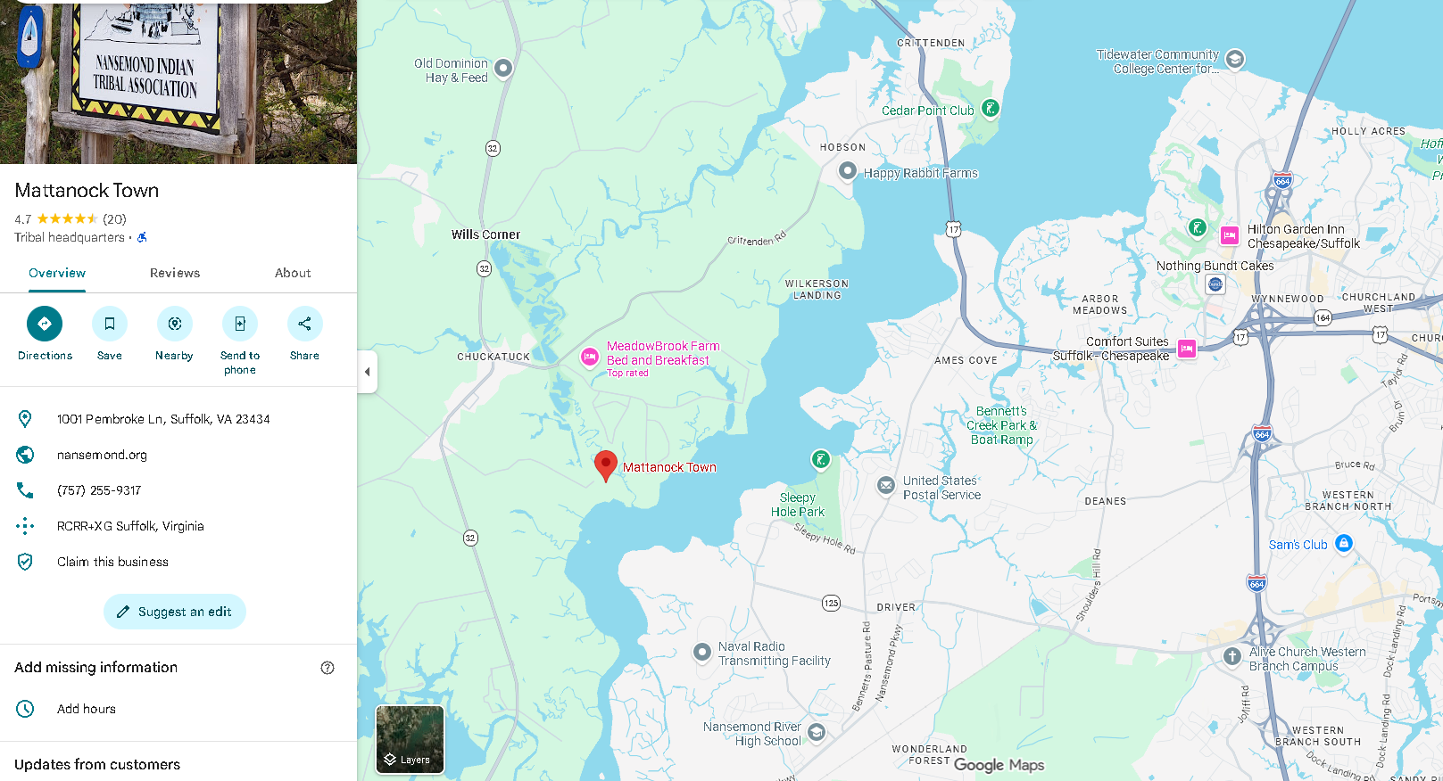
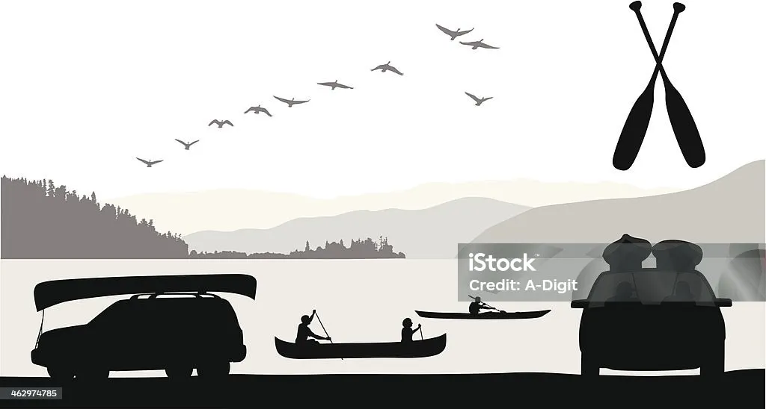

Driving
St Theresa’s Church

Slide 7
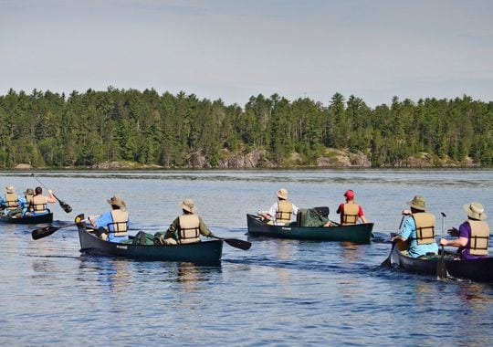


Slide 8
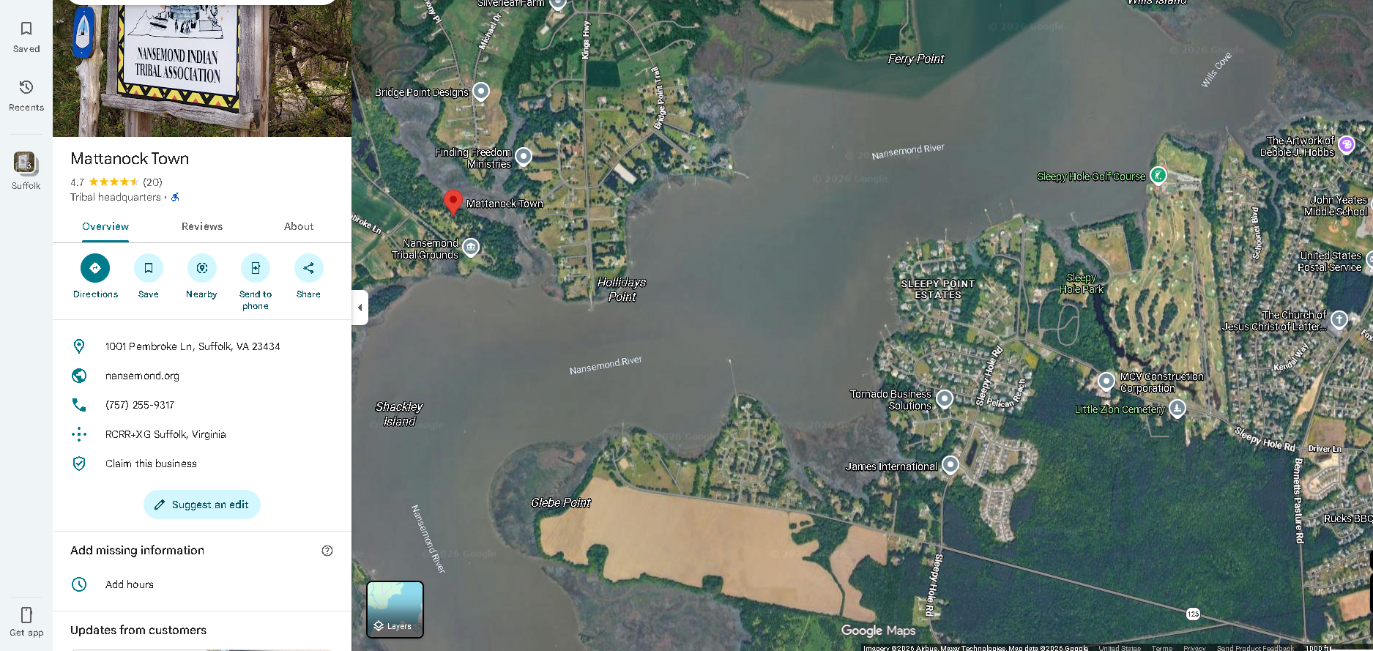
2.5 miles

Slide 9
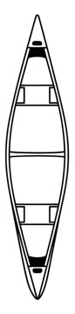
SPL 5259 Task
Group #2
Group #4
Group #1
Group #3
C2
Scout: ___________
G2
Scout: ___________
A2
Scout: ___________
Scout: ___________
E2
Scout: ___________
C3
G3
Scout: ___________
Alternate
Map/Compass
A3
Scout: ___________
C1
E3
Scout: ___________
G1
Primary
Map/ Compass
ASPL TBD
D2
Scout: ___________
A1
ASPL
H2
Scout:
___________
B2
E1
F2
Scout: ___________
SPL Emma
Scout: ___________
Boat C
D3
Scout: ___________
SPL Sameul
Boat G
H3
Scout:
___________
B3
F3
Scout: ___________
Boat A
Scout: ___________
Boat E
D1
H1
B1
Mr. Bertrand
Sr. Adult
Adult
F1
Adult
Adult
SM MJ
Sr. Adult
ASM Gandy
Sr. Adult
Adult
Boat D
TBD
Boat H
Boat B
Boat F

Slide 10
Leadership & Safety (Super Important)
At least one trained adult leader in Safety Afloat & Safe Swim Defense
Buddy system on the water
Life jackets (PFDs) always worn
Swim test done ahead of time
First aid–trained adult
1 adult for 2x boats
Canoe Seating Priority ISO Risk Mitigation
Earned Canoeing or Kayaking MB
Earning Indian Culture MB
Earned Swimming MB
First Class and Above
Then Rank and SM approvals
All others will be driven to Pow wow

Slide 11
Risk Management
Prevent and plan for:
Cold water (hypothermia risk even in mild air temps)
Afternoon storms
Dehydration
Sunburn
Tired Scouts making ill-informed (aka) bad decisions
Rule: If weather looks bad, get off the water early.
Canoe Seating Priority ISO Risk Mitigation
Earned Canoeing or Kayaking MB
Earning Indian Culture MB
Earned Swimming MB
First Class and Above
Then Rank and SM approvals
All others will be driven to Pow wow

Slide 12
SPL 5259 Task
Driven to POW WOW
Requires additional Parental Support
All scouts not canoeing will need to be driven to Pow wow
Any Scouts not attending must be supervised at Camp by a qualified Adult
Adult Driver:______________
Scout: ___________________
Scout: ___________________
Scout: ___________________
Scout: ___________________
Adult Driver:______________
Scout: ___________________
Scout: ___________________
Scout: ___________________
Scout: ___________________
Adult Driver:______________
Scout: ___________________
Scout: ___________________
Scout: ___________________
Scout: ___________________
Adult Staying At Site: ______________
Scout: ___________________
Scout: ___________________
Scout: ___________________
Scout: ___________________

Slide 13
American Indian Culture Merit Badge
1. Identify the different American Indian cultural areas. Explain what makes them each unique. Thursday –open discussion with patrol
2. Each Scout: Research an American Indian tribe, group, or nation. Each Scout: Tell your counselor about traditional dwellings, way of life, tribal government, religious beliefs, family and clan relationships, language, clothing styles, arts and crafts, food cultivation, foraging and preparation, means of getting around, games, customs in warfare, and where and how they live today. Thursday evening--
3. Each Scout: Do the following: Thursday evening
(a) Learn 10 common terms in an American Indian language and their meanings.
(b) Identify the meaning of 10 place names of American Indian origin in the United States.
(c) Name five well-known American Indian leaders, either from the past or people of today. Give their tribes or nations. Describe what they did or do now that makes them notable.
4. Do the following: (will be on Friday night)
(a) Describe how life might have been different for the European settlers if there had been no Native Americans to meet them when they came to this continent.
(b) Describe eight things adopted by others from American Indians.
(c) Learn a game played by a group or tribe. Teach and lead it with a Scout group (their individual patrols will play their game).
5. Do ONE of the following: (will be done on Saturday)
(b) Attend a contemporary American Indian gathering. Discuss with your counselor proper etiquette for attending as well as what you learned and observed during your visit.

Slide 14

13AUG Scout MTG MB Requirements
1. Identify the different American Indian cultural areas. Explain what makes them each unique. Thursday –open discussion with all Scouts
2. Each Scout: Research an American Indian tribe, group, or nation. Each Scout: Tell your counselor about traditional dwellings, way of life, tribal government, religious beliefs, family and clan relationships, language, clothing styles, arts and crafts, food cultivation, foraging and preparation, means of getting around, games, customs in warfare, and where and how they live today. Thursday--
3. Each Scout: Do the following: Thursday
(a) Learn 10 common terms in an American Indian language and their meanings.
(b) Identify the meaning of 10 place names of American Indian origin in the United States.
(c) Name five well-known American Indian leaders, either from the past or people of today. Give their tribes or nations. Describe what they did or do now that makes them notable.
Using a Tri-Fold
List 10x place names of American Indian Origin
3b
Tribe Name
Pictures of Traditional Dwellings & Way of life, Req 2
Describe your game as part of Requirement #4b
Pictures of Family, Trible government, clothing #2
List 10x common Terms (req 3a).
Map of US showing where your tribe was located.
Pictures of 5x well-known American Indian Leaders with their description of what they did for America #3c

Slide 15
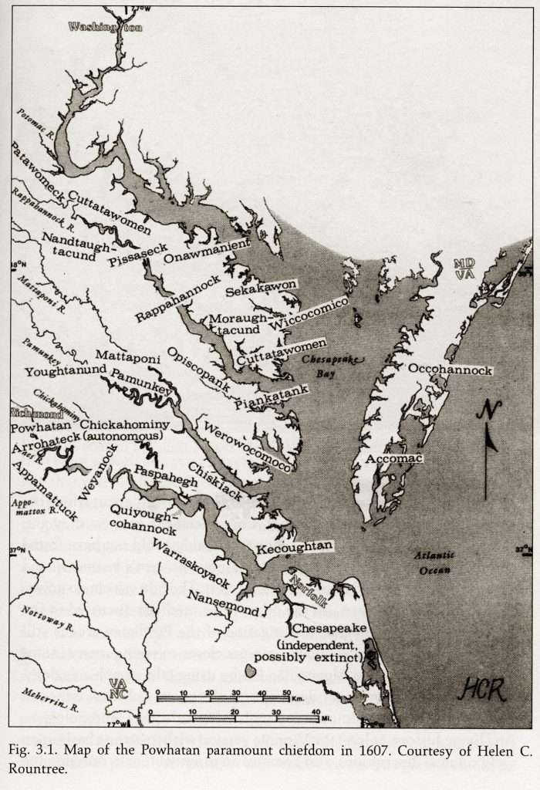
American Indian Culture Merit Badge
1. Identify the different American Indian cultural areas. Explain what makes them each unique.

Slide 16
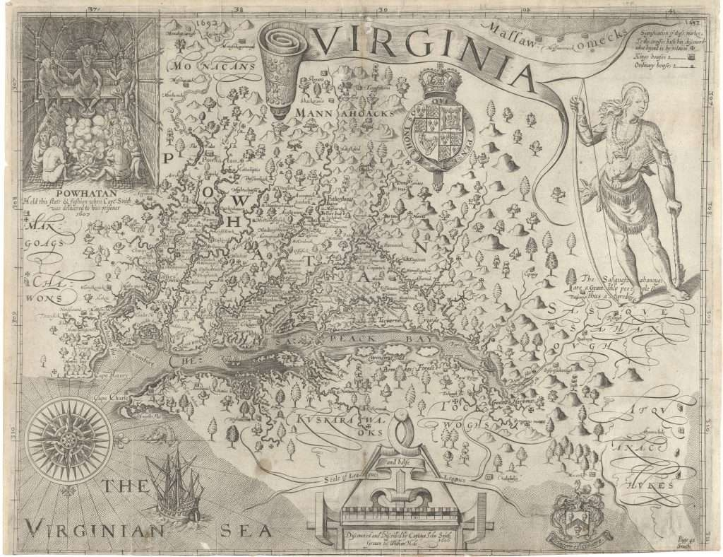
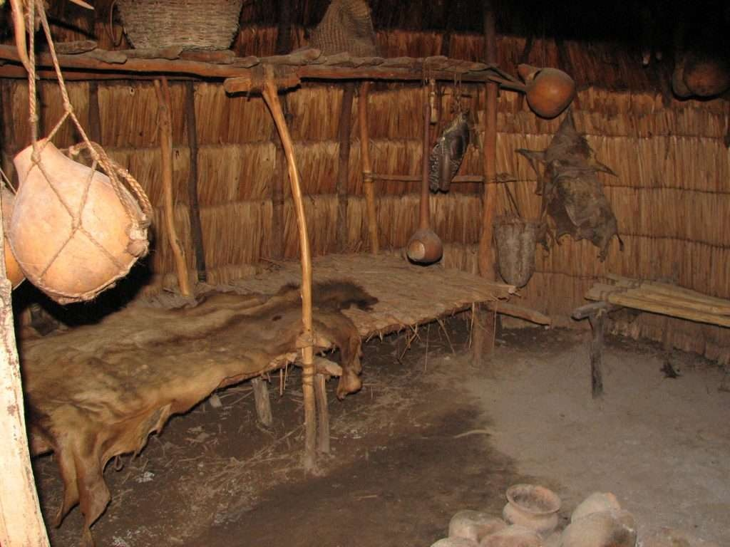
American Indian Culture Merit Badge
2. Research an American Indian tribe, group, or nation. Tell your counselor about traditional dwellings, way of life, tribal government, religious beliefs, family and clan relationships, language, clothing styles, arts and crafts, food cultivation, foraging and preparation, means of getting around, games, customs in warfare, and where and how they live today.

Slide 17
American Indian Culture Merit Badge
3. Do the following:
(a) Learn 10 common terms in an American Indian language and their meanings.
(b) Identify the meaning of 10 place names of American Indian origin in the United States.
(c) Name five well-known American Indian leaders, either from the past or people of today. Give their tribes or nations. Describe what they did or do now that makes them notable.

Slide 18
American Indian Culture Merit Badge
4. Do the following:
(a) Describe how life might have been different for the European settlers if there had been no Native Americans to meet them when they came to this continent.
(b) Describe eight things adopted by others from American Indians.
(c) Learn a game played by a group or tribe. Teach and lead it with a Scout group

Slide 19
American Indian Culture Merit Badge
5. Do ONE of the following:
(a) Visit a museum either in-person or virtually to see American Indian exhibitions and collections. Discuss with your counselor what you observed or learned from two exhibitions and identify 10 artifacts by tribe or nation, their shape, size, and use.
(b) Attend a contemporary American Indian gathering. Discuss with your counselor proper etiquette for attending as well as what you learned and observed during your visit

Slide 20
Requested Support Tasks
High Adventure Coordinator/ Mr. Bertrand
-Design and plan comprehensive American Indian Culture (AIC) MB weekend of events; request support for division of labor effects
-MBC for all Scouts seeking AIC MB, outline requirements to Scouts, design educational evolutions for Scouts to learn and achieve requirements
-Support SMs in Leadership and management of Scouts during weekend through SPLs and Scout Leadership Positions
-
SM MJ
-Aid SPLs on manifesting Scouts into Canoes; ; aid SPLs and coordinate w/ parents for land-transportation from Sleepy Hole to Powwow and return on 15AUG
-Coordinate for >1x Adult to stay at Sleepy Hole for oversight and security of Scouts not attending powwow on Saturday
-Coordinate for Troop Trailer to be taken to Sleepy Hole and returned to Church
-Coordinate w/ Committee to schedule Sleepy Hole for Camping 14-16AUG
ASM Gandy:
-Reserve 8 canoes + gear for 14-16AUG
-Secure 8 canoes w/ vests + paddles & transport canoes to Sleepy Hole and return
-Perform Sr. Watercraft OIC for Safety (provide canoe safety briefing)
SPL Emma and SPL Samuel
-13AUG, Manifest Canoe paddlers IAW Priorities (Emma Lead w/ Samuel Support)
-23July, present SM’s with list of all participating MB Scouts for (a) Campout, (b) participating in AIC MB, (c) Canoe and non-canoe transportation (Samuel)
-(Emma) Supervise consolidated Axe-Yard construction, ensure tools are safe, sharp, and all users have proper Tote’n Chit authoriazation
-Ensure Patrol-group Camping, not Troop
-Ensure Patrol- group cooking over fire (unless fire ban)
-Ensure each Patrol has a Yell (motto) practiced before 13AUG
-Ensure each Patrol has meal plan w/ recommended AIC menu items and inform PLs to enable special dietary concerns to be accounted for and adjusted for.

Slide 21
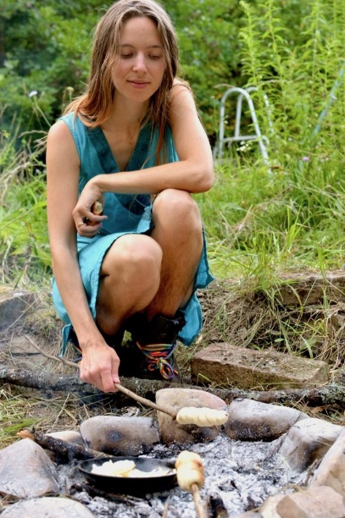
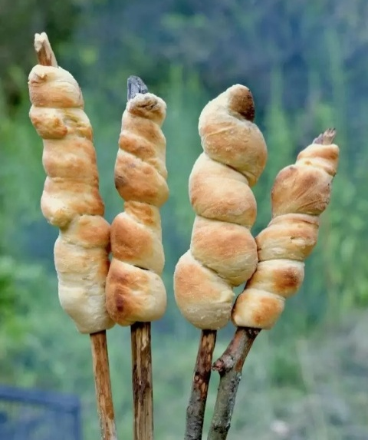
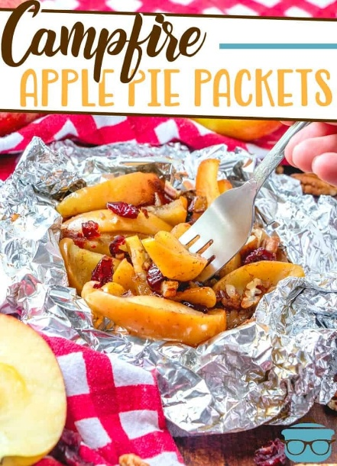
Friday
6:00–7:00 PM
Arrive at Sleepy Hole campground (All)
Campsite selection and setup (tents up, firewood collected, cooking tools prepared) - Patrols
Patrol campsites, flags posted, and campsite w/ cooking ring prepared w/ wood ready - Patrols
7:00 PM
Cook Dinner (by Patrols) cooked all over fire
  Dutch oven chicken stew
  Stick-bread w/ honey
  Baked Apples w/ cinnamon (tin foil)
8:30: Each Patrol plays their game: req 4c
9:00 PM
Opening Troop-wide campfire—SMs
Discuss the Indigenous peoples of the Tidewater region, including the Powhatan Confederacy and their relationship with the waterways– Mr. Bertrand.
Review canoe safety and the next day’s float plan – ASM Gandy.
10:30 PM
Lights out

Slide 22
Saturday – Canoe Adventure & Powwow
7:00 AM
Breakfast
  Johnnycakes (cornmeal cakes)
  Scrambled eggs
  Fresh berries
9:00 AM
Safety briefing
Paddle strokes review
Launch canoes
9:15 AM–10:00 AM
Canoe to POWWOW
Observe wildlife
Navigation exercise
10:00 PM
Beach landing at POWWOW
Attend a Native American powwow.
Scouts can:
Observe Grand Entry.
Visit educational booths.
Learn about drumming, dancing, regalia, and crafts.
Practice respectful etiquette.
Complete portions of American Cultures or American Indian-related advancement where appropriate.
Meet everyone at flagpole
Eat on your own
2:30 PM
meet at flag pole then onto canoes / shuttle transportation
2:30– 4:00 PM
Paddle to Sleepy Hole // car shuttle to sleepy hole
4:30 PM Dinner Prep
Return to camp—get cooking fire lit and ready.
Patrol Cooking: Native-inspired dinner
Menu inspired by foods available in pre-colonial Virginia:
Skewer Chicken pieces over fire
Tin Foil sweet potatoes, or
Three Sisters succotash: Corn + Beans + Squash
Cobbler in a Dutch oven
Discuss: Why corn, beans, and squash are called the “Three Sisters.”
8:00 PM
Campfire:
Native American stories (with permission and proper attribution)
Astronomy
Leave No Trace discussion
Scout reflections
Recommend providing Cash to your scout to buy food treats or Native American souvenirs at Saturday’s Powwow

Slide 23
Sunday
6:30 AM
Breakfast
Oatmeal (patrol dependent)
Dried fruit
Nuts
Honey
8:30 AM
Interfaith Scouts’ Own service: who needs their communication MB requirement?
9:00 AM
Trash pick-up
9:15 AM
MBC AIC Discussion
9:30 AM
a) Scouts Pick-up
b) 2x Trailers Returned- Scout trailer + Canoe trailer

Slide 24
AIC MB Weekend
Native-inspired menu
Skills Covered
  Cooking, Camping, Canoeing, Pioneering, Communications, and American Cultures MBs
  Paul Bunyon, Tot’en Chit, and Fireman Chit tools—refresher*
  Rank-up tasks
  Leave No Trace
  Local history
  Conservation
  Citizenship
  Respect for Native cultures
Recommend providing Cash to your scout to buy food treats or Native American souvenirs at Saturday’s Powwow

Slide 25
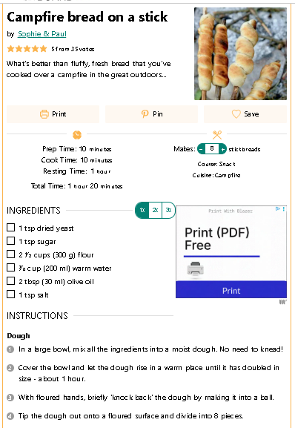
Meal | Menu
Fri Dinner | Dutch oven pot - chicken stew, stick bread, baked apples (over fire)
Saturday Breakfast | Cornbread Jonny cakes (cornbread Pancakes) w/ berries, eggs (over fire)
Saturday Lunch | Turkey wraps, fruit (lunch sack)
Saturday Dinner | chicken skewers or stew, sweet potatoes w/ cinnamon + sugar (in tinfoil) or Three Sisters succotash in pot, Dutch oven cobbler of choice (over fire)
Sunday Breakfast | nuts, dried fruit, jerky meat

Slide 26
SHOPPING LIST for Patrol Cooking: each patrol will have to figure out portions size to buy food
Raw chicken (enough for two meals)
  Friday Dinner Stew in Dutch oven
  Saturday Dinner on Skewers over fire
  ** Recommend Thighs and then cut them up
Stick Bread (portions dependent)—see recipe on slide #24
  Dried yeast
  Sugar
  Flower
  Olive oil
  Salt
Honey or Jam for stick bread
Apples, cinnamon, sugar, butter, and tin foil
Jiffy cornbread boxes, milk, oil
Frozen berries– for the Jonny cakes
Eggs (butter)
Tortillas + sliced turkey, apples
Sweet potatoes, butter, brown sugar
Dutch Oven Cobbler ingredients: butter, cake mix, filling, cinnamon
Three Sisters succotash: canned corn, canned lima beans, fresh Squash
mixed nuts, dried fruit, jerky meat
Paper sacks for lunch bags 1x per scout
Meal | Menu
Fri Dinner | Dutch oven pot - chicken stew, stick bread, baked apples (over fire)
Saturday Breakfast | Cornbread Jonny cakes (cornbread Pancakes) w/ berries, eggs (over fire)
Saturday Lunch | Turkey wraps, fruit (lunch sack)
Saturday Dinner | chicken skewers or stew, sweet potatoes w/ cinnamon + sugar (in tinfoil) or Three Sisters succotash in pot, Dutch oven cobbler of choice (over fire)
Sunday Breakfast | nuts, dried fruit, jerky meat

Slide 27

