Slide 1

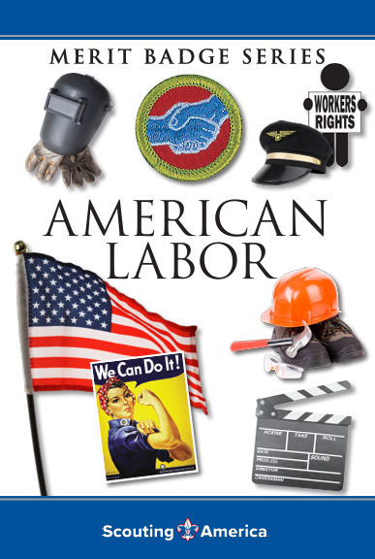
American Labor Merit Badge
Saturday, Feb 7th at the Church
4137 Portsmouth Blvd, Chesapeake, VA 23321
POC Mr. Robert Bertrand: cell: 910.916.0755
Merit Badge Counselor: ASM CAPT Gandy and Mr. Bertrand

Slide 2
American Labor Merit Badge
5x W’s
Who: Scouts of America w/ Support from Community
What: Learn about American Labor
When: Saturday, FEB 7th from 0750-1600hrs
Where: Church of St. Therese; 4137 Portsmouth Blvd, Chesapeake, VA 23321
Why: Become better American citizens and earn American Labor MB

Slide 3

American Labor MB
Scheme of Maneuver
Saturday, Feb 7th at the Church
0750-0800: Accountability and Administrative Overview
0800-0950: Req # 5: watch movie ‘Newies - Disney’
1000-1100: Req # 1, 2a-c: Guest Speaker IAW: CAPT Gandy, Labor Unions
IFPTE Local 1 President: Corey Henderson
Executive VP: Tim Kerrigan
Steward: Justin Davis
1100-1200: Req # 3
1200-1230: Lunch: Scout Lead: Sandwich line… Cooking MB
1230-1500: Req’s # 4, 6, 7
1500-1600: Req # 8 & 9

Slide 4
1. Using resources available to you, learn about working people and work-related concerns. List and briefly describe or give examples of at least EIGHT concerns of American workers. These may include, but are not limited to, working conditions, workplace safety, hours, wages, seniority, job security, equal-opportunity employment and discrimination, guest workers, automation and technologies that replace workers, unemployment, layoffs, outsourcing, and employee benefits such as health care, child care, profit sharing, continuing education, and retirement benefits.
2. With your counselor's and parent or guardian's approval and permission, visit the office or attend a meeting of a local union, a central labor council, or an employee organization, or contact one of these organizations via the internet. Then do the following:
(a) Find out what the organization does.
(b) Share the list of issues and concerns you made for requirement 1. Ask the people you communicate with which issues are of greatest interest or concern to them and why.
(c) Draw a diagram showing how the organization is structured, from the local to the national level, if applicable.
3. Explain to your counselor what labor unions are, what they do, and what services they provide to members. In your discussion, show that you understand the concepts of labor, management, collective bargaining, negotiation, union shops, open shops, grievance procedures, mediation, arbitration, work stoppages, strikes, and lockouts.
4. Explain what is meant by the adversarial model of labor-management relations, compared with a cooperative-bargaining style.
5. Do ONE of the following:
(c) With your counselor's and parent or guardian's approval and permission, watch a movie that addresses organized labor in the United States. Afterward, discuss the movie with your counselor and explain what you learned.
6. Explain the term globalization. Discuss with your counselor some effects of globalization on the workforce in the United States. Explain how this global workforce fits into the economic system of this country.
7. Choose a labor issue of widespread interest to American workers - an issue in the news currently or known to you from your work on this merit badge. Before your counselor, or in writing, argue both sides of the issue, first taking management's side, then presenting labor's or the employee's point of view. In your presentation, summarize the basic rights and responsibilities of employers and employees, including union members and nonunion members.
8. Discuss with your counselor the different goals that may motivate the owners of a business, its stockholders, its customers, its employees, the employees' representatives, the community, and public officials. Explain why agreements and compromises are made and how they affect each group in achieving its goals.
9. Learn about opportunities in the field of labor relations. Choose one career in which you are interested and discuss with your counselor the major responsibilities of that position and the qualifications, education, and training such a position requires.

Slide 5

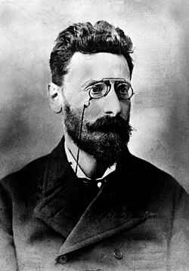
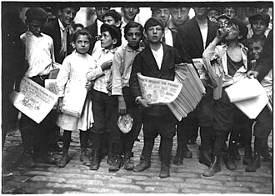
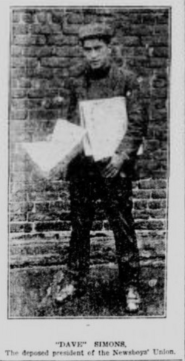
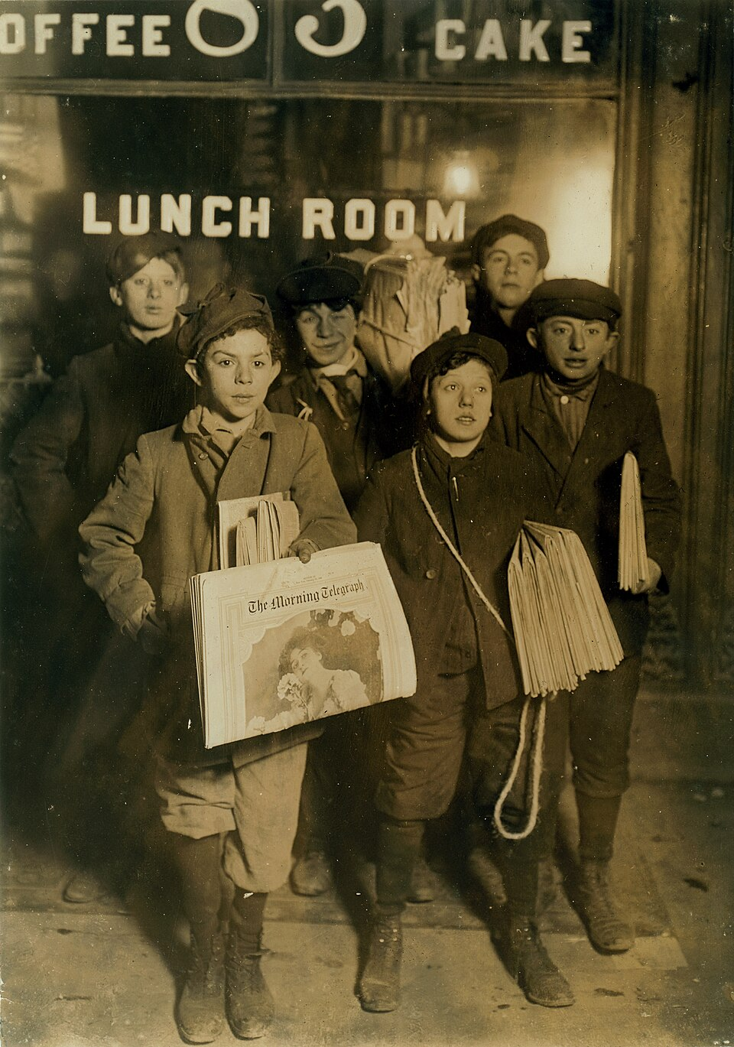
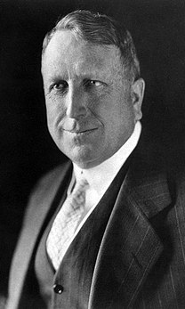
5. Do ONE of the following:
(c) With your counselor's and parent or guardian's approval and permission, watch a movie that addresses organized labor in the United States. Afterward, discuss the movie with your counselor and explain what you learned.
Newsies (1992): A Disney musical loosely based on the real-life 1899 newsboy strike in New York City. It's a spirited story about young workers standing up to powerful publishers for fair wages.
Newsboys and newsgirl getting afternoon papers in New York City (1910)
Joseph Pulitzer
Dave Simmons, first president of the Newsboys' union. (1899)
William R. Hearst
Boys selling newspapers on Brooklyn Bridge (1908)
Pulitzer and Hearst were the cause of the newsboys' strike of 1899, a youth-led campaign to force change in the way that Joseph Pulitzer and William Randolph Hearst's newspapers compensated their child newspaper hawkers

Slide 6
Recommended Viewing for Everyone before Saturday’s dialogs.
Best Titans of Wall Street for Scouts; YouTube or Netflix
Episode 2: Railroad Rivalry (~50 min)
  Focus: Early titans like J.P. Morgan & Cornelius Vanderbilt building massive industries, but also the harsh conditions and violent strikes (like Great Railroad Strike of 1877) that highlight early labor issues and management's power.
  Scout Connection: Shows the birth of big business, the fight for fair wages/conditions, and how management/labor conflict shaped America.
Episode 6: FDR vs. The Titans (~50 min)
  Focus: The Great Depression's impact, how titans like Joe Kennedy navigated it, and FDR's New Deal fundamentally changed America's economic rules, introducing social security, labor protections (Wagner Act), and shifting power from Wall Street to government/workers.
  Scout Connection: Demonstrates government's role in balancing big business with public welfare, the rise of worker rights, and the evolution of the modern social contract.
Both show the dramatic evolution: from unchecked power (Ep 2) to regulation and worker empowerment (Ep 6).

Slide 7
1. Using resources available to you, learn about working people and work-related concerns.
List and briefly describe or give examples of at least EIGHT concerns of American workers. These may include, but are not limited to: working conditions, workplace safety, hours, wages, seniority, job security, equal-opportunity employment and discrimination, guest workers, automation and technologies that replace workers, unemployment, layoffs, outsourcing, and employee benefits, such as: a) health care, b) child care, c) profit sharing, d) continuing education, or e) retirement benefits.
1)
2)
3)
4)
5)
6)
7)
8)

Slide 8
1. List and briefly describe or give examples of at least EIGHT concerns of American workers.
American workers are concerned with issues like stagnant wages, job insecurity (due to automation, contractor misclassification), poor work-life balance, lack of benefits (health, paid leave, retirement), limited career growth, unstable schedules, and feeling disrespected or unheard, all impacting financial stability and well-being.
Wage Stagnation & Affordability: Many feel pay hasn't kept up with living costs, making it hard to get by, with low wages in some sectors
Job Security: Worries about layoffs, automation (AI), and being misclassified as an independent contractor (losing benefits) threaten stability,
Work-Life Balance & Schedules: Unpredictable, last-minute schedules and long hours reduce control,
Lack of Benefits & Paid Leave: Insufficient or lost health insurance, retirement plans (pensions), and paid time off remain major concerns,
Limited Career Growth: Many workers see few paths for promotion or skill development, leading to stagnation,
Poor Management & Lack of Voice: Feeling unappreciated, unheard, or poorly led, especially concerning new tech like AI adoption, erodes engagement
Workplace Safety & Respect: Concerns include physical dangers (warehouse surveillance), harassment, discrimination, and dignity,
Skills Mismatch & Training Gaps: Workers worry about needing new technical skills (AI, data literacy) for future jobs

Slide 9

2. With your counselor's and parent or guardian's approval and permission, visit the office or attend a meeting of a local union, a central labor council, or an employee organization, or contact one of these organizations via the internet. Then do the following:
(a) Find out what the organization does.
(b) Share the list of issues and concerns you made for requirement 1. Ask the people you communicate with which issues are of greatest interest or concern to them and why.
(c) Draw a diagram showing how the organization is structured, from the local to the national level, if applicable.

Slide 10
3. Explain to your counselor what labor unions are, what they do, and what services they provide to members. In your discussion, show that you understand the concepts of labor, management, collective bargaining, negotiation, union shops, open shops, grievance procedures, mediation, arbitration, work stoppages, strikes, and lockouts.
Bottom Line: Explain what labor unions:
Are,
What they do,
What services they provide to their members

Slide 11

3. Explain to your counselor what labor unions are, what they do, and what services they provide to members.
How They Work and Services Provided
Unions negotiate a legally enforceable, written contract, known as a collective bargaining agreement (CBA), that outlines the rights and responsibilities of both employees and management. Beyond the contract, unions provide several services to their members:
Negotiation & Advocacy:
Job Security:
Legal Representation:
Training & Education:
Consumer Benefits:
Political Action:
A labor union is an organization of employees who join to advance common interests and goals such as wages, benefits, work hours, and other employment terms. Their primary role is to give workers a powerful, collective voice to negotiate with their employer through a process called collective bargaining.

Slide 12
3. Explain to your counselor what labor unions are, what they do, and what services they provide to members.
Labor unions
How They Work and Services Provided
Unions negotiate a legally enforceable, written contract, known as a collective bargaining agreement (CBA), that outlines the rights and responsibilities of both employees and management. Beyond the contract, unions provide several services to their members:
Negotiation & Advocacy: Representing members in negotiations for higher pay, better health insurance, retirement plans, paid time off, and safer working conditions.
Job Security: Protecting employees from unjust dismissal by ensuring "just cause" provisions and providing a formal grievance and arbitration process for disputes with management.
Legal Representation: Offering support and expert representation in workplace disputes or legal issues.
Training & Education: Providing access to job training programs, skill development, and scholarships for members and their families.
Consumer Benefits: Utilizing the collective buying power of members to negotiate discounts on various consumer goods and services like financial products, travel, and car rentals.
Political Action: Lobbying local, state, and federal legislators to pass laws that protect workers' rights and advance social justice

Slide 13
3. In your discussion, show that you understand the concepts of labor, management, collective bargaining, negotiation, union shops, open shops, grievance procedures, mediation, arbitration, work stoppages, strikes, and lockouts.
Labor and management concepts involve workers (labor) and employers (management) negotiating terms like pay and conditions via collective bargaining, using negotiation, mediation, or arbitration to resolve disputes, with tactics like strikes (workers stop work) or lockouts (management bars entry) if talks fail, all within systems like union/open shops and grievance procedures.
Core Concepts:
Workplace Structures:
Dispute Resolution:
Tactics (Work Stoppages):

Slide 14
3. In your discussion, show that you understand the concepts of labor, management, collective bargaining, negotiation, union shops, open shops, grievance procedures, mediation, arbitration, work stoppages, strikes, and lockouts.
Labor and management concepts involve workers (labor) and employers (management) negotiating terms like pay and conditions via collective bargaining, using negotiation, mediation, or arbitration to resolve disputes, with tactics like strikes (workers stop work) or lockouts (management bars entry) if talks fail, all within systems like union/open shops and grievance procedures.
Core Concepts:
Who / What makes up the issues
(the parties involved and what do they discuss?):

Slide 15
3. In your discussion, show that you understand the concepts of labor, management, collective bargaining, negotiation, union shops, open shops, grievance procedures, mediation, arbitration, work stoppages, strikes, and lockouts.
Labor and management concepts involve workers (labor) and employers (management) negotiating terms like pay and conditions via collective bargaining, using negotiation, mediation, or arbitration to resolve disputes, with tactics like strikes (workers stop work) or lockouts (management bars entry) if talks fail, all within systems like union/open shops and grievance procedures.
Core Concept of a Union?
Labor: Workers, often organized into unions, seeking better pay, conditions, and job security.
Management: Employers or their representatives coordinating resources and people to achieve goals, often in opposition to labor's demands.
Collective Bargaining: Unions and management negotiating a contract (CBA) covering wages, benefits, safety, etc., for a group of workers.
Negotiation: The dialogue and bargaining process to reach agreements on terms of employment.

Slide 16
3. In your discussion, show that you understand the concepts of labor, management, collective bargaining, negotiation, union shops, open shops, grievance procedures, mediation, arbitration, work stoppages, strikes, and lockouts.
Labor and management concepts involve workers (labor) and employers (management) negotiating terms like pay and conditions via collective bargaining, using negotiation, mediation, or arbitration to resolve disputes, with tactics like strikes (workers stop work) or lockouts (management bars entry) if talks fail, all within systems like union/open shops and grievance procedures.
Workplace Structures (hint there are 2):

Slide 17
3. In your discussion, show that you understand the concepts of labor, management, collective bargaining, negotiation, union shops, open shops, grievance procedures, mediation, arbitration, work stoppages, strikes, and lockouts.
Labor and management concepts involve workers (labor) and employers (management) negotiating terms like pay and conditions via collective bargaining, using negotiation, mediation, or arbitration to resolve disputes, with tactics like strikes (workers stop work) or lockouts (management bars entry) if talks fail, all within systems like union/open shops and grievance procedures.
Workplace Structures:
Union Shop: Workers must join the union after being hired (as a condition of employment).
Open Shop: Employees can choose whether or not to join the union; union membership isn't required for employment.

Slide 18
3. In your discussion, show that you understand the concepts of labor, management, collective bargaining, negotiation, union shops, open shops, grievance procedures, mediation, arbitration, work stoppages, strikes, and lockouts.
Labor and management concepts involve workers (labor) and employers (management) negotiating terms like pay and conditions via collective bargaining, using negotiation, mediation, or arbitration to resolve disputes, with tactics like strikes (workers stop work) or lockouts (management bars entry) if talks fail, all within systems like union/open shops and grievance procedures.
Types of Dispute Resolution:

Slide 19
3. In your discussion, show that you understand the concepts of labor, management, collective bargaining, negotiation, union shops, open shops, grievance procedures, mediation, arbitration, work stoppages, strikes, and lockouts.
Labor and management concepts involve workers (labor) and employers (management) negotiating terms like pay and conditions via collective bargaining, using negotiation, mediation, or arbitration to resolve disputes, with tactics like strikes (workers stop work) or lockouts (management bars entry) if talks fail, all within systems like union/open shops and grievance procedures.
Dispute Resolution:
Grievance Procedures: Formal steps for union workers to complain about contract violations, resolved by union reps and supervisors.
Mediation: A neutral third party helps facilitate discussion and suggests solutions, but doesn't impose a decision.
Arbitration: A neutral third party hears both sides and makes a final, binding decision to resolve the dispute.

Slide 20
3. In your discussion, show that you understand the concepts of labor, management, collective bargaining, negotiation, union shops, open shops, grievance procedures, mediation, arbitration, work stoppages, strikes, and lockouts.
Labor and management concepts involve workers (labor) and employers (management) negotiating terms like pay and conditions via collective bargaining, using negotiation, mediation, or arbitration to resolve disputes, with tactics like strikes (workers stop work) or lockouts (management bars entry) if talks fail, all within systems like union/open shops and grievance procedures.
Types / Tactics (Work Stoppages):

Slide 21
3. In your discussion, show that you understand the concepts of labor, management, collective bargaining, negotiation, union shops, open shops, grievance procedures, mediation, arbitration, work stoppages, strikes, and lockouts.
Labor and management concepts involve workers (labor) and employers (management) negotiating terms like pay and conditions via collective bargaining, using negotiation, mediation, or arbitration to resolve disputes, with tactics like strikes (workers stop work) or lockouts (management bars entry) if talks fail, all within systems like union/open shops and grievance procedures.
Tactics (Work Stoppages):
Work Stoppage: General term for organized cessation of work.
Strike: Workers refuse to work until demands are met, losing wages but creating pressure.
Lockout: Management closes the workplace to prevent employees from working, often to pressure workers or bring in replacement labor.

Slide 22
3. What labor unions are, what they do, and what services they provide to members.
Labor,
Management,
Collective bargaining,
Negotiation,
Union shops,
Open shops,
Grievance procedures,
Mediation,
Arbitration,
Work stoppages,
Strikes,
Lockouts.

Slide 23
Req #3
Labor: Refers to the collective body of employees or workers who provide physical or mental effort to produce goods and services. In a labor-management context, it refers to organized workers (unions) as opposed to management.
Management: The individuals or group responsible for directing the operations of a business, making hiring/firing decisions, and representing the employer's interests in dealing with labor.
Collective Bargaining: The process through which an organized group of workers (a union) negotiates with an employer to reach an agreement (contract) on wages, hours, benefits, and working conditions.
Negotiation: The act of bargaining in good faith between representatives of labor and management to resolve differences and reach a mutually acceptable contract.
Union Shop: A workplace where the employer agrees to hire either union or non-union members, but all employees must join the union within a specified period and pay dues to retain their jobs.
Open Shop: A workplace where union membership is not a condition of employment; employees are not required to join a union or pay dues to keep their jobs.
Grievance Procedures: A formal, structured process within a collective bargaining agreement designed to resolve complaints or disputes between employees and management regarding contract interpretation or workplace issues.
Mediation: A dispute resolution method where an impartial third party (mediator) helps labor and management reach a voluntary agreement, but does not have the authority to impose a binding decision.
Arbitration: A method of dispute resolution where a neutral third party (arbitrator) studies the conflict and renders a binding decision that both parties must accept.
Work Stoppages: A halt in production or service initiated by employees (a strike) or by employers (a lockout) due to a labor dispute.
Strikes: A collective, organized cessation of work by employees to force an employer to agree to union demands.
Lockouts: A temporary, defensive action taken by management where they refuse to allow employees to work until a contract agreement is reached or a dispute is resolved.

Slide 24
4. Explain what is meant by the adversarial model of labor-management relations and compared with a cooperative-bargaining style.
Adversarial model of labor-management relations:
Pro:
Con;
Cooperative-bargaining style:
Pro:
Con;

Slide 25
4. Explain what is meant by the adversarial model of labor-management relations, compared with a cooperative-bargaining style.
The adversarial model sees labor and management as opposing teams fighting over a fixed pie (wages, benefits), focusing on winning through conflict (strikes, threats), while a cooperative model views them as partners solving problems for mutual gain ("win-win"), expanding the pie through collaboration (joint problem-solving, quality programs) for better business and worker outcomes, though traditional U.S. law often pushes the adversarial path.
Adversarial Model
Core Belief:
Approach:
Goal:
Examples:

Slide 26

4. Explain what is meant by the adversarial model of labor-management relations, compared with a cooperative-bargaining style.
The adversarial model sees labor and management as opposing teams fighting over a fixed pie (wages, benefits), focusing on winning through conflict (strikes, threats), while a cooperative model views them as partners solving problems for mutual gain ("win-win"), expanding the pie through collaboration (joint problem-solving, quality programs) for better business and worker outcomes, though traditional U.S. law often pushes the adversarial path.
Adversarial Model
Core Belief: Interests are inherently conflicting; it's a zero-sum game (one side's gain is the other's loss).
Approach: Combat-oriented, using tough tactics, threats, and bluffs; focus on maximizing one's own share.
Goal: To win concessions from the other side, often through economic warfare (strikes/lockouts).
Examples: Hardball tactics during contract negotiations, rigid separation of roles.

Slide 27
4. Explain what is meant by the adversarial model of labor-management relations, compared with a cooperative-bargaining style.
The adversarial model sees labor and management as opposing teams fighting over a fixed pie (wages, benefits), focusing on winning through conflict (strikes, threats), while a cooperative model views them as partners solving problems for mutual gain ("win-win"), expanding the pie through collaboration (joint problem-solving, quality programs) for better business and worker outcomes, though traditional U.S. law often pushes the adversarial path.
Cooperative Bargaining Style
Core Belief:
Approach:
Goal:
Example:

Slide 28
4. Explain what is meant by the adversarial model of labor-management relations, compared with a cooperative-bargaining style.
The adversarial model sees labor and management as opposing teams fighting over a fixed pie (wages, benefits), focusing on winning through conflict (strikes, threats), while a cooperative model views them as partners solving problems for mutual gain ("win-win"), expanding the pie through collaboration (joint problem-solving, quality programs) for better business and worker outcomes, though traditional U.S. law often pushes the adversarial path.
Cooperative Bargaining Style
Core Belief: Shared interests exist in business success, productivity, and employee well-being; interests can be complementary.
Approach: Problem-solving and partnership; seeks mutually beneficial solutions (win-win).
Goal: To "expand the pie" through joint efforts, improving operations and building loyalty, not just dividing resources.
Examples: Quality of Work Life (QWL) programs, worker representation, joint training, exploring win-win trade-offs.

Slide 29
4. Explain what is meant by the adversarial model of labor-management relations, compared with a cooperative-bargaining style.
The adversarial model sees labor and management as opposing teams fighting over a fixed pie (wages, benefits), focusing on winning through conflict (strikes, threats), while a cooperative model views them as partners solving problems for mutual gain ("win-win"), expanding the pie through collaboration (joint problem-solving, quality programs) for better business and worker outcomes, though traditional U.S. law often pushes the adversarial path.
Adversarial Model
Core Belief: Interests are inherently conflicting; it's a zero-sum game (one side's gain is the other's loss).
Approach: Combat-oriented, using tough tactics, threats, and bluffs; focus on maximizing one's own share.
Goal: To win concessions from the other side, often through economic warfare (strikes/lockouts).
Examples: Hardball tactics during contract negotiations, rigid separation of roles.
Cooperative Bargaining Style
Core Belief: Shared interests exist in business success, productivity, and employee well-being; interests can be complementary.
Approach: Problem-solving and partnership; seeks mutually beneficial solutions (win-win).
Goal: To "expand the pie" through joint efforts, improving operations and building loyalty, not just dividing resources.
Examples: Quality of Work Life (QWL) programs, worker representation, joint training, exploring win-win trade-offs.
Key Difference between the two .……?

Slide 30
4. Explain what is meant by the adversarial model of labor-management relations, compared with a cooperative-bargaining style.
The adversarial model sees labor and management as opposing teams fighting over a fixed pie (wages, benefits), focusing on winning through conflict (strikes, threats), while a cooperative model views them as partners solving problems for mutual gain ("win-win"), expanding the pie through collaboration (joint problem-solving, quality programs) for better business and worker outcomes, though traditional U.S. law often pushes the adversarial path.
Adversarial Model
Core Belief: Interests are inherently conflicting; it's a zero-sum game (one side's gain is the other's loss).
Approach: Combat-oriented, using tough tactics, threats, and bluffs; focus on maximizing one's own share.
Goal: To win concessions from the other side, often through economic warfare (strikes/lockouts).
Examples: Hardball tactics during contract negotiations, rigid separation of roles.
Cooperative Bargaining Style
Core Belief: Shared interests exist in business success, productivity, and employee well-being; interests can be complementary.
Approach: Problem-solving and partnership; seeks mutually beneficial solutions (win-win).
Goal: To "expand the pie" through joint efforts, improving operations and building loyalty, not just dividing resources.
Examples: Quality of Work Life (QWL) programs, worker representation, joint training, exploring win-win trade-offs.
Key Difference
The fundamental shift is from "us vs. them" (adversarial) to "us working together to solve problems" (cooperative), moving beyond traditional legal frameworks that often presuppose conflict

Slide 31
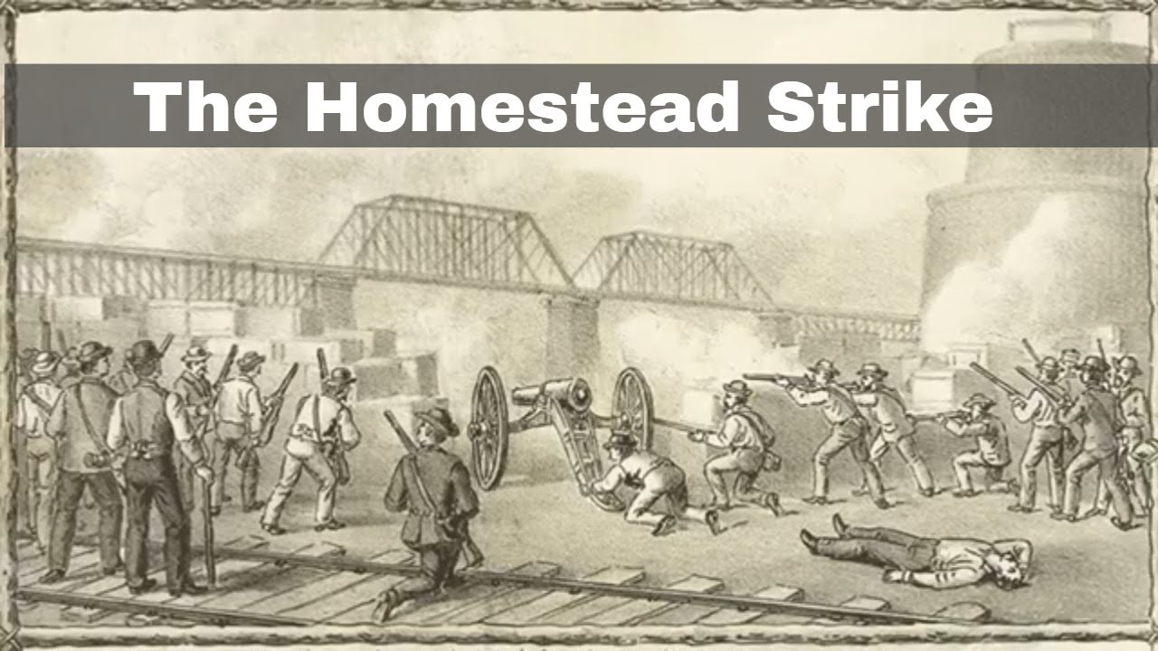
5. Do ONE of the following:
(a) Develop a timeline of significant events in the history of the American labor movement from the 1770s to the present.
The American labor movement's timeline starts with colonial artisans striking for wages (1760s-1780s), evolves through early unions (Cordwainers 1794), major clashes like Haymarket (1886) and Pullman (1894), and the rise of national bodies (AFL 1886, CIO 1935), leading to New Deal reforms (FLSA 1938, Wagner Act 1935) securing rights, and faces modern challenges with large strikes (Postal Strike 1970) and evolving worker protections, all pushing for better pay, hours, and conditions.
18th Century: Early Roots
1768: First recorded strike by New York journeymen tailors protesting wage cuts.
1770s: Artisans and laborers involved in protests British taxes (Boston Massacre, Tea Party).
1786: Philadelphia printers win first successful strike for higher wages.
1794: Formation of the Federal Society of Journeymen Cordwainers (shoemakers), marking sustained union organization.
19th Century: Industrialization & Conflict
1827: Mechanic's Union of Trades' Association formed in Philadelphia.
1830s: Rise of Workingmen's Parties advocating for labor rights.
1840s-1860s: Lowell Mill Women form unions; significant strikes occur, pushing for 10-hour days.
1886: Formation of the American Federation of Labor (AFL) focusing on skilled craft workers.
1886: Haymarket Riot in Chicago, linked to the 8-hour day movement, increases anti-union sentiment.
1892: Homestead Strike at Carnegie Steel, a violent clash showing company power.
1894: Pullman Strike demonstrates federal government intervention against unions.
20th Century: Growth, Crisis & Reform
1909: Triangle Shirtwaist Factory Fire kills 146 workers, highlighting dangerous conditions.
1914: Clayton Antitrust Act exempts unions from antitrust laws, but enforcement is weak.
1935: Congress of Industrial Organizations (CIO) forms, organizing industrial workers.
1935: National Labor Relations Act (Wagner Act) guarantees workers' right to organize and bargain.
1938: Fair Labor Standards Act establishes minimum wage, overtime pay, and ends child labor.
1941: A. Philip Randolph threatens march on Washington for defense jobs, leading to fair hiring orders.
1947: Taft-Hartley Act restricts union power (e.g., closed shops).
1955: AFL and CIO merge, forming the AFL-CIO.
1968: United Auto Workers strike against General Motors for improved benefits.
1970: Great Postal Strike by federal employees shows massive worker power.
Late 20th Century & 21st Century: Shifting Landscape
1981: Reagan fires striking PATCO (air traffic controllers) workers, signaling a tougher stance.
1990s-2000s: Growth of "living wage" movements and increased unionization in service sectors.
2001: Living wage ordinances enacted in numerous communities.
2000s-Present: Struggles for immigrant worker rights (Cesar Chavez legacy), healthcare access, and against globalization impacts.
6th July 1892: The Homestead Strike sees Pinkerton agents fight striking steelworkers
https://www.youtube.com/watch?v=-ZypvdYjKSM

Slide 32

5. Do ONE of the following:
(b) Prepare an exhibit, a scrapbook, or a computer presentation, such as a slide show, illustrating three major achievements of the American labor movement and how those achievements affect American workers.
The American labor movement achieved landmark rights like the 8-hour day/40-hour week, established crucial workplace safety regulations (OSHA), and fought for fair wages, benefits (health, pensions), and protections against child labor, creating the modern middle class and ensuring fundamental rights to organize and bargain collectively that benefit all workers, unionized or not, through foundational laws like the FLSA and NLRA.
Here are three major achievements and their impacts:
The 8-Hour Day & 40-Hour Workweek
  Achievement: Unions campaigned tirelessly, leading to the Fair Labor Standards Act (FLSA) of 1938, establishing the standard 8-hour day, 40-hour week, and overtime pay.
  Impact: This ended grueling 60+ hour workweeks and created work-life balance, ensuring fair compensation for extra hours, a standard benefit for nearly all US workers.
Workplace Safety & Health Protections
  Achievement: After horrific incidents like the Triangle Shirtwaist Factory fire, labor activism led to the creation of the Occupational Safety and Health Administration (OSHA) in 1970, mandating safe conditions.
  Impact: Employers are now legally required to provide safe environments, reducing accidents, and establishing rights to sick leave, workers' compensation, and safety equipment, protecting everyone from dangerous jobs.
Right to Organize & Collective Bargaining
  Achievement: Landmark legislation like the National Labor Relations Act (NLRA) (Wagner Act) of 1935 protected workers' right to form unions and bargain for better wages, benefits (healthcare, pensions), and conditions.
  Impact: This empowered workers to negotiate as a group, raising overall pay scales and benefit standards, and fostering the growth of the American middle class, with benefits often extending beyond union jobs

Slide 33
5. Do ONE of the following: (c) With your counselor's and parent or guardian's approval and permission, watch a movie that addresses organized labor in the United States. Afterward, discuss the movie with your counselor and explain what you learned.
Key movies addressing U.S. organized labor cover diverse eras and struggles, from classics like The Grapes of Wrath (migrant workers), On the Waterfront (corrupt docks), Norma Rae (textile unionizing), Matewan (mining conflict), and Harlan County, USA (documenting miner strikes) to modern takes like Sorry to Bother You (gig economy/race) and documentaries like American Dream (Hormel strike) and At the River I Stand (Memphis sanitation strike), showcasing solidarity, corporate power, and worker resistance.
Classics & Historical Dramas
The Grapes of Wrath (1940): The classic tale of displaced farmers during the Dust Bowl seeking better conditions.
Salt of the Earth (1954): Based on a real zinc miners' strike in New Mexico, featuring solidarity between Mex-Amer workers and their wives.
On the Waterfront (1954): Explores corruption and conscience in the longshoremen's union.
The Molly Maguires (1970): About Irish coal miners in Pennsylvania fighting oppressive conditions.
F.I.S.T. (1978) / Hoffa (1992): Fictionalized (F.I.S.T.) and biopic (Hoffa) accounts of Teamsters leader Jimmy Hoffa.
Documentaries
Harlan County, USA (1976): Oscar-winning doc on a Kentucky coal miners' strike.
With Babies and Banners (1978): Focuses on the Women's Emergency Brigade during the Flint sit-down strikes.
American Dream (1992): About the Hormel Foods strike in Austin, Minnesota.
At the River I Stand (1993): Covers the 1968 Memphis sanitation workers' strike.
1970s-1990s Struggles & Organizing
Norma Rae (1979): Sally Field's Oscar-winning role as a Southern textile worker organizing for a union.
Blue Collar (1978): Three auto workers caught up in union corruption.
Silkwood (1983): Meryl Streep as Karen Silkwood, a worker exposing safety violations at a plutonium plant.
Matewan (1987): John Sayles' film about a deadly 1920 coal miners' strike in West Virginia.
Newsies (1992): A musical about the 1899 newsboys' strike in NYC.

Slide 34
5. Do ONE of the following:
(c) With your counselor's and parent or guardian's approval and permission, watch a movie that addresses organized labor in the United States. Afterward, discuss the movie with your counselor and explain what you learned.
As a Troop we will watch this movie as part of the MB:
Newsies (1992): A Disney musical loosely based on the real-life 1899 newsboy strike in New York City. It's a spirited and accessible entry point for younger scouts, featuring music and an energetic story about young workers standing up to powerful publishers for fair wages.

Slide 35
5. Do ONE of the following:
(c) With your counselor's and parent or guardian's approval and permission, watch a movie that addresses organized labor in the United States. Afterward, discuss the movie with your counselor and explain what you learned.
Newsies (1992): A Disney musical loosely based on the real-life 1899 newsboy strike in New York City. It's a spirited story about young workers standing up to powerful publishers for fair wages.
Newsboys and newsgirl getting afternoon papers in New York City (1910)
Joseph Pulitzer
Dave Simmons, first president of the Newsboys' union. (1899)
William R. Hearst
Boys selling newspapers on Brooklyn Bridge (1908)
Pulitzer and Hearst were the cause of the newsboys' strike of 1899, a youth-led campaign to force change in the way that Joseph Pulitzer and William Randolph Hearst's newspapers compensated their child newspaper hawkers

Slide 36
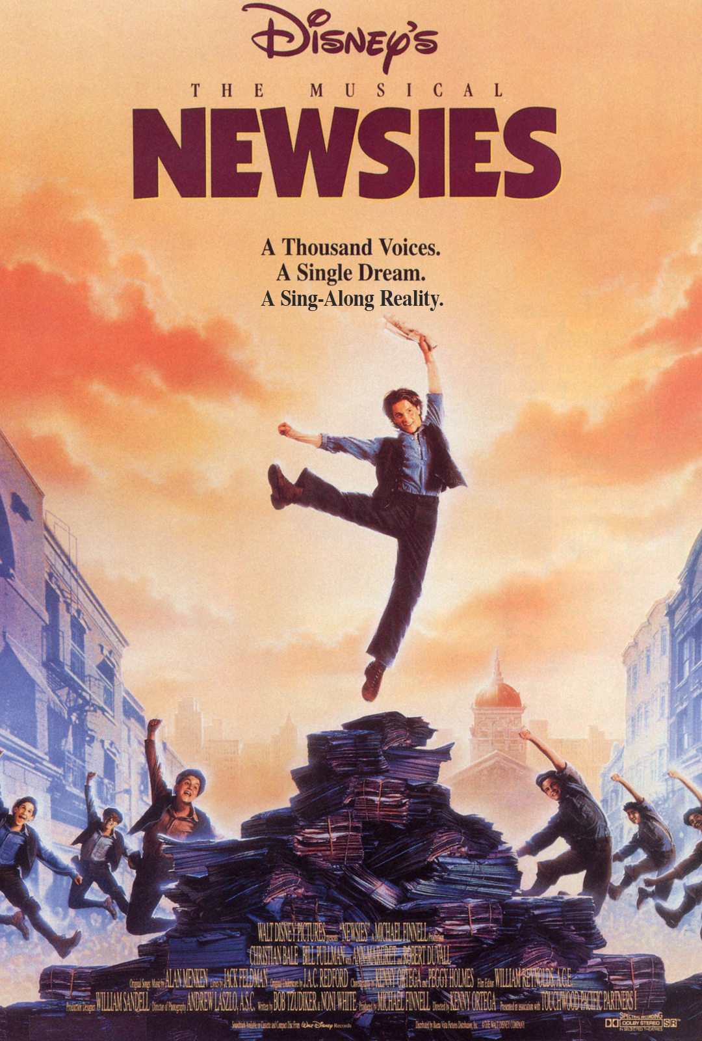

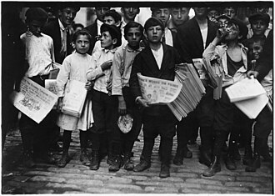
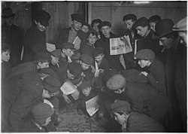

Scouts
Was the strike justified? Why or why not?
What risks did the newsies take?
Who showed the best leadership—and why?
How would this situation be handled today?

Slide 37
6. Explain the term globalization.
Discuss with your counselor some effects of globalization on the workforce in the United States.
Pro:
Con;
Explain how this global workforce fits into the economic system of this country.
Pro:
Con;

Slide 38

6. Explain the term globalization. Discuss with your counselor some effects of globalization on the workforce in the United States. Explain how this global workforce fits into the economic system of this country.
Globalization connects world economies through trade, tech, capital, and labor, creating an integrated global market with complex effects on the U.S. workforce, like job shifts (outsourcing/offshoring), increased competition (lowering some wages), but also new opportunities, lower consumer costs, and demands for adaptable, skilled workers, fitting into the U.S. system by creating specialized roles, driving innovation, and linking domestic needs with international labor pools and markets, though straining some traditional jobs.
What is Globalization?
It's the increasing flow and integration of goods, services, capital, technology, ideas, and people across national borders, fostering worldwide interdependence.
It makes national economies interconnected, creating a single global market where companies operate internationally, sourcing resources and selling products worldwide.
Effects on the U.S. Workforce (Discuss with Counselor)
Job Displacement & Outsourcing: Manufacturing and service jobs move to countries with lower labor costs (offshoring), hurting U.S. workers without college degrees and leading to wage stagnation in some sectors.
Increased Competition: U.S. workers compete with a vast global labor pool, potentially suppressing wages, notes study.com and Quora users.
New Opportunities: Globalization creates demand for skilled workers in tech, logistics, management, and cross-cultural roles, with opportunities for U.S. professionals abroad.
Lower Consumer Costs: Access to cheaper imported goods and services benefits all consumers, including the working class, from Quora.
Skill Demands: Workers need adaptability, linguistic skills, and global awareness to remain competitive.
How the Global Workforce Fits the U.S. Economic System
Interdependence: The U.S. economy relies on global supply chains for inputs and global markets for sales, making it part of a larger economic system.
Specialization: The U.S. specializes in high-tech, finance, and services, while relying on other nations for mass production, a form of economic specialization.
Capital & Labor Flows: Foreign investment and skilled/unskilled labor migration (both in and out) are integral, filling gaps and driving growth, even as they create social and economic challenges, as noted by Investopedia and study.com.
Winners & Losers: While boosting overall output, globalization creates distinct winners (high-skilled, capital owners) and losers (low-skilled manufacturing workers)

Slide 39
7. Choose a labor issue of widespread interest to American workers - an issue in the news currently or known to you from your work on this merit badge: __________________________________________________________
Management's side Comments:
labor's or the employee's point of view
Basic rights and responsibilities of employers
Basic Rights and responsibilities of employees,
  including union members
  and nonunion members.

Slide 40
7. Choose a labor issue of widespread interest to American workers - an issue in the news currently or known to you from your work on this merit badge.
Labor unions are most likely to be concerned with the issue of minimum wage as it directly impacts the wages and working conditions of their members, which is a primary focus of labor unions. Employers must pay at least minimum wage but can set terms, while employees have rights to organize for better pay/conditions, especially with unions for fair representation and contracts, though non-union workers have fewer protections; the core debate pits employer flexibility/economic freedom against worker collective power for equity, with unions arguing for fair shares and employers stressing market efficiency, but all face minimum wage laws, safety rules, and good-faith bargaining mandates under laws like the NLRA.
Employee Rights & Responsibilities
All Workers: Right to at least minimum wage, safe workplace (OSHA), discuss pay/conditions (NLRA), and report hazards without retaliation.
Union Members: Right to fair representation by union, covered by Collective Bargaining Agreements (CBAs) for wages, benefits, work rules; can vote on contracts.
Non-Union Members: "At-will" employment (can be fired for any reason/no reason), rely on employer's policies; covered by CBAs if in the bargaining unit but can't vote on it.
Responsibility: To work, follow rules, pay union dues/fees if applicable, and participate in good faith (if unionized).
Employer Rights & Responsibilities
Responsibilities: Pay minimum wage (federal/state), provide safe environment (OSHA), bargain in good faith with unions, don't retaliate against organizing.
Rights: Set wages/conditions (non-union), determine business needs, declare impasse in bargaining (if truly exhausted talks).
With Unions: Must bargain wages, hours, safety; cannot change terms unilaterally after contract, must respect grievance procedures.
Arguments: Unions vs. Employers
For Unions/Workers (Pro-Union):
Power Imbalance: Individual workers lack power; unions create balance, ensuring fair pay (reducing wage gaps) and better conditions.
Security: Contracts protect against arbitrary firing/discipline; grievance procedures offer recourse.
Fair Share: Unions ensure workers get a fair share of profits, not just minimums, boosting overall economy.
For Employers/Non-Union (Pro-Flexibility):
Economic Freedom: Unions restrict employer flexibility to adapt to market, potentially harming business/jobs.
Individual Merit: Non-union systems reward individual performance, not group seniority/negotiation.
Cost vs. Benefit: Union wages/benefits increase costs; "at-will" allows quick adaptation to business needs.
Minimum Wage & Unions
Base Level: All workers get minimum wage; unions negotiate above this base.
Union Impact: Unions often secure significantly higher wages and better raises than non-union settings, closing pay gaps for women/minorities.
Employer Stance: Employers often argue high union wages reduce competitiveness, but unions argue they lift living standards for all

Slide 41
8. Goals that may motivate:
Owners of a business,
Stockholders,
Customers,
Employees,
Employees' representatives,
The community,
Public officials
Explain why agreements and compromises are made and how they affect each group in goals.

Slide 42
8. Discuss with your counselor the different goals that may motivate the owners of a business, its stockholders, its customers, its employees, the employees' representatives, the community, and public officials. Explain why agreements and compromises are made and how they affect each group in achieving its goals.
Stakeholder Goals & Motivations
Owners/Management: Profit maximization, growth, market share, business survival, innovation, personal wealth, legacy.
Stockholders (Investors): Financial returns (dividends, stock appreciation), stable investment, long-term company health.
Customers: Quality products/services, fair prices, good value, reliability, ethical treatment.
Employees: Fair wages, benefits, safe conditions, job security, work-life balance, recognition, career growth.
Employee Representatives (Unions): Protect/advance worker rights, better contracts (pay, conditions), collective power.
Community: Local jobs, economic stability, environmental responsibility, tax revenue, community involvement.
Public Officials: Regulatory compliance, public welfare, economic development, fulfilling constituent needs, re-election.
Why Agreements & Compromises Happen
Interdependence: No group operates in isolation; actions of one affect others (e.g., higher wages raise costs for owners but improve employee lives).
Conflict Resolution: Different goals naturally clash (e.g., profit vs. wages). Compromise finds middle ground.
Mutual Benefit: Agreements (like union contracts) create stability, predictability, and avoid costly disputes (strikes/lockouts).
Legal/Regulatory Needs: Governments set rules; businesses compromise to stay compliant.
How Compromises Affect Groups
Owners/Stockholders: Might accept lower immediate profit for long-term stability or to avoid lawsuits/strikes.
Employees: May trade higher wages for better benefits or job security.
Customers: Might pay slightly more for ethically sourced goods or improved service.
Community: May accept some pollution (within limits) for jobs, but demand cleanup plans.
Officials: Might relax some regulations for investment but ensure worker protections remain.
Example Scenario: Wage Negotiations
Conflict: Employees want $20/hr; Owners offer $18/hr to protect profits.
Compromise: Agree on $19/hr plus enhanced (but cheaper for company) training benefits.
Outcome: Employees get more than offered (better skills); Owners pay less than demanded (still saving money); Community sees stable jobs; Officials see reduced labor strife.
By discussing these dynamics, you see how business isn't just about one goal but a balancing act of stakeholder interests, requiring negotiation for a functioning ecosystem.

Slide 43
9. Learn about opportunities in the field of labor relations. Choose one career in which you are interested and discuss with your counselor the major responsibilities of that position and the qualifications, education, and training such a position requires.
Choose one career in which you are interested: ________________________
Major responsibilities of that position
Qualifications,
Education,
Training such a position requires.

Slide 44

9. Learn about opportunities in the field of labor relations.
Labor Relations Specialist: A professional who acts as an intermediary between employers and employees (often union representatives) to resolve disputes, negotiate contracts, and ensure compliance with labor laws.
Arbitrator, Mediator, or Conciliator: Impartial third parties who facilitate dialogue and help resolve conflicts outside of the court system.
Union Representative/Organizer: An individual who works directly with employees to form or manage labor unions, represents their interests, and negotiates with management on their behalf.
Career Focus: Labor Relations Specialist
The role of a Labor Relations Specialist (sometimes called an Employee Relations Specialist) is a dynamic position for those interested in employment law, negotiation, and fostering positive workplace environments. This career focuses on managing the complex relationship between an organization's management and its employees or labor unions.
Negotiating Collective Bargaining Agreements: Labor relations specialists draft, propose, and negotiate contracts (collective bargaining agreements) that cover wages, benefits, and working conditions for groups of employees.
Resolving Disputes and Grievances: They investigate complaints or alleged policy violations, mediate conflicts between employees and management, and work to find fair and equitable solutions.
Ensuring Legal Compliance: A key duty is to monitor company practices to ensure they adhere to federal, state, and local labor laws and regulations (such as the NLRA and FLSA).
Advising and Training Management: Specialists advise managers on appropriate disciplinary procedures, contract administration, and provide training on labor relations best practices.
Documentation and Reporting: They maintain meticulous records of all labor relations activities and may prepare reports or even provide testimony in legal or administrative proceedings.
Qualifications, Education, and Training
Education: A bachelor's degree in labor relations, human resources, business administration, or a related field is typically the minimum requirement. Some positions, especially senior ones, may prefer a master's degree in a related field or even a law degree (JD). Coursework in employment law, human resource management, and negotiation is crucial.
Experience: Most employers seek candidates with several years (typically 3-5 years) of experience in human resources or an employee relations role. Experience can be gained through entry-level positions like an HR assistant or through internships.
Key Skills:
  Excellent communication (written and verbal), active listening, and interpersonal skills are essential for dealing with diverse groups of people.
  Strong negotiation and conflict resolution abilities.
  In-depth knowledge of labor laws and regulations.
  Strong analytical, problem-solving, and detail-oriented skills.
Training and Certifications: While not always mandatory, professional certifications can enhance job prospects. Certifications such as the Professional in Human Resources (PHR) or Senior Professional in Human Resources (SPHR), offered by the HR Certification Institute, or the SHRM-CP/SHRM-SCP from the Society for Human Resource Management, are highly valued. On-the-job training often supplements formal education

