Slide 1
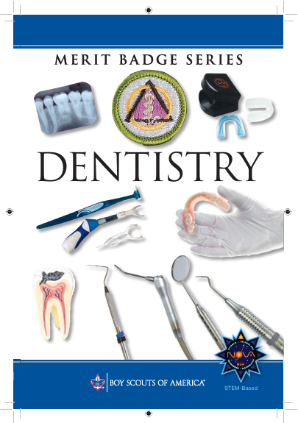

Dentistry Merit Badge
Star Scout Ryan Bertrand
MBC: Dr. Gregory Engel, DDS

Slide 2
1. Using X-ray (radiographic) films or images and with your counselor's guidance, do the following:
(a) Study the tooth structure and look for decay.
(b) Draw a lower molar, using the radiographs as a guide. Label its parts and surfaces. Show surrounding structures such as bone and gum tissues.
(c) Show on your drawing where the nerves and blood vessels enter and leave the tooth.
(d) Show on your drawing where bacterial plaque is most likely to be found.
2. Do the following:
(a) Tell or write about what causes dental decay and gum disease. Tell how each of the following contributes to dental decay and gum disease: bacterial plaque, sugars, and acid.
(b) Tell the possible causes for traumatic tooth loss, describe the types of mouth guards used to help prevent tooth trauma, and list the athletic activities during which a person should wear a mouth guard.
(c) Explain the first-aid procedure for saving a tooth that has been knocked out.
(d) Discuss how the use of tobacco products can negatively affect your oral health.
3. Arrange for a visit with a dentist. Before you go, ask whether your visit can include a dental examination and a plaque-control demonstration. Afterward, ask questions about things you want to know. Then tell your counselor what the dentist does during a checkup examination.
4. Do TWO of the following:
(a) Name at least five instruments and five pieces of equipment a dentist uses.
(b) With the help of a dentist, prepare a dental stone cast using a vibrator, a mixing bowl, a water measure, a plastic measure, model stone, and a spatula.
(c) Keep a record of everything you eat for three days. Circle those items that may provide the sugars that bacterial plaque needs to make acid. List snacks that you should avoid to help maintain the best oral health.
5. Discuss with your counselor the following:
(a) How fluorides help prevent tooth decay and the ways fluorides can be provided to the teeth.
(b) How the mouth is related to the rest of the body. Topics might include chewing, saliva, enzymes, nutrition, and speech.
6. Do TWO of the following:
(a) Make a model tooth out of soap, clay, paper-mâché, or wax. Using a string and a large hand brush, show your troop or a school class proper tooth-brushing and flossing procedures.
(b) Make a poster on the prevention of dental disease. Show the importance of good oral health.
(c) Collect at least five advertisements for different toothpastes. List the claims that each one makes. Tell about the accuracy of the advertisements.
(d) Write a feature story for your school newspaper on the proper care of teeth and gums. Include in your story how the use of tobacco products can negatively affect a person's oral health.
(e) Make drawings and write about the progress of dental decay. Describe the types of dental filling and treatments a dentist can use to repair dental decay problems.
7. Identify three career opportunities that would use skills and knowledge in dentistry. Pick one and research the training, education, certification requirements, experience, and expenses associated with entering the field. Research the prospects for employment, starting salary, advancement opportunities and career goals associated with this career. Discuss what you learned with your counselor and whether you might be interested in this career.

Slide 3
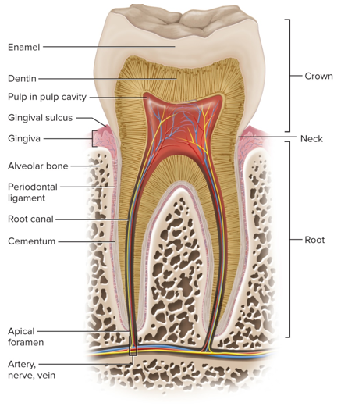
1. Using X-ray (radiographic) films or images and with your counselor's guidance, do the following:
(a) Study the tooth structure and look for decay.
(b) Draw a lower molar, using the radiographs as a guide. Label its parts and surfaces. Show surrounding structures such as bone and gum tissues.
(c) Show on your drawing where the nerves and blood vessels enter and leave the tooth.
(d) Show on your drawing where bacterial plaque is most likely to be found.
A lower molar drawing should feature the crown, roots, pulp chamber, surrounding jawbone, and gum line, with plaque buildup concentrated near the gum margin and interproximal areas.
Lower Molar Anatomy and Plaque Locations
Tooth Parts and Surfaces
Crown: The top part visible above the gum.
Roots: The lower part anchored in the bone (lower molars usually have two roots).
Enamel: The hard white outer layer of the crown.
Dentin: The yellow layer under the enamel.
Pulp Chamber: The soft inner space holding nerves and blood vessels.
Surfaces: Occlusal (top chewing side), buccal (cheek side), lingual (tongue side), mesial (front side), and distal (back side).
Surrounding Structures
Alveolar Bone: The jawbone that holds the roots.
Gingiva (Gums): The pink tissue that covers the bone and lower part of the crown.
Periodontal Ligament: Tiny fibers that hold the root inside the bone socket.
Nerves and Blood Vessels
Entry and Exit: They enter and leave through the very tip of each root (root apex) via a tiny opening called the apical foramen.
Path: They travel up through the root canals into the central pulp chamber.
Bacterial Plaque Location
Gum Line: Plaque collects heavily right where the tooth meets the edge of the gum (gingival margin).
Grooves: It also sits deep inside the pits and fissures on the top chewing surface.
Between Teeth: It gathers in the tight spaces where two teeth touch (interproximal areas).

Slide 4
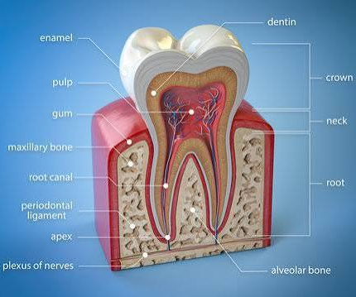
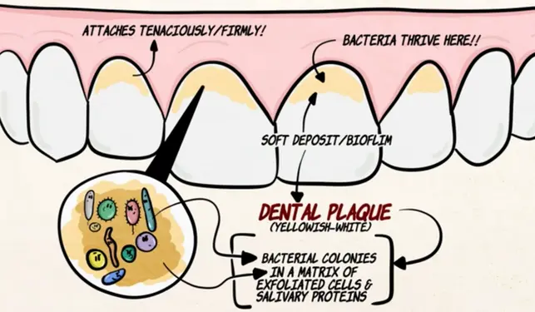

Slide 5
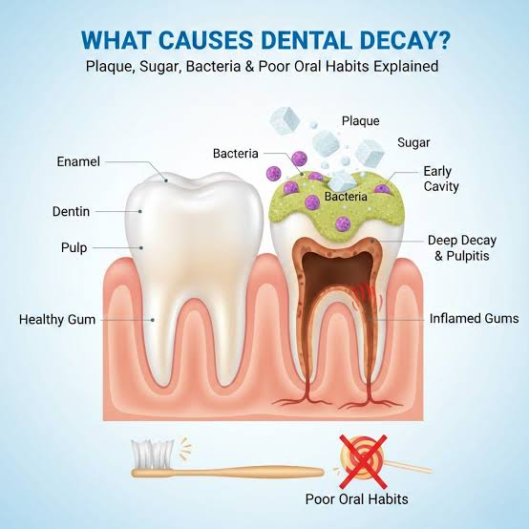
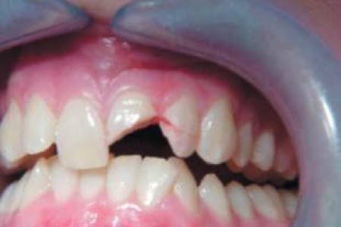
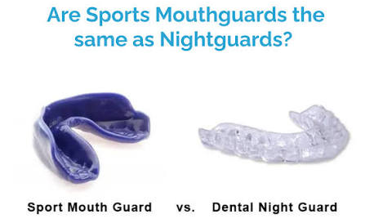
2. Do the following:
(a) Tell or write about what causes dental decay and gum disease. Tell how each of the following contributes to dental decay and gum disease: bacterial plaque, sugars, and acid.
(b) Tell the possible causes for traumatic tooth loss, describe the types of mouth guards used to help prevent tooth trauma, and list the athletic activities during which a person should wear a mouth guard.

Slide 6
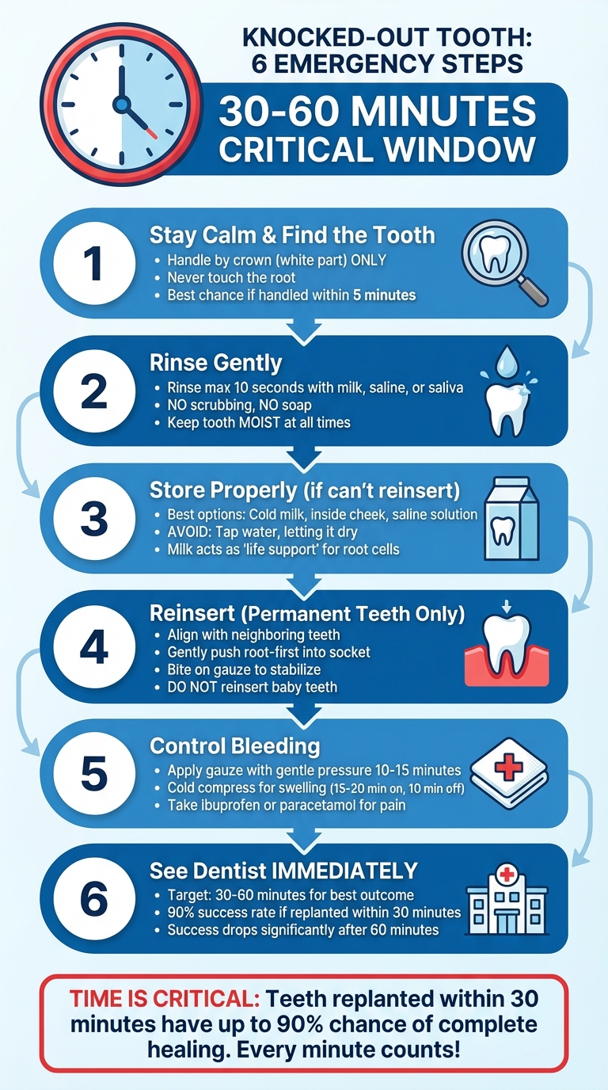
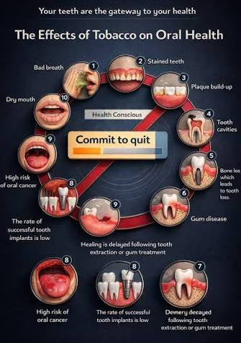
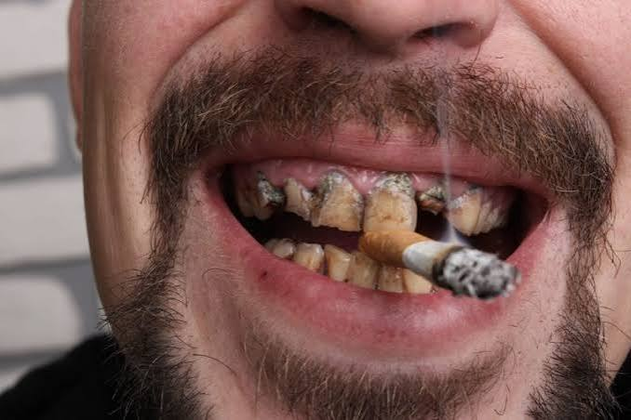
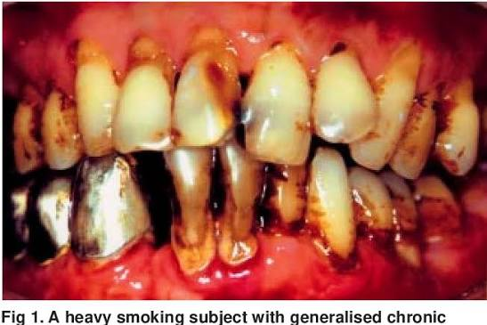
2. Do the following:
(c) Explain the first-aid procedure for saving a tooth that has been knocked out.
(d) Discuss how the use of tobacco products can negatively affect your oral health.

Slide 7
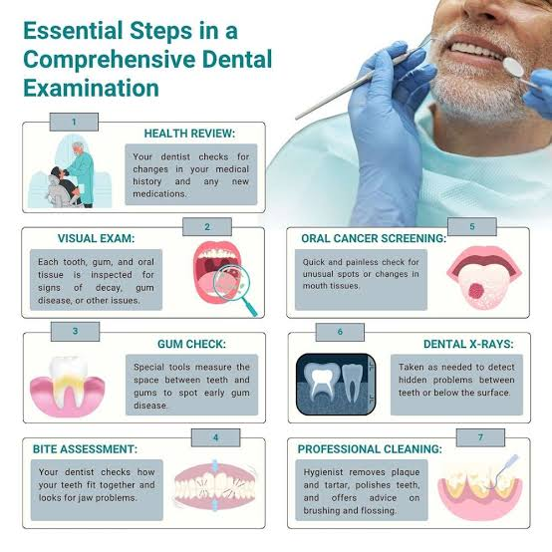
3. Arrange for a visit with a dentist. Before you go, ask whether your visit can include a dental examination and a plaque-control demonstration. Afterward, ask questions about things you want to know. Then tell your counselor what the dentist does during a checkup examination.
Questions & Answers
1.
Q- are my gums inflamed
A- yes
2.
Q-why do I need to get my teeth checked regulary
A- the reason we get checked regularly is because just brushing and flossing at home dosen’t get hardend tartar

Slide 8
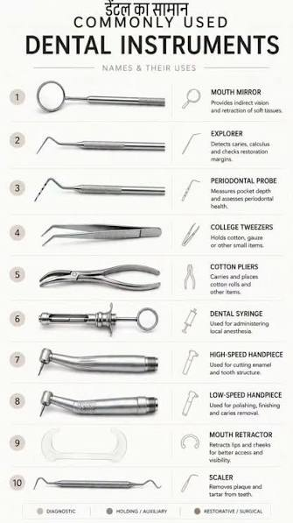
4. Do TWO of the following:
(a) Name at least five instruments and five pieces of equipment a dentist uses.
(b) With the help of a dentist, prepare a dental stone cast using a vibrator, a mixing bowl, a water measure, a plastic measure, model stone, and a spatula.
(c) Keep a record of everything you eat for three days. Circle those items that may provide the sugars that bacterial plaque needs to make acid. List snacks that you should avoid to help maintain the best oral health.
 | Day 1 | Day 2 | Day 3
Breakfast |  | Oatmeal w/ brown sugar | Toast and butter
 |  | Milk
Lunch | Cheerios w/ Milk | Ham and cheese sandwich | Cinnamon cereal with milk
 | Fruit Snack bar | Small coke and water
 |  | Chips
Dinner | Baked Ziti -sauce, cheese, meat, noodles | Salmon and rice with veggies | ham and cheese wrap, Gatorade
Mostly everything has some sugar and needs to be brushed off.

Slide 9
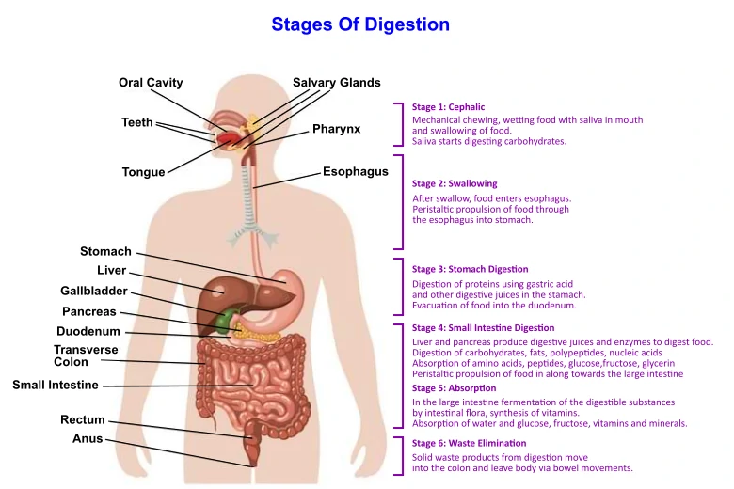
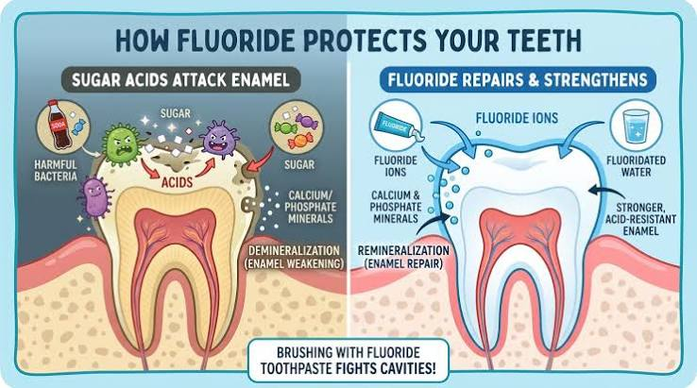
5. Discuss with your counselor the following:
(a) How fluorides help prevent tooth decay and the ways fluorides can be provided to the teeth.
(b) How the mouth is related to the rest of the body. Topics might include chewing, saliva, enzymes, nutrition, and speech.

Slide 10
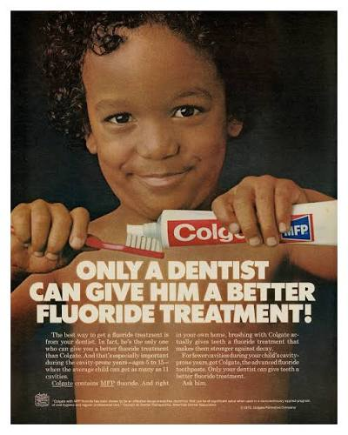
6. Do TWO of the following:
(a) Make a model tooth out of soap, clay, paper-mâché, or wax. Using a string and a large hand brush, show your troop or a school class proper tooth-brushing and flossing procedures.
(b) Make a poster on the prevention of dental disease. Show the importance of good oral health.
(c) Collect at least five advertisements for different toothpastes. List the claims that each one makes. Tell about the accuracy of the advertisements.
(d) Write a feature story for your school newspaper on the proper care of teeth and gums. Include in your story how the use of tobacco products can negatively affect a person's oral health.
(e) Make drawings and write about the progress of dental decay. Describe the types of dental filling and treatments a dentist can use to repair dental decay problems.

Slide 11
7. Identify three career opportunities that would use skills and knowledge in dentistry.
Pick one and research the training, education, certification requirements, experience, and expenses associated with entering the field. Research the prospects for employment, starting salary, advancement opportunities and career goals associated with this career. Discuss what you learned with your counselor and whether you might be interested in this career.
1. Dental Hygienist
Core Role: Focuses heavily on preventative oral health care, patient screenings, and early disease detection.
Skills Used: They perform deep teeth cleanings (scaling and polishing), take and interpret dental X-rays, check for signs of oral diseases like gingivitis, and educate patients on proper brushing and flossing techniques.
Requirements: Typically requires an Associate degree in dental hygiene and state licensure.
2. Dental Laboratory Technician
Core Role: Works behind the scenes in a laboratory setting to design and manufacture dental prosthetics.
Skills Used: They apply comprehensive knowledge of dental anatomy, tooth morphology, and occlusion to create custom crowns, bridges, dentures, veneers, and orthodontic appliances. This career increasingly uses modern CAD/CAM software and 3D printing technologies.
Requirements: Can be entered via a technical certificate, Associate degree, or on-the-job training.
3. Dental Sales Representative / Consultant
Core Role: Acts as a bridge between dental product manufacturers and practicing dental offices. [1, 2]
Skills Used: They use their clinical knowledge of dental tools, materials, and procedures to effectively market and sell specialized equipment, pharmaceuticals, or software to dental offices and clinics. They must understand a dentist's clinical workflow to consult on what products will improve patient outcomes and office efficiency.

