Slide 1
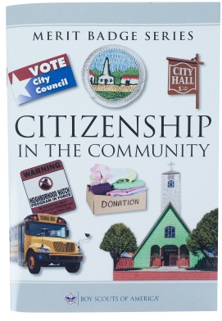
Citizenship in the Community Merit Badge
Merit Badge Counselor: __________________
Merit Badge Expert: _____________________

Slide 2
1. Discuss with your counselor what citizenship in the community means and what it takes to be a good citizen in your community. Discuss the rights, duties, and obligations of citizenship, and explain how you can demonstrate good citizenship in your community, Scouting unit, place of worship, or school.
2. Do the following:
(a) Using an electronic mapping tool or paper map, locate and pinpoint the following services and landmarks in your community. Determine and record the distances from your home including driving time AND either walking or biking time.
(1) Chief government buildings such as your city hall, county courthouse, and public works/services facilities
(2) Fire station, police station, and hospital nearest your home
(3) Parks, playgrounds, recreation areas, and trails
(4) Historical or other interesting points of interest.
(b) Chart the organization of your local or state government. Show the top offices and tell whether they are elected or appointed.
3. Do the following:
(a) Attend an in-person meeting of your city, town, or county council or school board, local court session; OR another state or local governmental meeting approved in advance by your counselor.
(b) Choose one of the issues discussed at the meeting where a difference of opinions was expressed, and explain to your counselor why you agree with one opinion more than you do another one.
4. Choose an issue that is important to the citizens of your community; then do the following:
(a) Find out which branch of local government is responsible for this issue.
(b) With your counselor's and a parent or guardian's approval, interview one person from the branch of government you identified in requirement 4(a). Ask what is being done about this issue and how young people can help.
(c) Share what you have learned with your counselor.
5. With the approval of your counselor and a parent or guardian, watch a movie that shows how the actions of one individual or group of individuals can have a positive effect on a community. Discuss with your counselor what you learned from the movie about what it means to be a valuable and concerned member of the community.
6. List some of the services (such as the library, recreation center, public transportation, and public safety) your community provides that are funded by taxpayers. Tell your counselor why these services are important to your community.

Slide 3
7. Do the following:
(a) Identify three charitable organizations outside of Scouting that interest you and bring people in your community together to work for the good of your community.
(b) Pick ONE of the organizations you chose for requirement 7(a). Using a variety of resources (including newspapers, fliers and other literature, the internet, volunteers, and employees of the organization), find out more about this organization.
(c) With your counselor's and your parent or guardian's approval, contact the organization you chose for requirement 7(b), and find out what young people can do to help. While working on this merit badge, volunteer at least eight hours of your time for the organization. After your volunteer experience is over, discuss what you have learned with your counselor.
8. Develop a public presentation (such as a video, slide show, speech, digital presentation, or photo exhibit) about important and unique aspects of your community. Include information about the history, cultures, and ethnic groups of your community; its best features and popular places where people gather; and the challenges it faces. Stage your presentation in front of your counselor or a group, such as your patrol or a class at school (Church).

Slide 4
1. Discuss with your counselor what citizenship in the community means and what it takes to be a good citizen in your community.
Discuss the
rights,
duties, and
obligations of citizenship, and
--explain how you can demonstrate good citizenship in your
community, Scouting unit, place of worship, or school.

Slide 5
1. Discuss with your counselor what citizenship in the community means and what it takes to be a good citizen in your community.
Discuss the rights,
Access to Public Records (FOIA): Under the Virginia Freedom of Information Act (FOIA), citizens have the right to inspect or receive copies of public records created or maintained by the City of Suffolk.
Participation in Government: Citizens have the right to attend public meetings, provide input, and petition the government. The city operates with an elected City Council (mayor and seven representatives), allowing for local representation.
Right to Public Services and Safety: Residents have the right to report non-emergency issues like potholes, damaged, or unsafe public property through the "Suffolk Citizen Connections"
Specific Local Rights and Regulations
Public Records Request: You can request records via U.S. Mail, email, or in person from the FOIA Officer, and you have the right to have charges estimated in advance.
Addressing Local Issues: Citizens can request specific signage, such as "Watch for Children" or "Deer Crossing" signs, subject to city policies.
Property and Development: Citizens have the right to develop their property in accordance with the Unified Development Ordinance, which aims to protect health, safety, and community welfare.
Concealed Handgun Permits: Eligible residents aged 21 or older have the right to apply for a 5-year concealed handgun permit through the Circuit Court Clerk's Office.
Rights to Public Spaces
Parks and Recreation: Citizens have the right to use public parks, subject to rules against open containers of alcohol (unless permitted for a special event) and specific permitting requirements for large events (100+ people, live entertainment, etc.).
ADA Protections: The City of Suffolk ensures that people with disabilities have equal access to city programs and services, including the right to request modifications to policies if needed for participation.
Restoration of Rights
In Virginia, individuals convicted of a felony lose their civil rights (voting, jury service, etc.). However, they have the right to apply for the restoration of these rights through the Secretary of the Commonwealth once they have completed their term of incarceration.
For more specific information, you can contact the City of Suffolk’s FOIA officer or visit the city's official website.

Slide 6
1. Discuss with your counselor what citizenship in the community means and what it takes to be a good citizen in your community.
Discuss the duties
Obeying Laws and Regulations: Citizens must follow federal, state, and local ordinances, including traffic laws and zoning regulations.
Paying Taxes: It is a requirement to pay federal, state, and local taxes, which fund services like schools, roads, public safety, and sanitation.
Serving on Juries: When summoned, citizens are legally required to attend, as it is a crucial part of the justice system.
Registering for Selective Service: Male citizens and residents aged 18 to 25 must register.
Attending School: Children are required to obtain an education.
Local Community Responsibilities (Suffolk-Specific)
Reporting Non-Emergency Issues: Residents are encouraged to use the "Suffolk Citizen Connections“ to report potholes, water leaks, and damaged city property.
Staying Informed: Utilizing resources like the Suffolk Police "Police 2 Citizen Portal" to stay aware of local crime information and community developments.
Environmental Responsibility: Properly maintaining vehicles to prevent fluid leaks, picking up pet waste, and managing yard waste/fertilizer to protect local water
systems from pollution.
Safety Practices: Ensuring personal safety by securing homes, reporting suspicious activity to the Suffolk Police, and cooperating with the Commonwealth's Attorney to prevent crime.
Volunteering: Contributing to the community through programs like the Citizen Corps, which supports local emergency management and public safety efforts.

Slide 7
1. Discuss with your counselor what citizenship in the community means and what it takes to be a good citizen in your community.
Discuss the obligations of citizenship
Legal Obligations (Mandatory)
Obey Federal, State, and Local Laws: Residents must comply with all laws, including those specific to the City of Suffolk.
Pay Taxes: You are required to pay federal, state, and local taxes, including property taxes in Suffolk, to support public services like schools, infrastructure, and public safety.
Serve on a Jury: When summoned, you must serve on a jury to uphold the right to a fair trial, a cornerstone of the U.S. justice system.
Register for Selective Service: Male citizens and immigrants residing in the U.S. between the ages of 18 and 25 must register with the Selective Service System.
Defend the Constitution: All citizens must support and defend the Constitution.
Civic Responsibilities (Expected in the Community)
Participate in the Democratic Process: This includes registering to vote in Suffolk and voting in local, state, and federal elections.
Stay Informed: It is your responsibility to stay informed about local issues, such as city council decisions, and to participate in community affairs.
Active Community Involvement: Citizens are encouraged to get involved in the community, such as volunteering, attending city meetings, or using tools like to report local issues (e.g., potholes).
Respect Others: Upholding the rights, beliefs, and opinions of other community members is essential.
Serve the Community: Actively engaging in your community makes it safer and more prosperous.

Slide 8
2. Do the following:
(a) Using an electronic mapping tool or paper map, locate and pinpoint the following services and landmarks in your community. Determine and record the distances from your home including driving time AND either walking or biking time.
(1) Chief government buildings such as your city hall, county courthouse, and public works/services facilities
(2) Fire station, police station, and hospital nearest your home
(3) Parks, playgrounds, recreation areas, and trails
(4) Historical or other interesting points of interest.
(b) Chart the organization of your local or state government. Show the top offices and tell whether they are elected or
See next set of slides

Slide 9
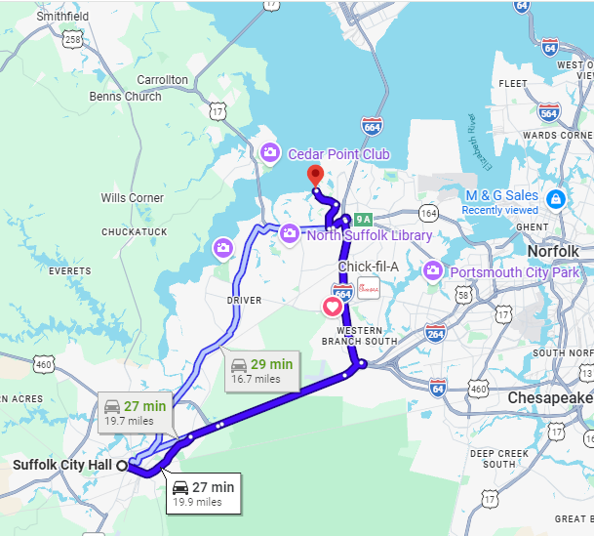
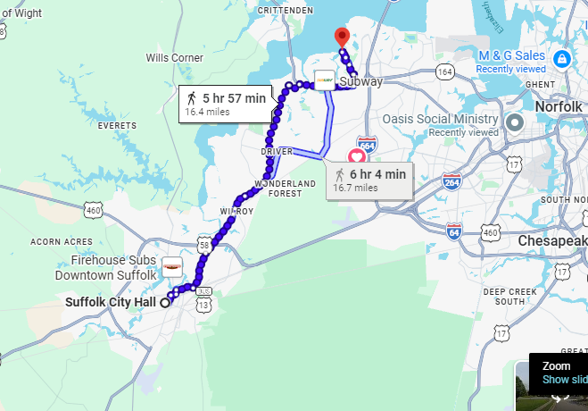
2. Do the following:
(a) Using an electronic mapping tool or paper map, locate and pinpoint the following services and landmarks in your community. Determine and record the distances from your home including driving time AND either walking or biking time.
(1) Chief government buildings such as your city hall, county courthouse, and public works/services facilities
(2) Fire station, police station, and hospital nearest your home
(3) Parks, playgrounds, recreation areas, and trails
(4) Historical or other interesting points of interest.
(b) Chart the organization of your local or state government. Show the top offices and tell whether they are elected or appointed.

Slide 10
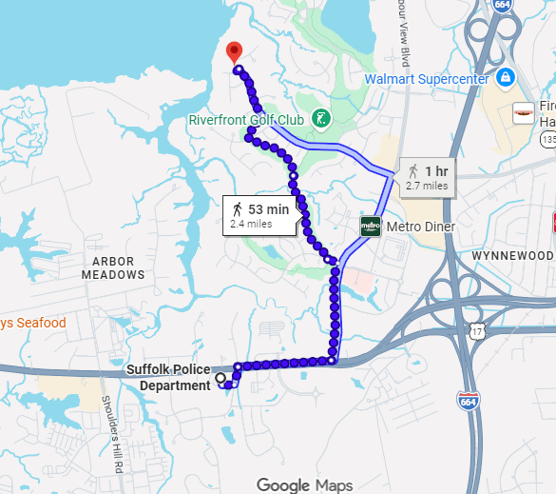
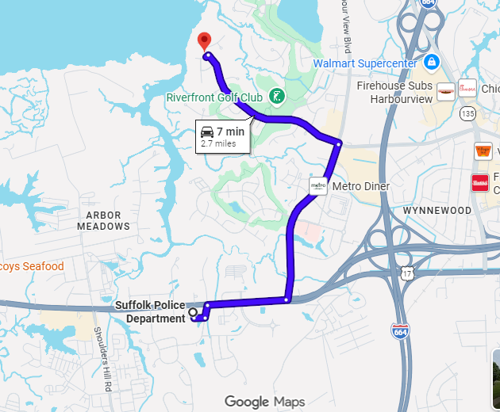
2. Do the following:(2) Fire station, police station, and hospital nearest your home
.

Slide 11
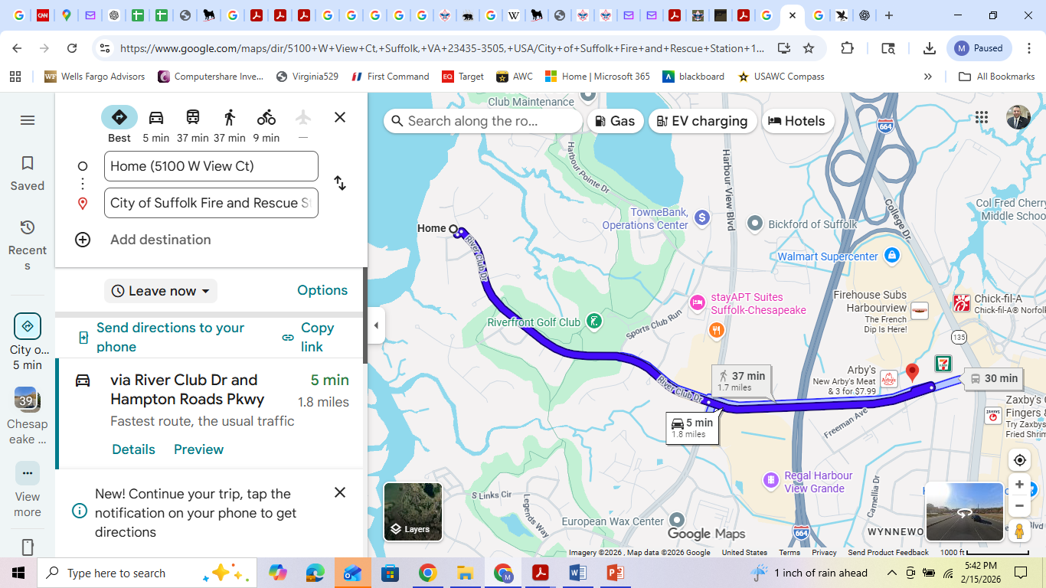
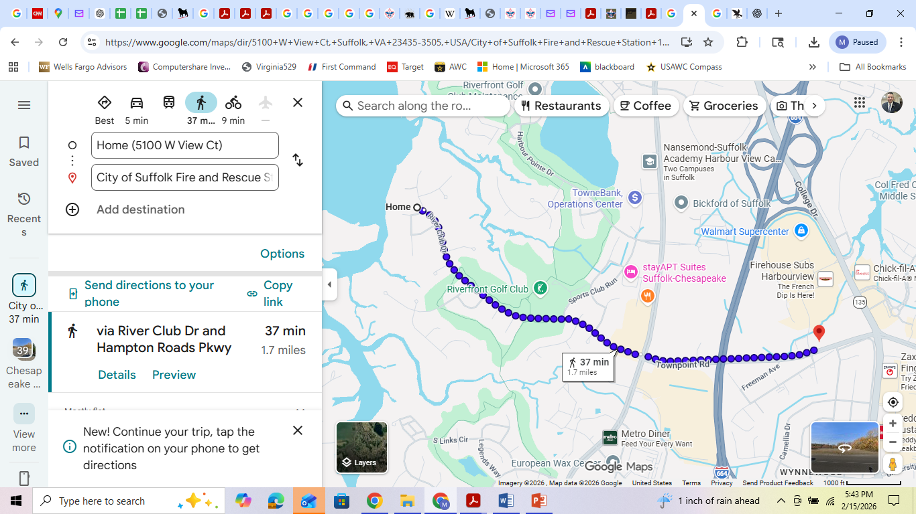
2. Do the following:(2) Fire station, police station, and hospital nearest your home
Fire Department

Slide 12
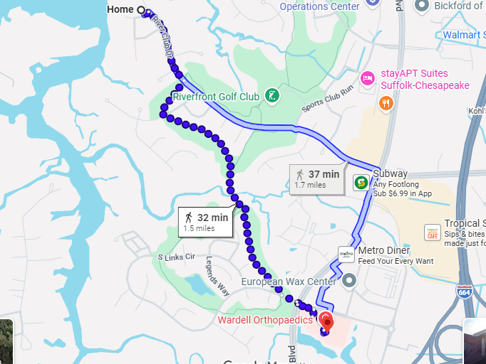
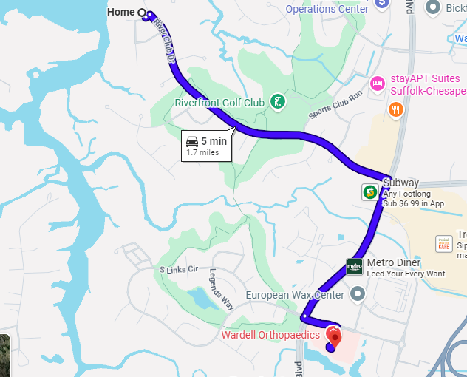
2. Do the following:
(a) Using an electronic mapping tool or paper map, locate and pinpoint the following services and landmarks in your community. Determine and record the distances from your home including driving time AND either walking or biking time.
(2) Fire station, police station, and hospital nearest your home
Bon Secures Hospital

Slide 13
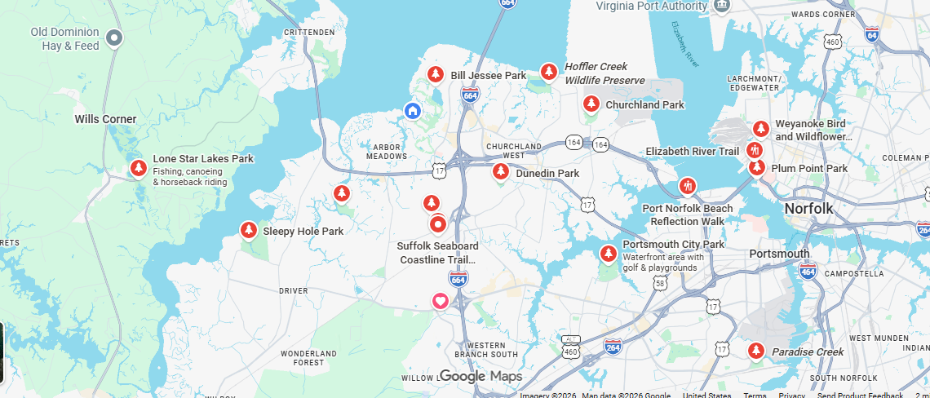
2. Do the following: (3) Parks, playgrounds, recreation areas, and trails
Parks and Trails for recreation around my home

Slide 14
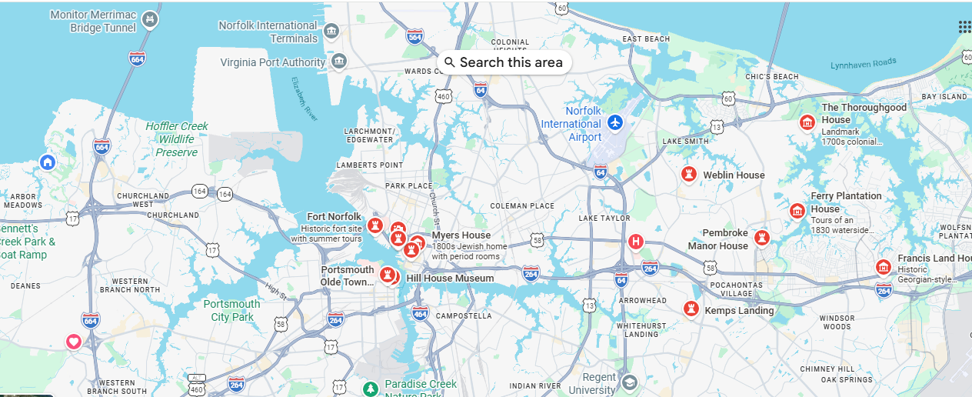
2. Do the following: (4) Historical or other interesting points of interest.
Historical sites; does not include Yorktown, Colonial Williamsburg, or DC

Slide 15
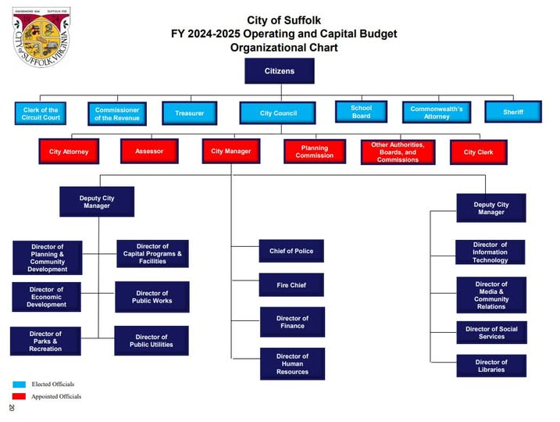
2. Do the following:
(4) Historical or other interesting points of interest. (b) Chart the organization of your local or state government. Show the top offices and tell whether they are elected or appointed.
BLUE = Elected
RED = Appointed
Elected City Council Members (2026):
Mayor: Michael D. Duman
Vice Mayor: Lue R. Ward, Jr. (Nansemond Borough)
Chuckatuck Borough: Shelley Butler Barlow
Cypress Borough: Leroy Bennett
Holy Neck Borough: Timothy Johnson
Sleepy Hole Borough: Ebony Wright
Suffolk Borough: John T. Rector
Whaleyville Borough: LeOtis Williams
These officials are elected to four-year terms to set policy, goals, and priorities for the city.
Constitutional Officers
In addition to the City Council, Suffolk voters elect several "constitutional officers" who manage specific state-mandated local functions:
Commissioner of the Revenue: Responsible for local tax assessments.
Commonwealth's Attorney: Serves as the city's lead prosecutor.
City Treasurer: Manages city funds and tax collection.
Sheriff: Oversees court security and civil process.
Clerk of the Circuit Court: Maintains court records.
The Suffolk School Board is also an elected body that governs the city's public school system.
Dr. Deborah Wahlstrom, Chair
Dr. Judith Brooks-Buck, Vice Chair

Slide 16
3. Do the following:
(a) Attend an in-person meeting of your city, town, or county council or school board, local court session; OR another state or local governmental meeting approved in advance by your counselor.
(b) Choose one of the issues discussed at the meeting where a difference of opinions was expressed, and explain to your counselor why you agree with one opinion more than you do another one.

Slide 17
4. Choose an issue that is important to the citizens of your community; then do the following:
Harbor view and Bridge Road Traffic
(a) Find out which branch of local government is responsible for this issue.
The City of Suffolk Department of Public Works' Traffic Engineering division is responsible for managing traffic flow, signals, and safety on Bridge Road (Route 17) and Harbour View Boulevard. *** Planning & Coordination: Reviewing traffic impact analyses for development, managing the city's streetlight program, and coordinating with VDOT.
(b) With your counselor's and a parent or guardian's approval, interview one person from the branch of government you identified in requirement 4(a). Ask what is being done about this issue and how young people can help. Phone: 757-514-7603; trafficengineering@suffolkva.us; https://www.suffolkva.us/511/Traffic-Engineering
-how much will the traffic increase on the corner with the Mormon Temple locating at corner of Bridge Road and Harborview Blvd?
Where will the major enterance and exit point on Harborview be located?
How can young people help with this traffic issue?
Can we get safe bike lanes on harbor view for fitness and safety?
(c) Share what you have learned with your counselor.

Slide 18
5. With the approval of your counselor and a parent or guardian, watch a movie that shows how the actions of one individual or group of individuals can have a positive effect on a community. ‘To kill a mocking Bird’ or For 12-year-old Scouts, the top movie recommendation to show the positive effect of an individual on a community is Follow Me, Boys! (1966). It follows one man who starts a Scout troop in a small town, creating a lasting positive impact on the community.
Discuss with your counselor what you learned from the movie about what it means to be a valuable and concerned member of the community.

Slide 19
6. List some of the services (such as the library, recreation center, public transportation, and public safety) your community provides that are funded by taxpayers.
Tell your counselor why these services are important to your community.
Key taxpayer-funded services in Suffolk include:
Public Safety: Police, fire departments, and emergency medical services.
Libraries: Access to books, internet, and community programs.
Recreation & Parks: Recreational centers, community activities, and public parks.
Transportation & Infrastructure: Road repairs, maintenance, and public transportation options.
Social & Civic Services: Social services (child protective services, assistance programs), voter registrar, and tax relief programs.
Public Utilities & Education: Public schools and public landscaping.

Slide 20


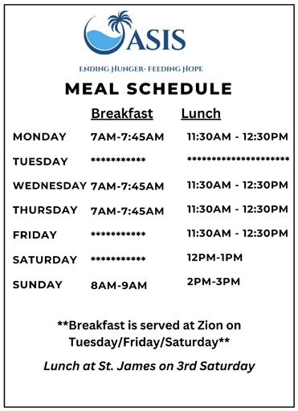
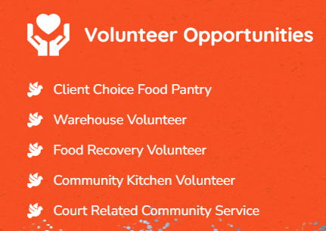
7. Do the following:
(a) Identify three charitable organizations outside of Scouting that interest you and bring people in your community together to work for the good of your community.
-St Jude's Cancer
-Oasis Social Ministry
-Freekind: rehabilitation of trafficked women
(b) Pick ONE of the organizations you chose for requirement 7(a). Using a variety of resources (including newspapers, fliers and other literature, the internet, volunteers, and employees of the organization), find out more about this organization.
Who We Are Oasis Social Ministry provides support to homeless and marginalized people, primarily in Portsmouth, VA, and surrounding areas. We provide a number of services, including a community soup kitchen, a client choice food pantry, and a thrifty boutique—all free of charge.
Main Office (757) 397-6060
Our Mission Our efforts in hunger relief are grounded by a true spirit of ensuring people of all colors, in all communities, have equitable access to healthy, nutritious food, clothing, and other essentials.

Slide 21
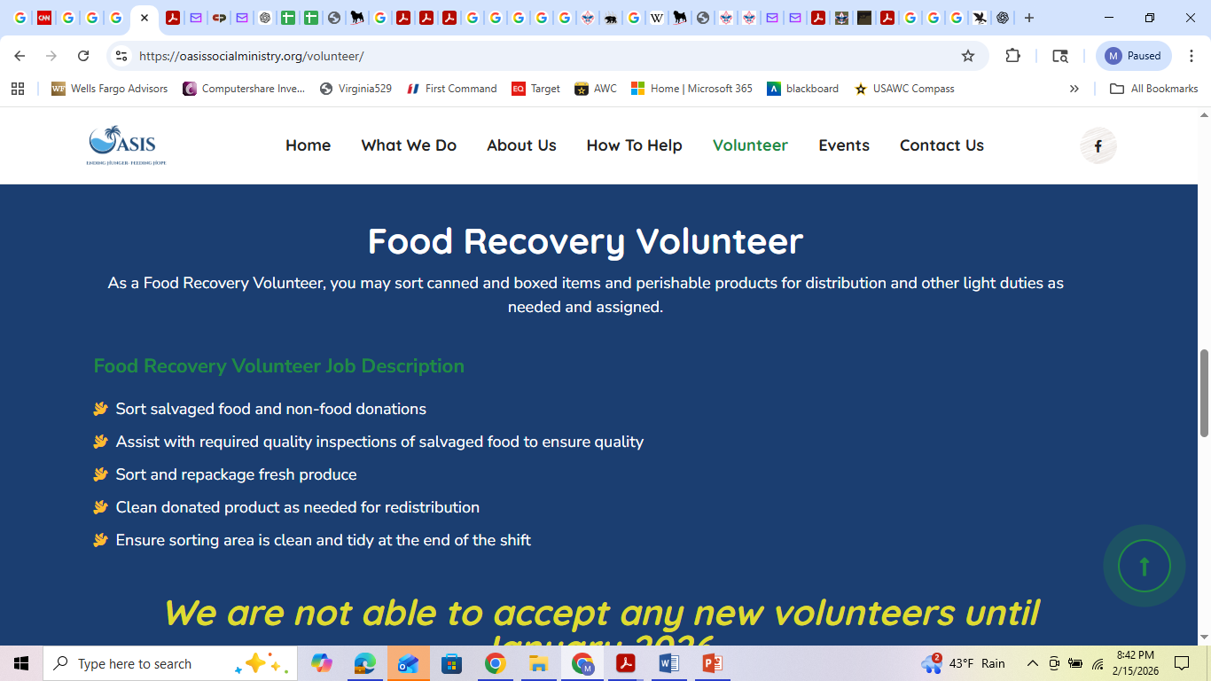
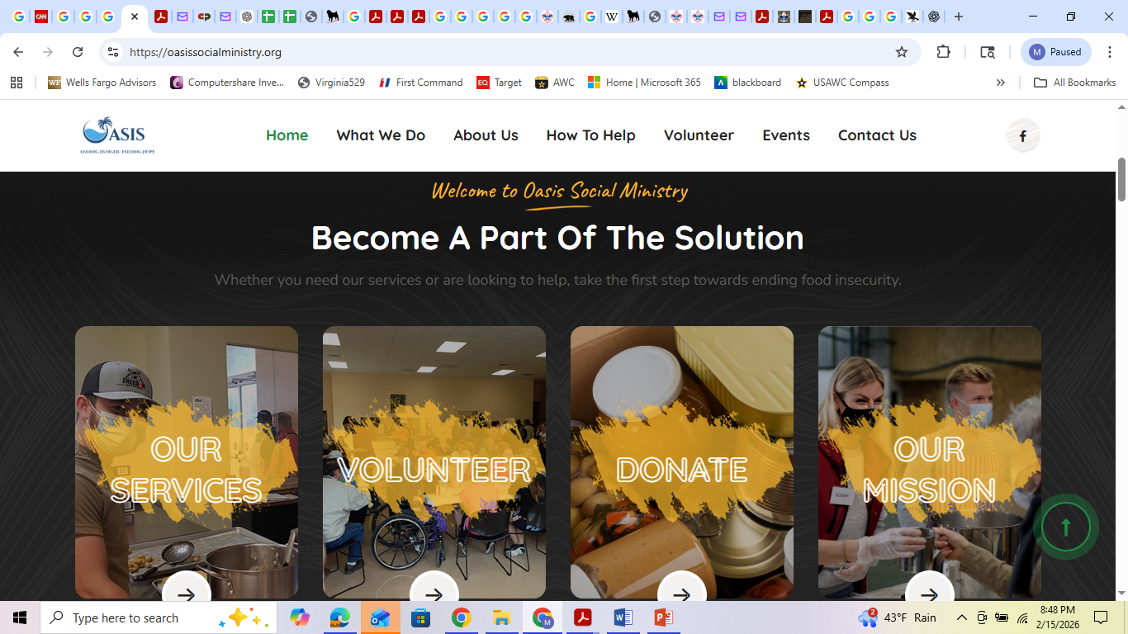
7. Do the following: (b) Pick ONE of the organizations you chose for requirement 7(a). Using a variety of resources (including newspapers, fliers and other literature, the internet, volunteers, and employees of the organization), find out more about this organization.

Slide 22
7. Do the following (c) With your counselor's and your parent or guardian's approval, contact the organization you chose for requirement 7(b), and find out what young people can do to help. While working on this merit badge, volunteer at least eight hours of your time for the organization. After your volunteer experience is over, discuss what you have learned with your counselor.

Slide 23
8. Develop a public presentation (such as a video, slide show, speech, digital presentation, or photo exhibit) about important and unique aspects of your community.
Include information about the history, cultures, and ethnic groups of your community; its best features and popular places where people gather; and the challenges it faces.
Stage your presentation in front of your counselor or a group, such as your patrol or a class at school (Church).

