Slide 1
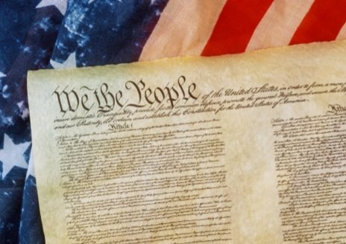
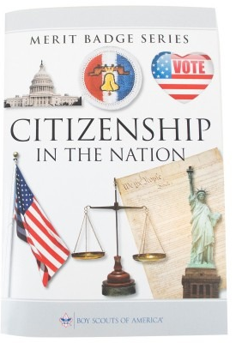
Citizenship in the Nation Merit Badge
Merit Badge Counselor(S):
Mr. Nimmo &
Mrs. Erin Nimmo
Scout Ryan Bertrand; cell: 757.418.2388
Mr. Robert Bertrand: cell: 910.9160755
29-30 DEC Tour DC
: National Archives (Declaration of Independence, Constitution, Bill of Rights, etc); Lincoln Memorial, National Museum of American Indian, Fords Theater, BSA Statues, FDR memorial, Jefferson Memorial, White House, Capital, and Supreme Court.

Slide 2
1. What is the Constitution of the United States? What does the Constitution do? What principles does it reflect? Why is it important to have a Constitution?
2. List the six purposes for creating the United States Constitution set forth in the Preamble to the Constitution. How do these purposes affect your family and community?
3. List the three branches of the United States government. Explain:
(a) The function of each branch of government; (b) Why it is important to divide powers among different branches; (c) How each branch "checks" and "balances" the others; (d) How citizens can be involved in each branch of government.
4. Discuss the importance of:
(a) Declaration of Independence
(b) Bill of Rights (the first 10 Amendments to the Constitution) and the 14th Amendment
(c) "E Pluribus Unum," the traditional United States motto.
5. Watch the national evening news for five days in a row or read the main stories in a national media organization (e.g., a newspaper or news website) for five days in a row. Discuss the national issues that you learned about with your counselor. Choose one issue and explain how it affects you, your family, and community.
6. With your counselor's approval, choose a speech of national historical importance. Explain:
(a) Who the author was; (b) What the historical context was (c) What difficulties the nation faced that the author wished to discuss ; (d) What the author said ;(e) Why the speech is important to the nation's history; (f) Choose a sentence or two from the speech that has significant meaning to you, and tell your counselor why.
7. Do TWO of the following:
(a) Visit a place that is listed as a National Historic Landmark or that is on the National Register of Historic Places. Tell your counselor what you learned about the landmark or site and what you found interesting about it.
(d) Choose a United States national monument that interests you. Using books, brochures, the internet (with your parent or guardian's permission), and other resources, find out more about the monument. Tell your counselor what you learned, and explain why the monument is important to this country's citizens.
8. Name your representatives in the United States Congress. Write a letter to your representative in Congress explaining your views on a national issue. Show your letter, along with any response you receive, to your counselor.

Slide 3
1. What is the Constitution of the United States?

Slide 4
2. List the six purposes for creating the United States Constitution set forth in the Preamble to the Constitution.
How do these purposes affect your family and community?

Slide 5
3. List the three branches of the United States government. Judicial, Executive, Legislature
Explain:
The function of each branch of government;
(b) Why it is important to divide powers among different branches;
(c) How each branch "checks" and "balances" the others;
(d) How citizens can be involved in each branch of government.

Slide 6
4. Discuss the importance of:
(a) Declaration of Independence:
(b) Bill of Rights (the first 10 Amendments to the Constitution) and the 14th Amendment:
(c) "E Pluribus Unum," the traditional United States motto

Slide 7
5. Watch the national evening news for five days in a row or read the main stories in a national media organization (e.g., a newspaper or news website) for five days in a row. Discuss the national issues that you learned about with your counselor.
Choose one issue and explain how it affects you, your family, and community. Ukraine:

Slide 8
6. With your counselor's approval, choose a speech of national historical importance.
President Franklin D. Roosevelt’s December 7, 1941 speech: “Address to Congress Requesting a Declaration of War;” commonly known as the “Day of Infamy” speech. Date delivered: December 8, 1941; Why: Japan’s surprise attack on Pearl Harbor, Hawaii; Audience: U.S. Congress (and the American public by radio); Result: Congress declared war on Japan the same day

Slide 9
6. With your counselor's approval, choose a speech of national historical importance.
Explain:
(a) Who the author was;
(b) What the historical context was:
(c) What difficulties the nation faced that the author wished to discuss ;
(d) What the author said ;
(e) Why the speech is important to the nation's history;
(f) Choose a sentence or two from the speech that has significant meaning to you, and tell your counselor why.

Slide 10
29-30DEC Tour DC: National Archives (Declaration of Independence, Constitution, Bill of Rights, etc); Lincoln Memorial, National Museum of American Indian, Fords Theater, BSA Statues, FDR memorial, Jefferson Memorial, White House, and Capital.
7. Do TWO of the following:
(a) Visit a place that is listed as a National Historic Landmark or that is on the National Register of Historic Places. Tell your counselor what you learned about the landmark or site and what you found interesting about it.

Slide 11
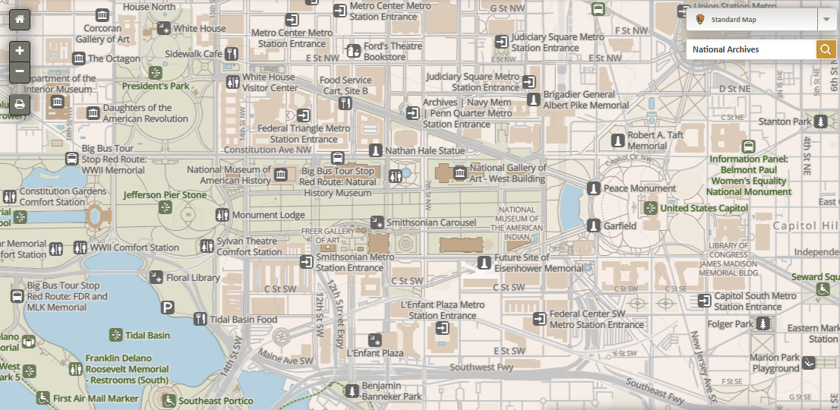
DEC 29th
2
Parking
1
BSA
Statue
3
NA
4
5
Jefferson Monument

Slide 12
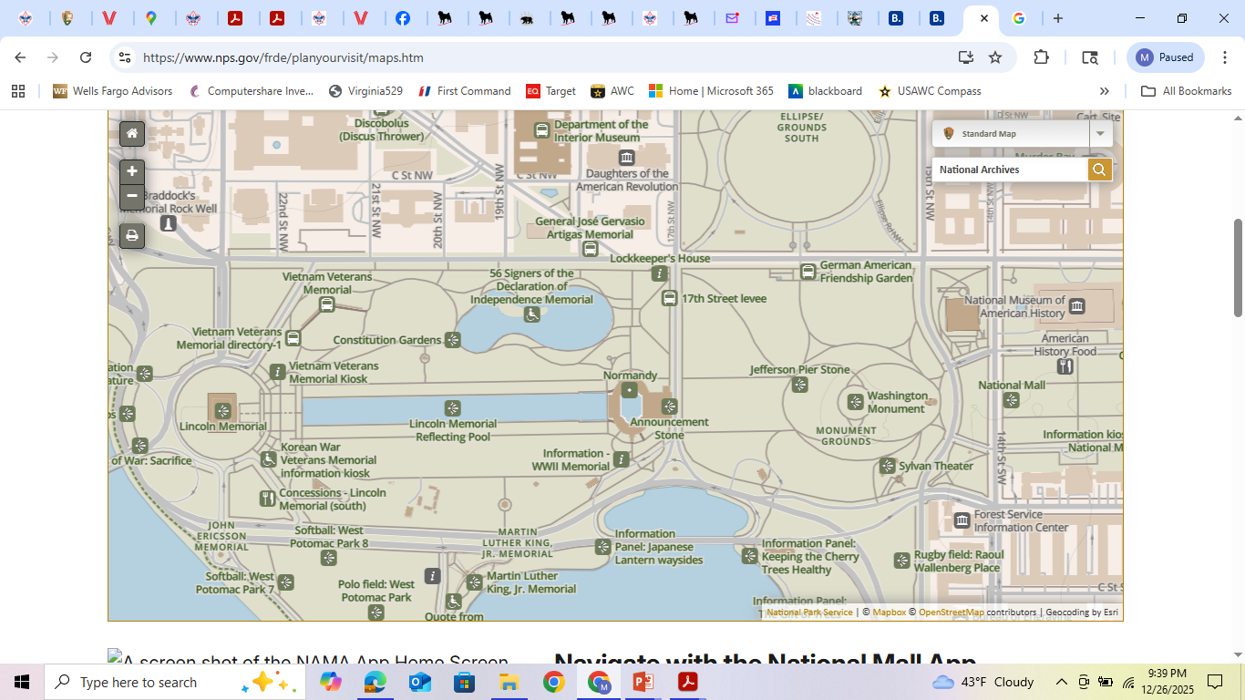
DEC 30th
1

Slide 13
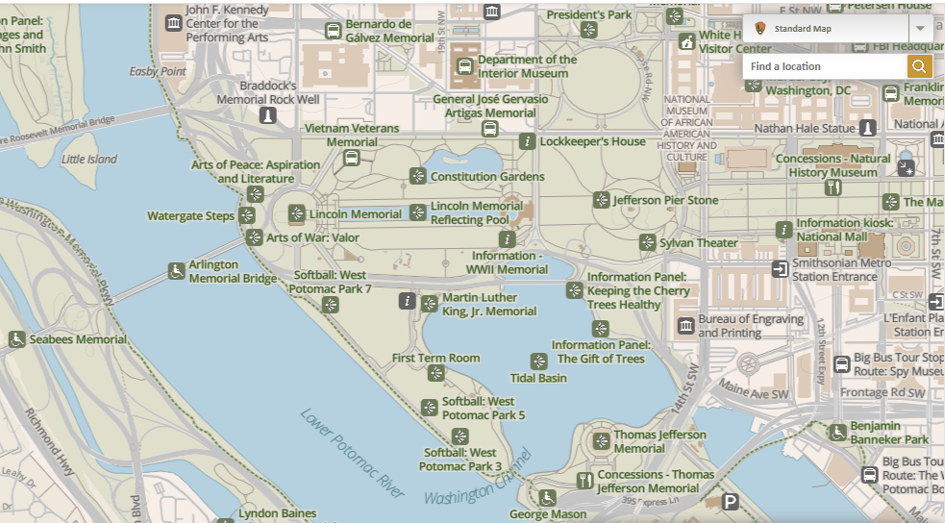
DEC 30th
BSA Statue
1
National Archives
Lincoln Memorial
2
FDR Memorial

Slide 14
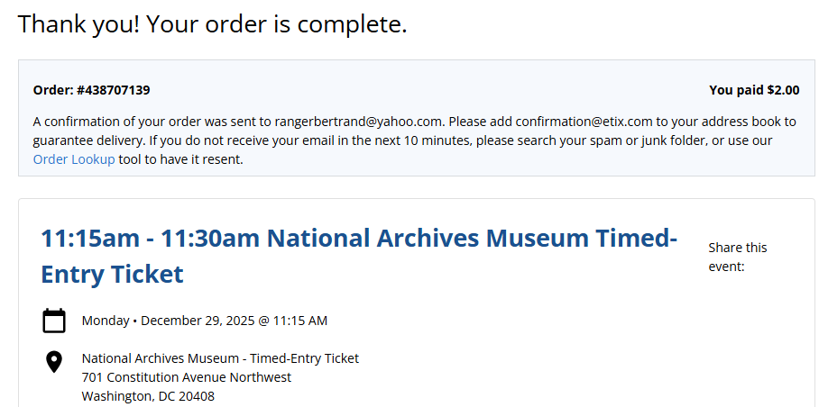
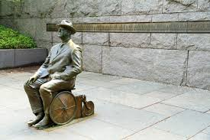
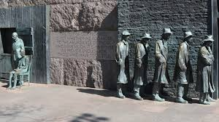
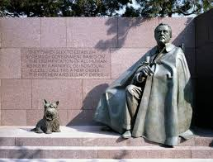
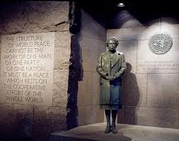

Slide 16
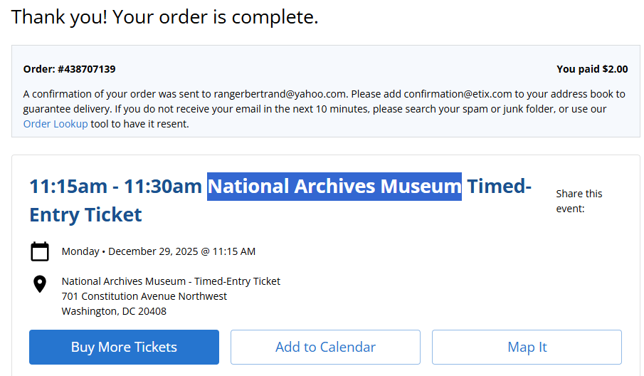

Slide 17
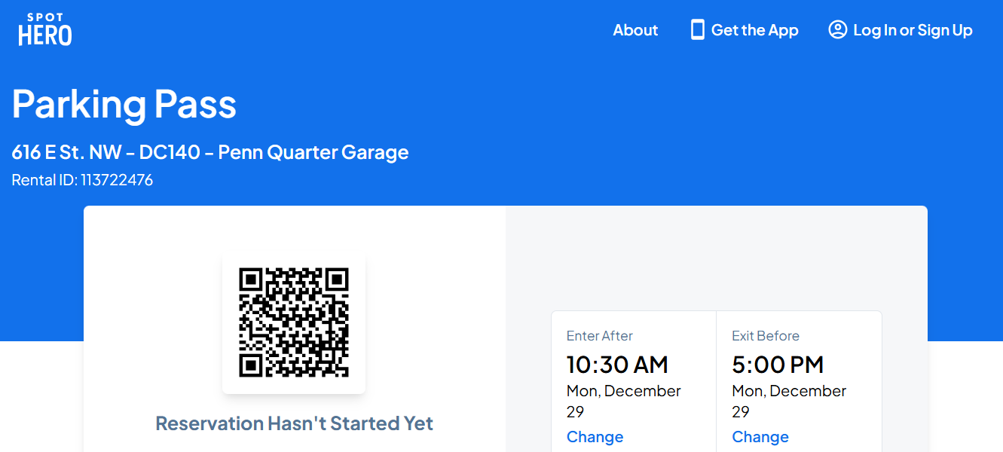

Slide 18
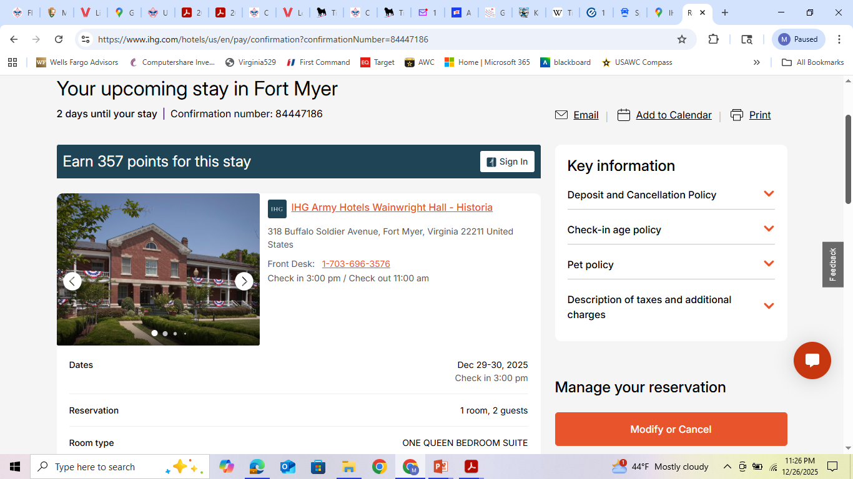

Slide 19
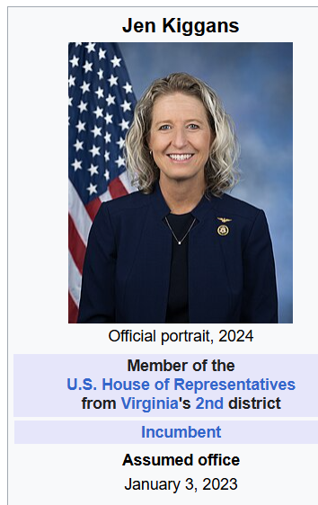
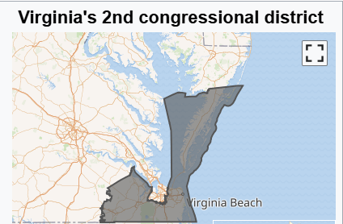
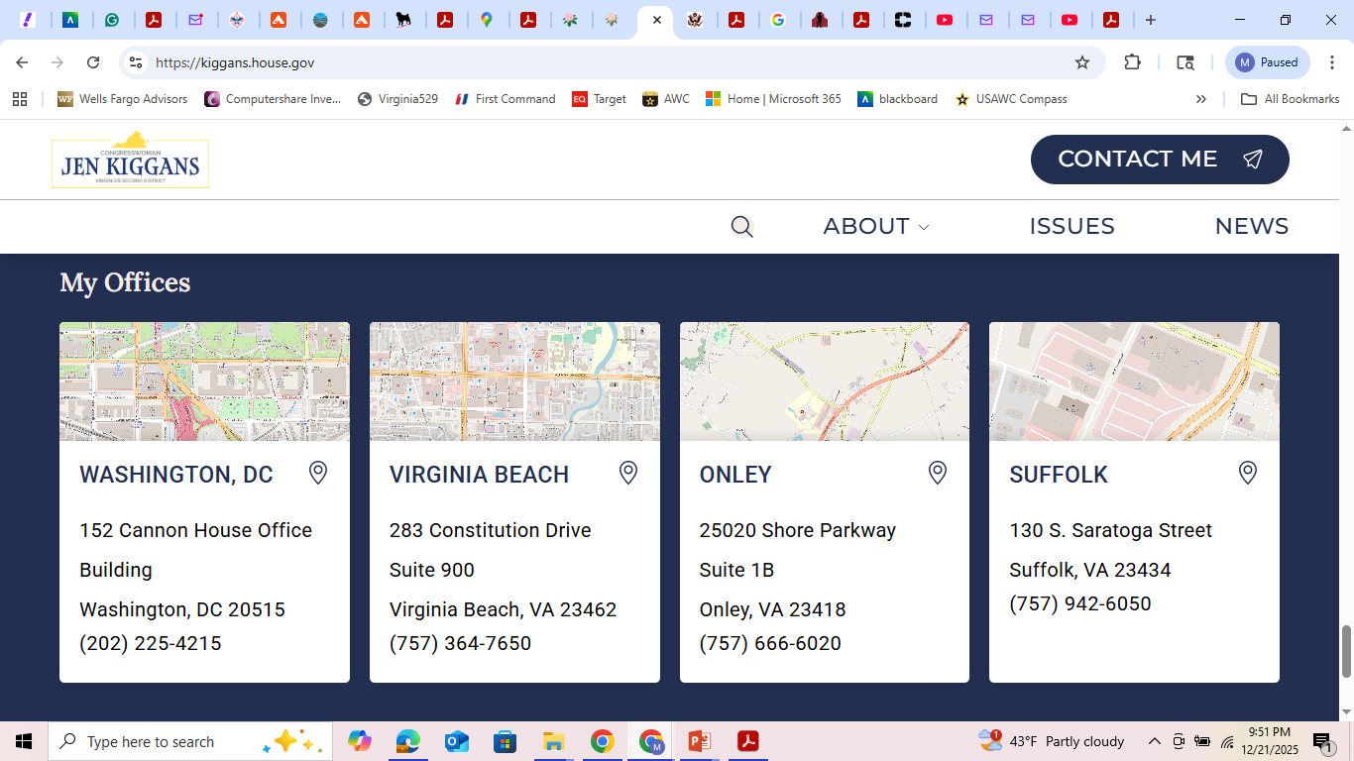
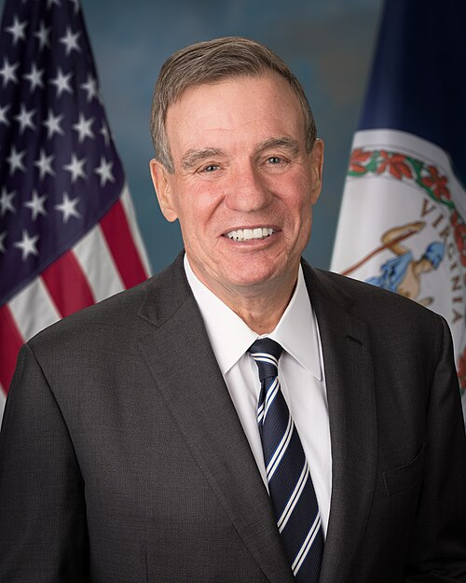
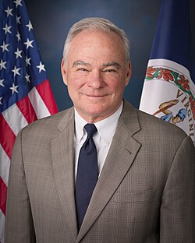
8. Name your representatives in the United States Congress. Write a letter to your representative in Congress explaining your views on a national issue. Show your letter, along with any response you receive, to your counselor.
Mark Warner,
U.S. Senator
Tim Kaine,
U.S. Senator

Slide 20
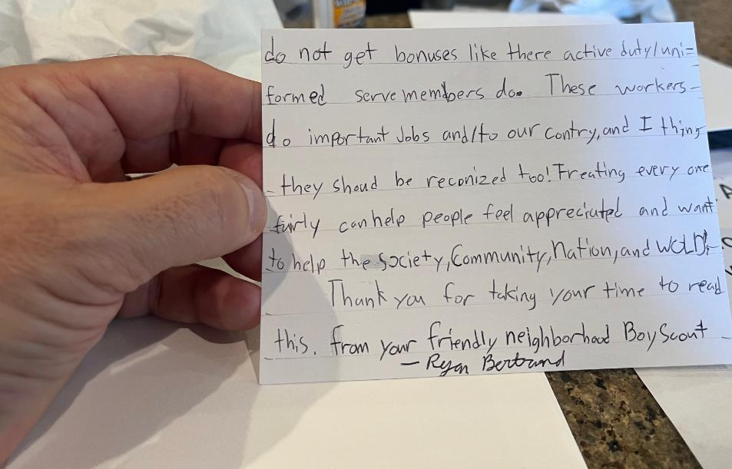
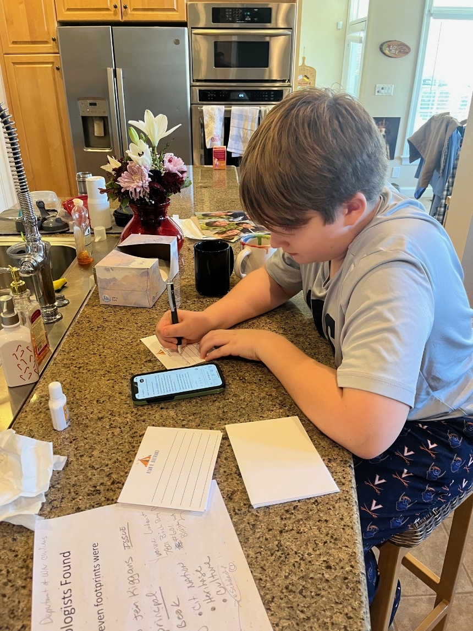
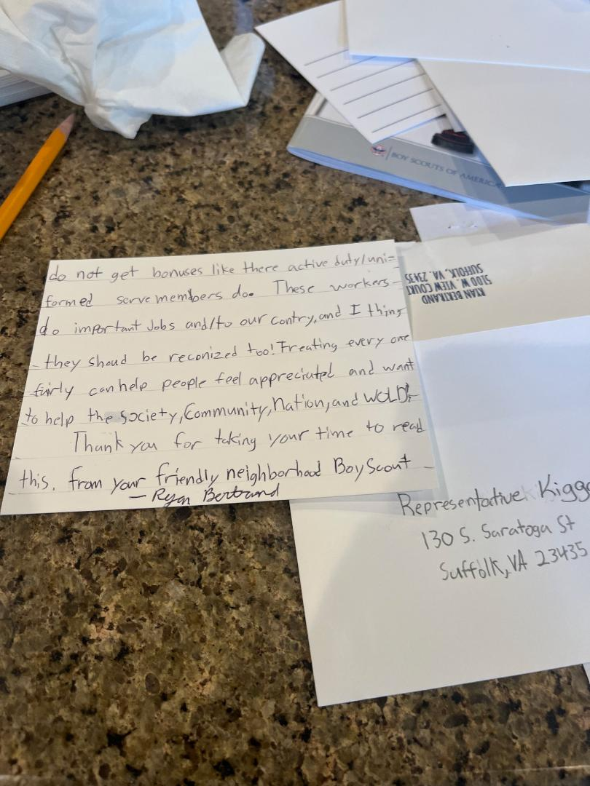
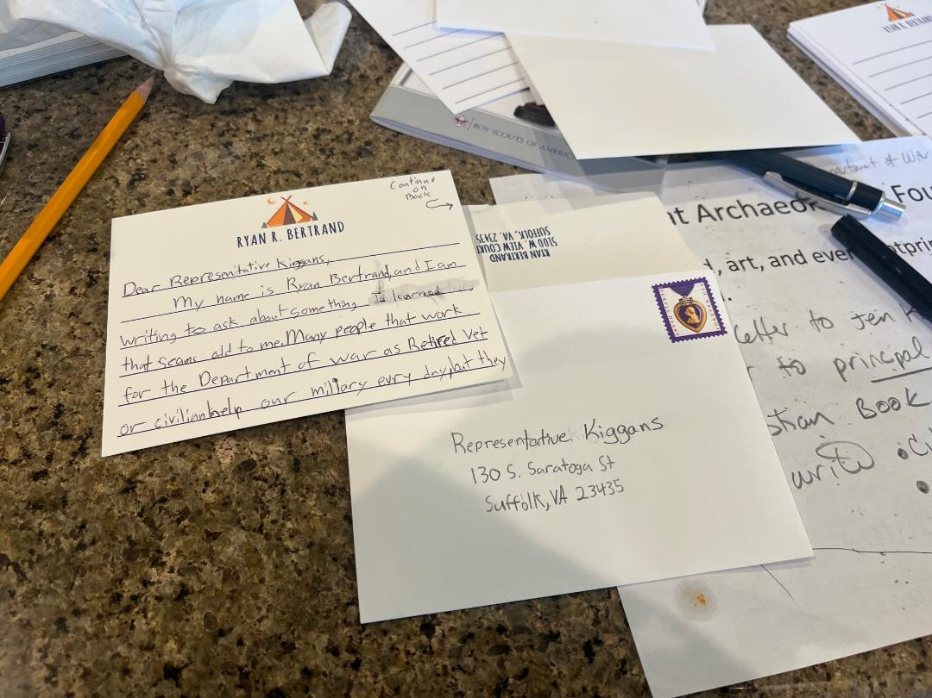
Letter Mailed to
Virginia 2d District:
Representative Keggan
DEC 27, 2025.

Slide 21
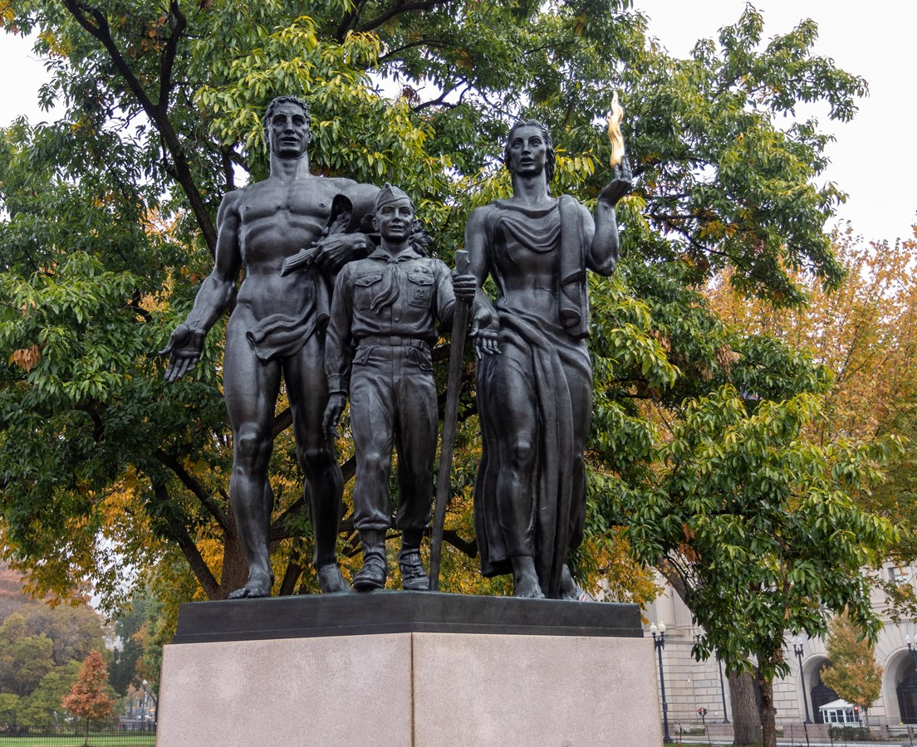
Boy Scout Commemorative Tribute

Slide 22
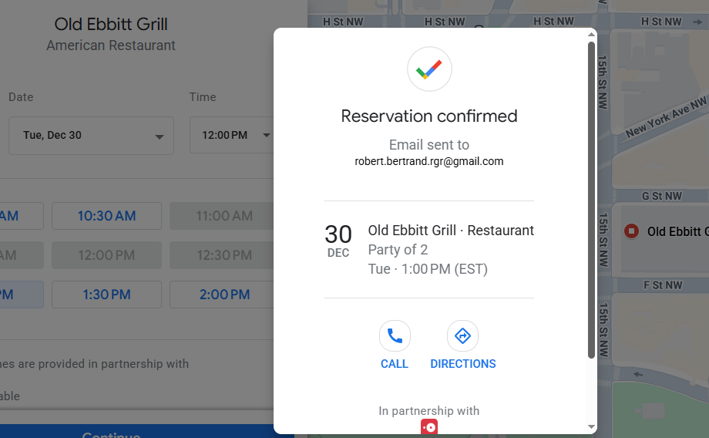
Tuesday Lunch

Slide 23
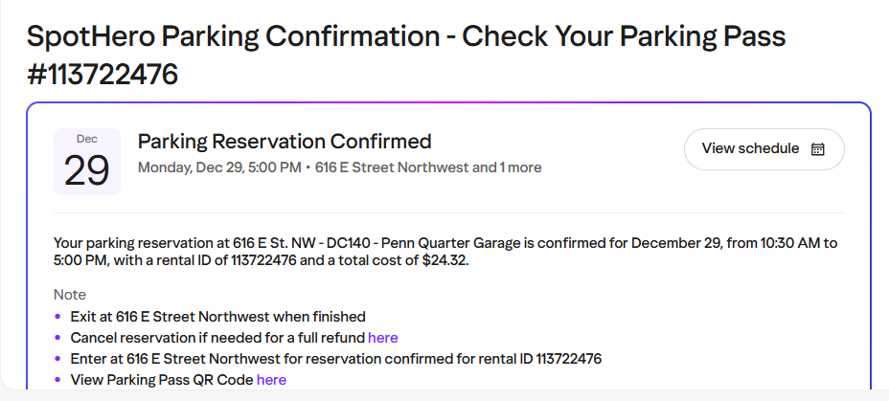

Slide 24
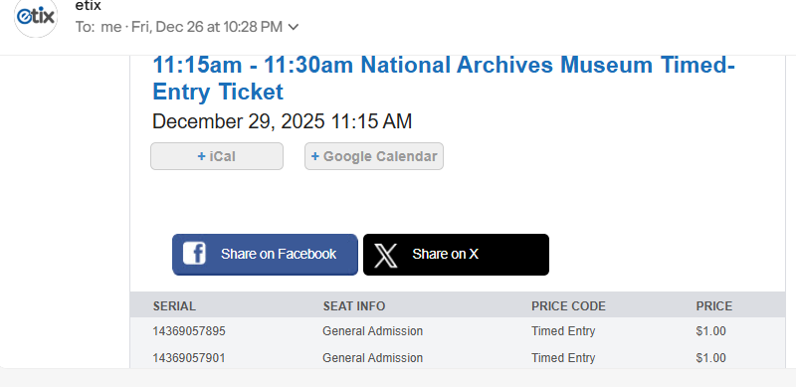

Slide 25
Open daily, 10 a.m. - 5:30 p.m.
701 Constitution Avenue, NW, Washington, DC 20408

Slide 26
Monday Dec 29
-Depart 0700
-Arrive DC 1020
-Park 1030
-Nat Archv 1100
-Declaration 1130
-Constitution 1200
-Bill of Rights 1230
-Other Documents 1300
-Depart NA 1400
-Walk-Fords Theater 1430
-Walk-BSA Statue 1515
-Walk-back 1600
-Secure POV 1630
-Jefferson Memorial 1700
-Dinner 1800
-O/O Hotel
Tuesday Dec 30
-Wake-up 0800
-Breakfast 0830
-Lincoln Memorial 1000
-FDR Memorial 1100
-Park/Shop 1200
-Old Ebbits 1300
-Depart 1430
Scouting America National Capital Area Council
(Marriott Scout Service Center)
9190 Rockville Pike, Bethesda, MD 20814

