Slide 1
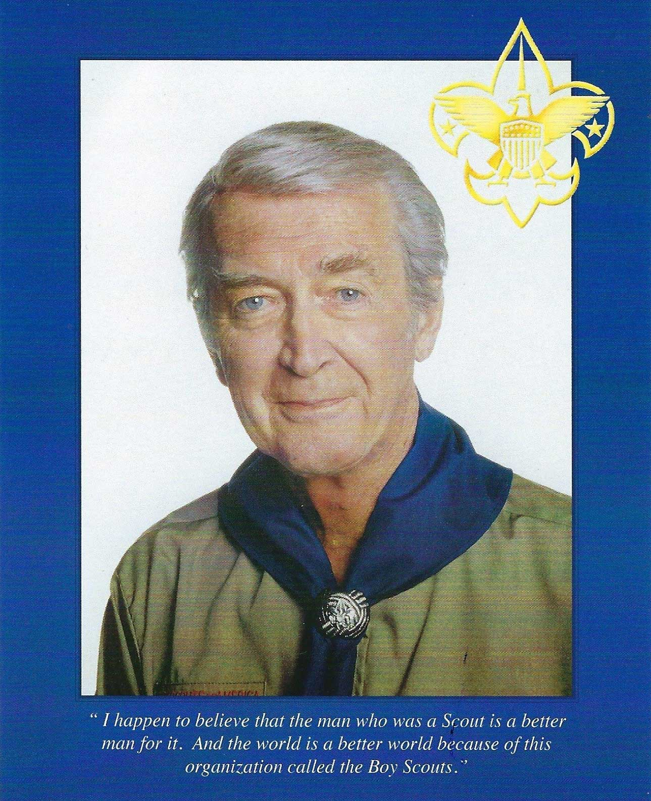
The James M. Stewart
Good Citizenship Award

Slide 2
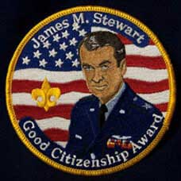
This award has been established by the James M. Stewart Museum Foundation with the consent and cooperation of the Boy Scouts of America, Penn’s Woods Council and the family of James M. Stewart. The purpose of this award is to introduce Boy Scouts to the life of a great American, James Maitland Stewart. The Jimmy Stewart Museum is offering this award to a Boy Scout or Scouter who has exemplified the characteristics necessary to live the life of a good citizen. To earn the award, Scouts are required to read through the Jimmy Stewart workbook, complete the Jimmy Stewart Museum quiz, write an essay of not less than 500 words, and do a good citizenship project in their community in honor of James M. Stewart. The scout cannot purchase the medal and patch before completing the work first.

Slide 3
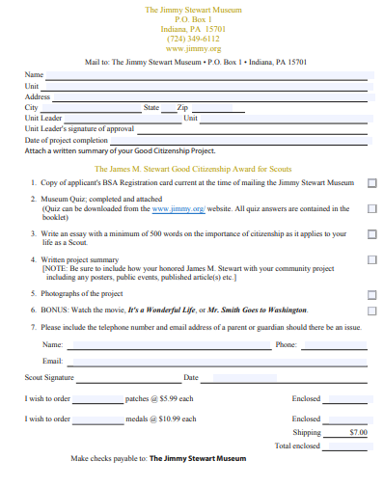
Requirements
Read the Book
Take quiz,
Write 500-word essay
Do a good citizen project in the name of Jimmy Stewart
After being approved by a local Scouting Representative, you will be notified, and your patch and /or medal will then be sent.
Receive Patch + Medal

Slide 4
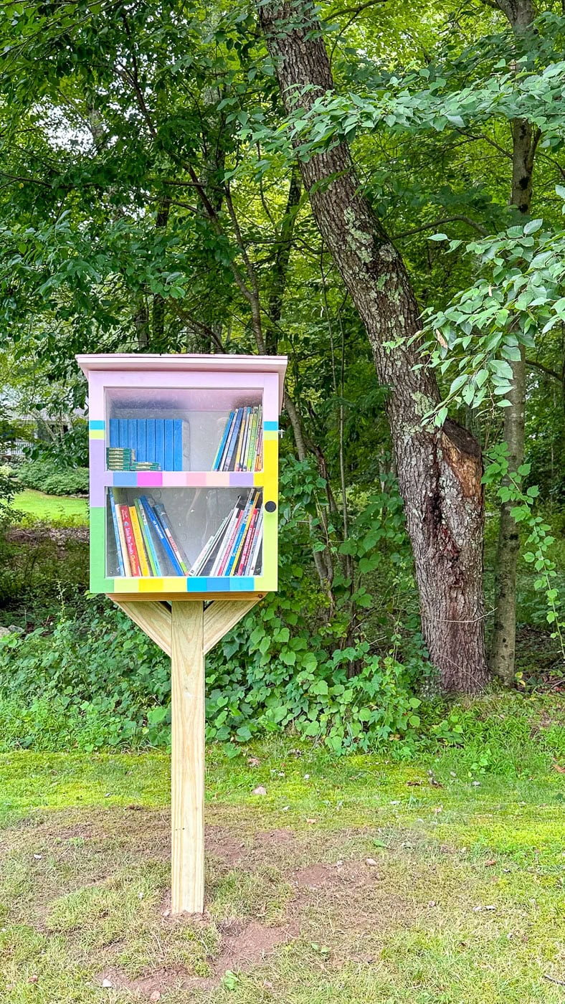
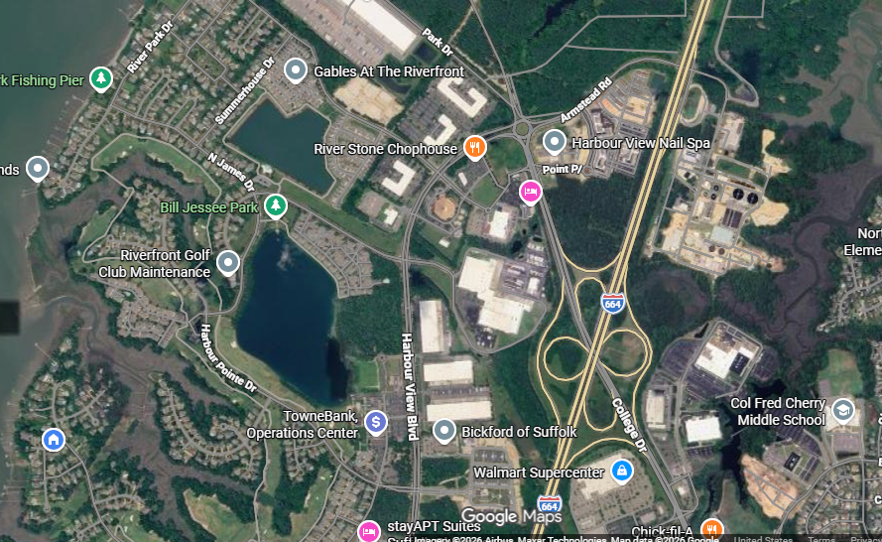

Oak and Lilly Academy
6801 BRIDGEWAY DRIVE,
SUFFOLK, VA 23435
a good citizen project in the name of Jimmy Stewart

Slide 5
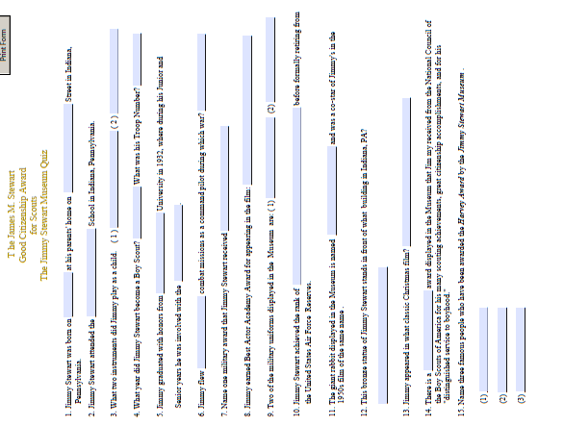
On-Line Quiz

Slide 6
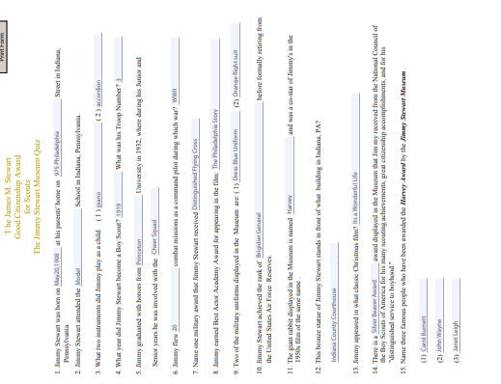
On-Line Quiz
Answered

Slide 7
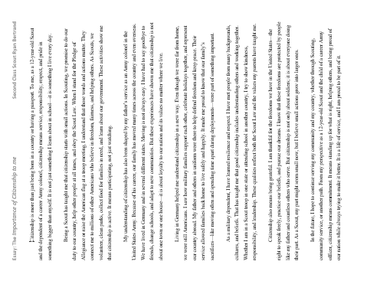
Essay

