Slide 1

Patrol Leader
Ryan Bertrand
(Troop Historian)

Slide 2
Asst Patrol Leader
1st Class Scout: Eli Gandy
(Troop Scribe)

Slide 3

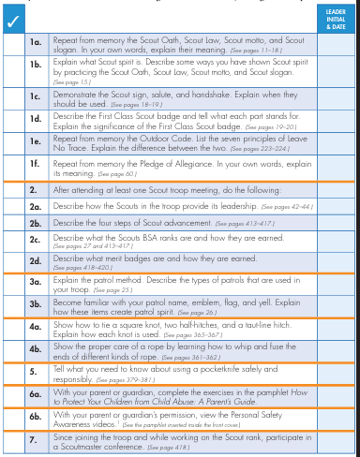
Noah Saunders
Scout Mentor: 1st Class Scout Eli Gandy
Date Signed into Scout Troop: __________________
Scout Rank Requirements
3-Month Goals:
15MAY
(a) Tot’en Chit
(b) Fireman Chit
(c) Merit Badges
________________
________________
(d) Campouts ______
(e) Service Hrs _____
Scout Camp
(a) _______________
(b) _______________
(c) _______________
(d) Swimming
3-Month Goals
May 15 Goal: (a) _______________
(b) _______________
(c) _______________
(d) Campouts ______

Slide 4

Firem’n Chit Requirements
This certification grants a Scout the right to carry fire-lighting devices (matches, lighters, etc.) to build campfires. The Scout must show their Scout leader, or someone designated by their leader, an understanding of the responsibility to do the following:
I have read and understand use and safety rules from the Scouts BSA Handbook.
I will build a campfire only when necessary and when I have the necessary permits (regulations vary by locality).
I will minimize campfire impacts or use existing fire lays consistent with the principles of Leave No Trace. I will check to see that all flammable material is cleared at least 5 feet in all directions from fire (total 10 feet).
I will safely use and store fire-starting materials.
I will see that fire is attended to at all times.
I will make sure that water and/or a shovel is readily available. I will promptly report any wildfire to the proper authorities.
I will use the cold-out test to make sure the fire is cold out and will make sure the fire lay is cleaned before I leave it.
I follow the Outdoor Code, the Guide to Safe Scouting, and the principles of Leave No Trace and Tread Lightly!
The Scout’s “Firem’n Rights” can be taken away if they fail in their responsibility.

Slide 5

Totin’ Chip Requirements
Read and understand woods tools use and safety rules from the Scouts BSA handbooks.
Demonstrate proper handling, care, and use of the pocketknife, ax, and saw.
Use knife, ax, and saw as tools, not playthings.
Respect all safety rules to protect others.
Respect property. Cut living and dead trees only with permission and good reason.
Subscribe to the Outdoor Code.
The Scout’s “Totin’ Rights” can be taken away if they fail in their responsibility.
This certification grants a Scout the right to carry and use woods tools. The Scout must show their Scout leader, or someone designated by their leader, that the Scout understands their responsibility to do the following:

Slide 6
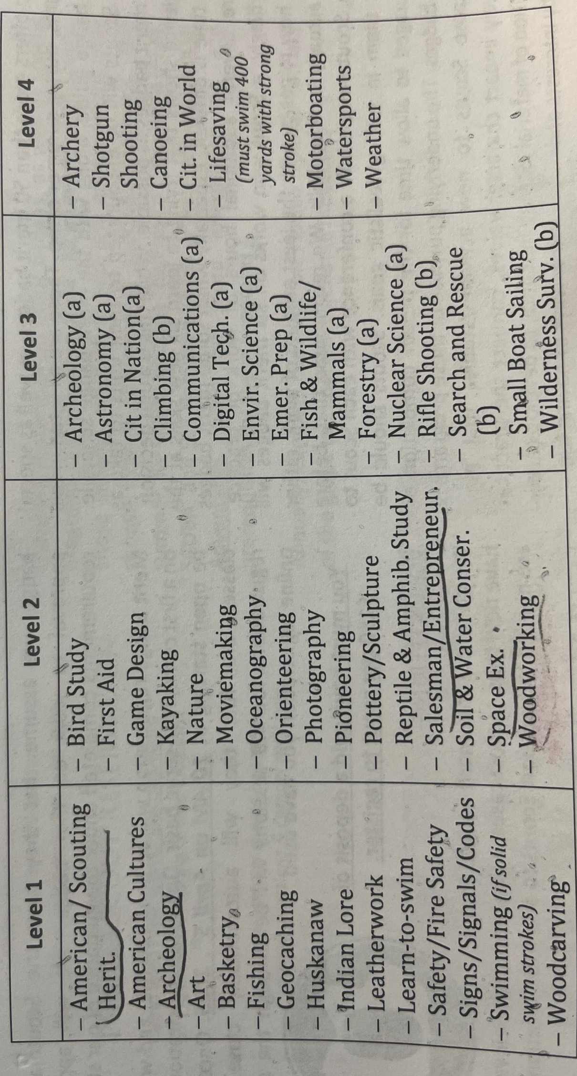
1st Class - Eagle
2d Class - Star
Pipsico Scout Camp 2025
Scout-Tenderfoot

Slide 7
Avier Mercado
Scout Mentor: 1st Class Scout Eli Gandy
Date Signed into Scout Troop: __________________
Scout Rank Requirements
3-Month Goals:
15MAY
(a) Tot’en Chit
(b) Fireman Chit
(c) Merit Badges
________________
________________
(d) Campouts ______
(e) Service Hrs _____
Scout Camp
(a) _______________
(b) _______________
(c) _______________
(d) Swimming
3-Month Goals
May 15 Goal: (a) _______________
(b) _______________
(c) _______________
(d) Campouts ______

Slide 8
Firem’n Chit Requirements
This certification grants a Scout the right to carry fire-lighting devices (matches, lighters, etc.) to build campfires. The Scout must show their Scout leader, or someone designated by their leader, an understanding of the responsibility to do the following:
I have read and understand use and safety rules from the Scouts BSA Handbook.
I will build a campfire only when necessary and when I have the necessary permits (regulations vary by locality).
I will minimize campfire impacts or use existing fire lays consistent with the principles of Leave No Trace. I will check to see that all flammable material is cleared at least 5 feet in all directions from fire (total 10 feet).
I will safely use and store fire-starting materials.
I will see that fire is attended to at all times.
I will make sure that water and/or a shovel is readily available. I will promptly report any wildfire to the proper authorities.
I will use the cold-out test to make sure the fire is cold out and will make sure the fire lay is cleaned before I leave it.
I follow the Outdoor Code, the Guide to Safe Scouting, and the principles of Leave No Trace and Tread Lightly!
The Scout’s “Firem’n Rights” can be taken away if they fail in their responsibility.

Slide 9
Totin’ Chip Requirements
Read and understand woods tools use and safety rules from the Scouts BSA handbooks.
Demonstrate proper handling, care, and use of the pocketknife, ax, and saw.
Use knife, ax, and saw as tools, not playthings.
Respect all safety rules to protect others.
Respect property. Cut living and dead trees only with permission and good reason.
Subscribe to the Outdoor Code.
The Scout’s “Totin’ Rights” can be taken away if they fail in their responsibility.
This certification grants a Scout the right to carry and use woods tools. The Scout must show their Scout leader, or someone designated by their leader, that the Scout understands their responsibility to do the following:

Slide 10
1st Class - Eagle
2d Class - Star
Pipsico Scout Camp 2025
Scout-Tenderfoot

Slide 11
Samuel Coxwell
Scout Mentor: 1st Class Scout Eli Gandy
Date Signed into Scout Troop: __________________
Scout Rank Requirements
3-Month Goals:
15MAY
(a) Tot’en Chit
(b) Fireman Chit
(c) Merit Badges
________________
________________
(d) Campouts ______
(e) Service Hrs _____
Scout Camp
(a) _______________
(b) _______________
(c) _______________
(d) Swimming
3-Month Goals
May 15 Goal: (a) _______________
(b) _______________
(c) _______________
(d) Campouts ______

Slide 12
Firem’n Chit Requirements
This certification grants a Scout the right to carry fire-lighting devices (matches, lighters, etc.) to build campfires. The Scout must show their Scout leader, or someone designated by their leader, an understanding of the responsibility to do the following:
I have read and understand use and safety rules from the Scouts BSA Handbook.
I will build a campfire only when necessary and when I have the necessary permits (regulations vary by locality).
I will minimize campfire impacts or use existing fire lays consistent with the principles of Leave No Trace. I will check to see that all flammable material is cleared at least 5 feet in all directions from fire (total 10 feet).
I will safely use and store fire-starting materials.
I will see that fire is attended to at all times.
I will make sure that water and/or a shovel is readily available. I will promptly report any wildfire to the proper authorities.
I will use the cold-out test to make sure the fire is cold out and will make sure the fire lay is cleaned before I leave it.
I follow the Outdoor Code, the Guide to Safe Scouting, and the principles of Leave No Trace and Tread Lightly!
The Scout’s “Firem’n Rights” can be taken away if they fail in their responsibility.

Slide 13
Totin’ Chip Requirements
Read and understand woods tools use and safety rules from the Scouts BSA handbooks.
Demonstrate proper handling, care, and use of the pocketknife, ax, and saw.
Use knife, ax, and saw as tools, not playthings.
Respect all safety rules to protect others.
Respect property. Cut living and dead trees only with permission and good reason.
Subscribe to the Outdoor Code.
The Scout’s “Totin’ Rights” can be taken away if they fail in their responsibility.
This certification grants a Scout the right to carry and use woods tools. The Scout must show their Scout leader, or someone designated by their leader, that the Scout understands their responsibility to do the following:

Slide 14
1st Class - Eagle
2d Class - Star
Pipsico Scout Camp 2025
Scout-Tenderfoot

Slide 15
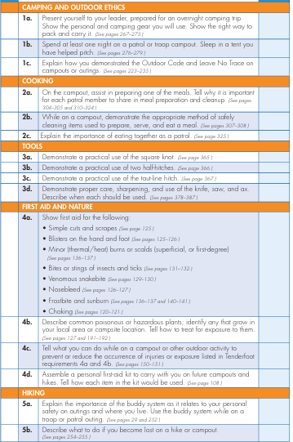
3-Month Goals:
15MAY
(a) Tot’en Chit
(b) Fireman Chit
(c) Merit Badges
________________
________________
(d) Campouts ______
(e) Service Hrs _____
Scout Lucas Tonkison
Date Promoted to Scout: __________________
Scout Camp
(a) _______________
(b) _______________
(c) _______________
(d) Swimming

Slide 16
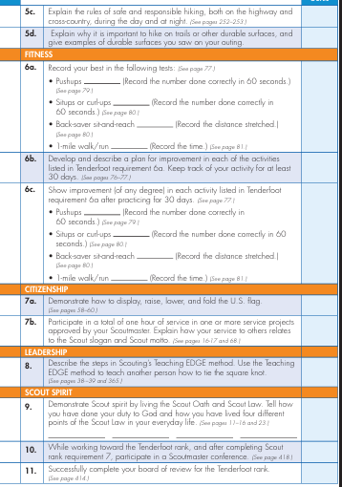
Scout Lucas Tonkison

Slide 17
Firem’n Chit Requirements
This certification grants a Scout the right to carry fire-lighting devices (matches, lighters, etc.) to build campfires. The Scout must show their Scout leader, or someone designated by their leader, an understanding of the responsibility to do the following:
I have read and understand use and safety rules from the Scouts BSA Handbook.
I will build a campfire only when necessary and when I have the necessary permits (regulations vary by locality).
I will minimize campfire impacts or use existing fire lays consistent with the principles of Leave No Trace. I will check to see that all flammable material is cleared at least 5 feet in all directions from fire (total 10 feet).
I will safely use and store fire-starting materials.
I will see that fire is attended to at all times.
I will make sure that water and/or a shovel is readily available. I will promptly report any wildfire to the proper authorities.
I will use the cold-out test to make sure the fire is cold out and will make sure the fire lay is cleaned before I leave it.
I follow the Outdoor Code, the Guide to Safe Scouting, and the principles of Leave No Trace and Tread Lightly!
The Scout’s “Firem’n Rights” can be taken away if they fail in their responsibility.

Slide 18
Totin’ Chip Requirements
Read and understand woods tools use and safety rules from the Scouts BSA handbooks.
Demonstrate proper handling, care, and use of the pocketknife, ax, and saw.
Use knife, ax, and saw as tools, not playthings.
Respect all safety rules to protect others.
Respect property. Cut living and dead trees only with permission and good reason.
Subscribe to the Outdoor Code.
The Scout’s “Totin’ Rights” can be taken away if they fail in their responsibility.
This certification grants a Scout the right to carry and use woods tools. The Scout must show their Scout leader, or someone designated by their leader, that the Scout understands their responsibility to do the following:

Slide 19
1st Class - Eagle
2d Class - Star
Pipsico Scout Camp 2025
Scout-Tenderfoot

Slide 20
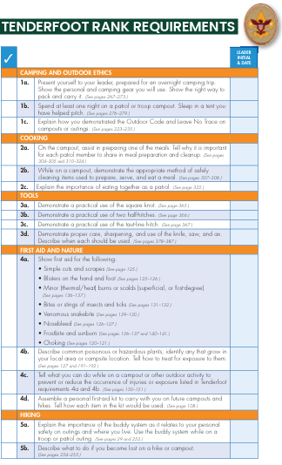
3-Month Goals:
15MAY
(a) Tot’en Chit
(b) Fireman Chit
(c) Merit Badges
________________
________________
(d) Campouts ______
(e) Service Hrs _____
Scout Daniel Ennis
Date Promoted to Scout: __________________
Scout Camp
(a) _______________
(b) _______________
(c) _______________
(d) Swimming

Slide 21
Scout Daniel Ennis

Slide 22
Firem’n Chit Requirements
This certification grants a Scout the right to carry fire-lighting devices (matches, lighters, etc.) to build campfires. The Scout must show their Scout leader, or someone designated by their leader, an understanding of the responsibility to do the following:
I have read and understand use and safety rules from the Scouts BSA Handbook.
I will build a campfire only when necessary and when I have the necessary permits (regulations vary by locality).
I will minimize campfire impacts or use existing fire lays consistent with the principles of Leave No Trace. I will check to see that all flammable material is cleared at least 5 feet in all directions from fire (total 10 feet).
I will safely use and store fire-starting materials.
I will see that fire is attended to at all times.
I will make sure that water and/or a shovel is readily available. I will promptly report any wildfire to the proper authorities.
I will use the cold-out test to make sure the fire is cold out and will make sure the fire lay is cleaned before I leave it.
I follow the Outdoor Code, the Guide to Safe Scouting, and the principles of Leave No Trace and Tread Lightly!
The Scout’s “Firem’n Rights” can be taken away if they fail in their responsibility.

Slide 23
Totin’ Chip Requirements
Read and understand woods tools use and safety rules from the Scouts BSA handbooks.
Demonstrate proper handling, care, and use of the pocketknife, ax, and saw.
Use knife, ax, and saw as tools, not playthings.
Respect all safety rules to protect others.
Respect property. Cut living and dead trees only with permission and good reason.
Subscribe to the Outdoor Code.
The Scout’s “Totin’ Rights” can be taken away if they fail in their responsibility.
This certification grants a Scout the right to carry and use woods tools. The Scout must show their Scout leader, or someone designated by their leader, that the Scout understands their responsibility to do the following:

Slide 24
1st Class - Eagle
2d Class - Star
Pipsico Scout Camp 2025
Scout-Tenderfoot

Slide 25
Scout Nathaniel Hanks
Date Promoted to Scout: __________________
Scout Camp
(a) _______________
(b) _______________
(c) _______________
(d) Swimming
3-Month Goals:
15MAY
(a) Tot’en Chit
(b) Fireman Chit
(c) Merit Badges
________________
________________
(d) Campouts ______
(e) Service Hrs _____

Slide 26
Firem’n Chit Requirements
This certification grants a Scout the right to carry fire-lighting devices (matches, lighters, etc.) to build campfires. The Scout must show their Scout leader, or someone designated by their leader, an understanding of the responsibility to do the following:
I have read and understand use and safety rules from the Scouts BSA Handbook.
I will build a campfire only when necessary and when I have the necessary permits (regulations vary by locality).
I will minimize campfire impacts or use existing fire lays consistent with the principles of Leave No Trace. I will check to see that all flammable material is cleared at least 5 feet in all directions from fire (total 10 feet).
I will safely use and store fire-starting materials.
I will see that fire is attended to at all times.
I will make sure that water and/or a shovel is readily available. I will promptly report any wildfire to the proper authorities.
I will use the cold-out test to make sure the fire is cold out and will make sure the fire lay is cleaned before I leave it.
I follow the Outdoor Code, the Guide to Safe Scouting, and the principles of Leave No Trace and Tread Lightly!
The Scout’s “Firem’n Rights” can be taken away if they fail in their responsibility.

Slide 27
Totin’ Chip Requirements
Read and understand woods tools use and safety rules from the Scouts BSA handbooks.
Demonstrate proper handling, care, and use of the pocketknife, ax, and saw.
Use knife, ax, and saw as tools, not playthings.
Respect all safety rules to protect others.
Respect property. Cut living and dead trees only with permission and good reason.
Subscribe to the Outdoor Code.
The Scout’s “Totin’ Rights” can be taken away if they fail in their responsibility.
This certification grants a Scout the right to carry and use woods tools. The Scout must show their Scout leader, or someone designated by their leader, that the Scout understands their responsibility to do the following:

Slide 28
1st Class - Eagle
2d Class - Star
Pipsico Scout Camp 2025
Scout-Tenderfoot

Slide 29
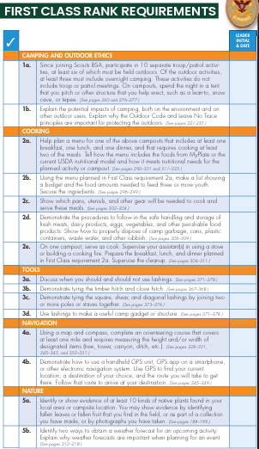
2d Class Ryan Bertrand
Date Promoted to 2d Class: __________________
3-Month Goals:
15MAY
(a) Tot’en Chit
(b) Fireman Chit
(c) Merit Badges
________________
________________
(d) Campouts ______
(e) Service Hrs _____
Scout Camp
(a) _______________
(b) _______________
(c) _______________
(d) Swimming

Slide 30
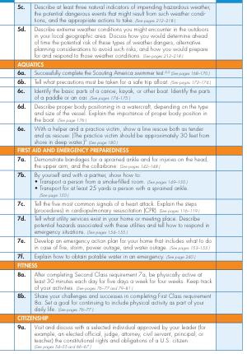
2d Class Ryan Bertrand

Slide 31
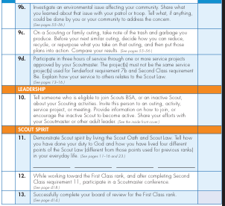
2d Class Ryan Bertrand

Slide 32
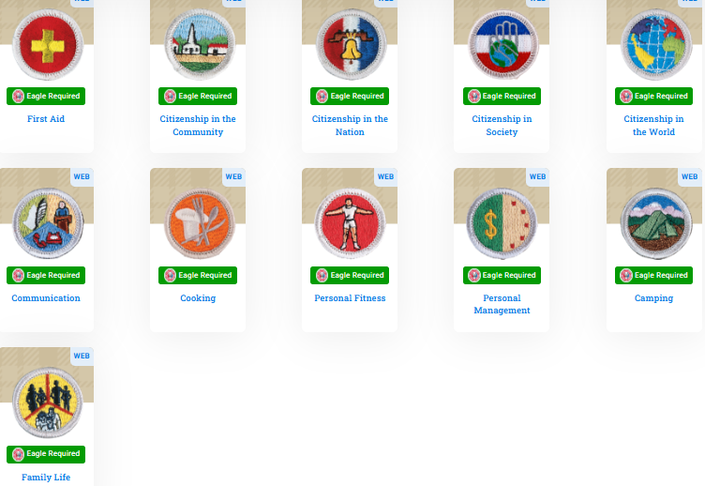
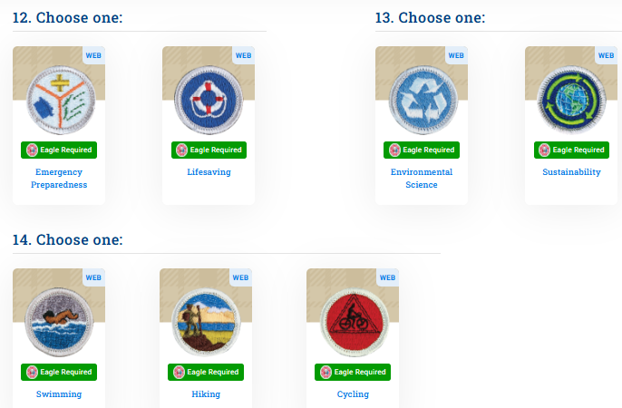
JAN-MAY
FEB-APR
Completed
Completed
FEB-APR
Completed
Completed
FEB-APR
Eagle Required
Ryan Bertrand Plan
Scout Camp
Scout Camp
Not interested
Not interested

Slide 33

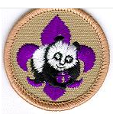
Paul Bunyan Award Requirements
Study the Scouts BSA Handbook and the Camping merit badge pamphlet, and demonstrate to your Scoutmaster or other qualified person the following:
Explain the most likely hazards you may encounter while using woods tools listed in requirement 5 and what you should do to anticipate, help prevent, manage, and respond to these hazards.
Show that you know first aid for injuries that could occur while using woods tools.
Earn the Totin’ Chip.
Help a Scout or patrol earn the Totin’ Chip, and demonstrate to them the value of proper woods-tools use.
Be familiar with the proper and safe use, maintenance and storage of woods tools including:
  Axe
  Hatchet
  Loppers
  McLeod
  Pulaski
  Saw
  Shovel
  Pick Axe
  PryBar
Demonstrate proper use of four of the tools listed in requirement 5.
With unit leader approval and supervision, using woods tools, spend at least two hours doing one of the following conservation oriented projects:
  Clear trails or fire lanes for two hours.
  Trim a downed tree, cut into four-foot lengths, and stack; make a brush with branches.
  Build a natural retaining wall or irrigation way to aid in a planned conservation effort.

Slide 34
1st Class - Eagle
2d Class - Star
Pipsico Scout Camp 2025
Scout-Tenderfoot

Slide 35
2d Class Ryan Bertrand
Goals for Feb 2026
Finish Personal Management
Start: AI MB___________
Start: Cit in Community MB
Start: Family Life MB
Earn Paul Bunyon
Goals for March 2026
____________________
Oceanography MB______
Wilderness Survival MB _
_____________________
Goals for April 2026
____________________
____________________
_____________________
_____________________
Paul Bunyon ______
Going to Scout Camp? _____________________
Goals for Scout Camp? ____________ , _________________, __________, ________________, _________________ , ___________, ______________

Slide 36
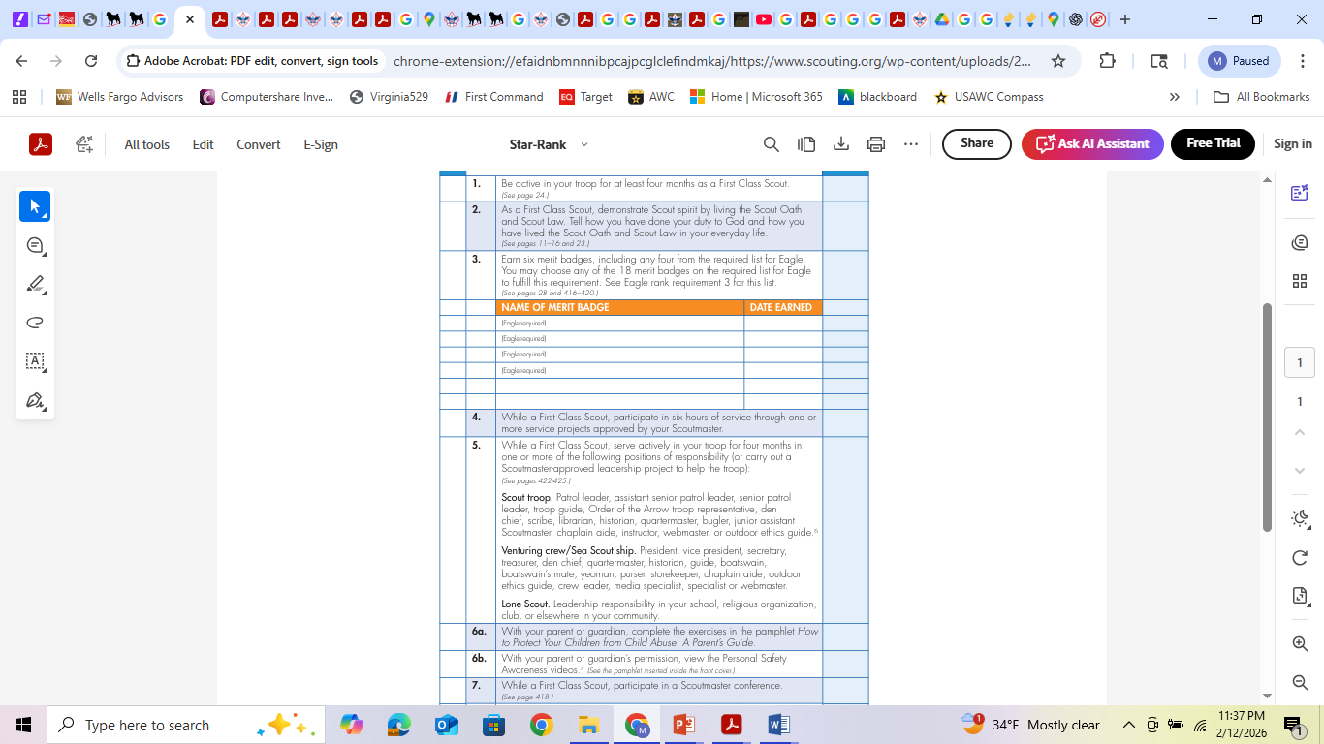
Star Requirements
Ryan Bertrand
.
.
.
.
.
.
.
Citizenship in World NOV 2025
Citizenship in Nation JAN 2026
Personal Fitness FEB 2026
Personal Management FEB 2026
Aviation OCT 2025
Engineering NOV 2025

Slide 37
1st Class Eli Gandy
Star Requirements
Date Promoted to 1st Class: FEB 1st 2026
Earliest Eligible for Board of Review: June 1st 2026 // ~After Scout Camp
.
.
.
.
.
First Aid June 2025
Swimming June 2025
Personal Fitness 2026
Pioneering DEC 2025
Law DEC 2025
3-Month Goals:
15MAY
(a) Tot’en Chit
(b) Fireman Chit
(c) Merit Badges
________________
________________
(d) Campouts ______
(e) Service Hrs _____
Scout Camp
(a) _______________
(b) _______________
(c) _______________
(d) Swimming
& Board of Review

Slide 38
1st Class - Eagle
2d Class - Star
Pipsico Scout Camp 2025
Scout-Tenderfoot

Slide 39
1st Class Eli Gandy
Goals for Feb 2026
____________________
____________________
_____________________
_____________________
Goals for March 2026
____________________
____________________
_____________________
_____________________
Goals for April 2026
____________________
____________________
_____________________
_____________________
Paul Bunyon ______
Going to Scout Camp? _____________________
Goals for Scout Camp? ____________ , _________________, __________, ________________, _________________ , ___________, ______________

Slide 40
Completed
Eagle Required
Eli Gandy Plan
Completed

Slide 41
Paul Bunyan Award Requirements
Study the Scouts BSA Handbook and the Camping merit badge pamphlet, and demonstrate to your Scoutmaster or other qualified person the following:
Explain the most likely hazards you may encounter while using woods tools listed in requirement 5 and what you should do to anticipate, help prevent, manage, and respond to these hazards.
Show that you know first aid for injuries that could occur while using woods tools.
Earn the Totin’ Chip.
Help a Scout or patrol earn the Totin’ Chip, and demonstrate to them the value of proper woods-tools use.
Be familiar with the proper and safe use, maintenance and storage of woods tools including:
  Axe
  Hatchet
  Loppers
  McLeod
  Pulaski
  Saw
  Shovel
  Pick Axe
  PryBar
Demonstrate proper use of four of the tools listed in requirement 5.
With unit leader approval and supervision, using woods tools, spend at least two hours doing one of the following conservation oriented projects:
  Clear trails or fire lanes for two hours.
  Trim a downed tree, cut into four-foot lengths, and stack; make a brush with branches.
  Build a natural retaining wall or irrigation way to aid in a planned conservation effort.

Slide 42
Firem’n Chit Requirements
This certification grants a Scout the right to carry fire-lighting devices (matches, lighters, etc.) to build campfires. The Scout must show their Scout leader, or someone designated by their leader, an understanding of the responsibility to do the following:
I have read and understand use and safety rules from the Scouts BSA Handbook.
I will build a campfire only when necessary and when I have the necessary permits (regulations vary by locality).
I will minimize campfire impacts or use existing fire lays consistent with the principles of Leave No Trace. I will check to see that all flammable material is cleared at least 5 feet in all directions from fire (total 10 feet).
I will safely use and store fire-starting materials.
I will see that fire is attended to at all times.
I will make sure that water and/or a shovel is readily available. I will promptly report any wildfire to the proper authorities.
I will use the cold-out test to make sure the fire is cold out and will make sure the fire lay is cleaned before I leave it.
I follow the Outdoor Code, the Guide to Safe Scouting, and the principles of Leave No Trace and Tread Lightly!
The Scout’s “Firem’n Rights” can be taken away if they fail in their responsibility.

Slide 43
Totin’ Chip Requirements
Read and understand woods tools use and safety rules from the Scouts BSA handbooks.
Demonstrate proper handling, care, and use of the pocketknife, ax, and saw.
Use knife, ax, and saw as tools, not playthings.
Respect all safety rules to protect others.
Respect property. Cut living and dead trees only with permission and good reason.
Subscribe to the Outdoor Code.
The Scout’s “Totin’ Rights” can be taken away if they fail in their responsibility.
This certification grants a Scout the right to carry and use woods tools. The Scout must show their Scout leader, or someone designated by their leader, that the Scout understands their responsibility to do the following:

Slide 44
1st Class Eli Gandy
Patrol Leader tasks:
Track Scouts progress and help them promote
Make plans for rank-up efforts
Make plans for MBs for Patrol
Report to Scribe attendance
Prepare Patrol for next adventure / campout
-Who is Grub Master
- Tent mates
-specialize packing list items: knives, raingear,
Plan and lead patrol meetings and activities.
Keep patrol members informed.
Create a duty roster for each camping trip.
Help patrol members succeed in their assigned duties
Represent the patrol at all Patrol Leaders’ Council (PLC) meetings.
Make sure Assistant Patrol Leader attends any meeting/activity he will not be able to attend.
Prepares the patrol to take part in all troop activities.
Develop patrol spirit.
Work with other troop leaders to make the troop run well.
Know what patrol members and other leaders can do.

Slide 45
1st Class Eli Gandy
Assistant Patrol Leader responsibilities next three months:
Mentor scouts on how to pitch a tent
Teach scouts on packing for camping trip
Mentor Patrol Grub master planning
Teach Patrol Tot’n Chit at CHOP campout
Organize service project where the Patrol can participate
Plan one Merit Badge event for Patrol: Fireman ship MB
Honest insight to the Patrol Leader
Help Scouts earn advancement requirements through First Class.
Help older Scouts teach skills to new Scouts with the guidance of the Assistant Scoutmaster.
Teach basic Scout skills.

Slide 46
Leadership Tips
Scouting offers many opportunities for you to lead. The longer you’re in the program, the more others will look to you to step up. But how do you become a good, responsible leader who commands respect from Scouts and adults alike?
Here are a few tips:
• Keep your word. If you say you’ll do something, do it. If you don’t know if you’ll be able to keep a promise, don’t make a promise. Your words won’t mean much when you don’t follow through consistently with your actions.
• Communicate and delegate. Treat your troop as your team, not as your subordinates. Share your plans or challenging situations with them rather than keeping it all to yourself. Someone else could have a good idea for how to tackle a problem. Assign tasks to take pressure off yourself and to empower your team.
• Be fair. You might want to rely on your friends, but showing favorites can create resentment. Be empathetic and treat everyone the way you’d want to be treated.
• Give praise and encouragement. Let your troop know you value their help and effort. Simply saying “good job” can go a long way.
• Ask for help. You don’t have to do everything yourself. Adult leaders can provide guidance; fellow Scouts can provide support. You’re not a failure if you fail. It’s all part of growing as a leader.
Every job contributes to a vibrant, effective troop. Don't be embarrassed to ask for help. You have many resources at your disposal. When confronted with a situation you don't know how to handle, ask someone with more experience for some advice and direction.
Criticize in Private. There will be times when you must provide a Scout with critical feedback. Pull the Scout aside and quietly explain what could be done better. Add suggestion on how it should be done correctly.
Accept Criticism as a Gift. Criticism, when offered and received properly, can give you ideas for performing your role better. Being open to suggestions and adopting those that will benefit your troop are signs of a good leader.
Have Fun. Most of all, have fun learning to be a leader. Your joy and enthusiasm will spread to other Scouts and will help energize the activities of the troop

Slide 47
Servant Leadership
Choosing to Lead
Give rather than receive
Make a difference
Help others to succeed
Make the group successful
Respect for others…dignity
Other Leadership Styles
Doing It All Yourself
Controlling
Intimidation
Wanting Everyone to Like You

Slide 48
The Servant Leader
Boss vs Team Member
When a leader recognizes that he is responsible to the team (and not the other way around) and acts accordingly, he becomes a “servant leader.”
Enable the success of those led, remove barriers for them to the best of the leader’s ability, and create an environment for the team to succeed.
Leaders need to lead— to set direction and lead team members in that direction.
Need to listen and know when the time for discussion is over.
Achieve consensus and know when to preserve things that are good without foundering in a constant storm of question and reinvention.
Set/maintain standards and know when to reject what does not maintain those standards or the team vision.
Serve their customers and know how to make a difference with the team. Please think about how you can be a servant leader in your current role in the troop.

Slide 49
Key Details for the Scouts BSA World Conservation Award:
Requirements: Scouts must earn three specific merit badges: Environmental Science, Citizenship in the World, and either Soil and Water Conservation or Fish and Wildlife Management
.
Project: A conservation project totaling at least three hours must be completed, which addresses a conservation need common to more than one country.
Application: The application must be submitted to the local council service center to purchase the patch, which is worn on the right pocket as a temporary insignia.
Purpose: To encourage Scouts to "think globally, act locally" and understand environmental interdependence.

Slide 50
1st Class - Eagle
2d Class - Star
Pipsico Scout Camp 2025
Scout-Tenderfoot

Slide 51
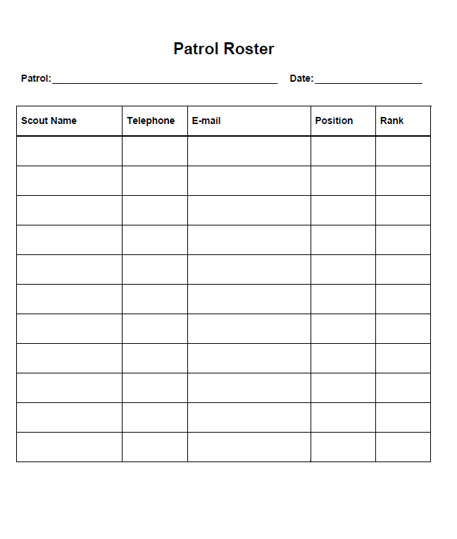
Present
Yes / No
Noah Sanders
Avier Mercado
Sameul Coxwell
Lucas Tonkison
Scout
Daniel Ennis
Scout
Nathaniel Hanks
Scout
Eli Gandy
APL /
Scribe
1st Class
Ryan Bertrand
PL /
Historian
2d Class

