Slide 1
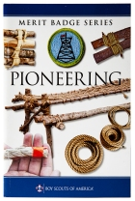

Pioneering Merit Badge
Merit Badge Counselor: Mr. Robert Bertrand

Slide 2
1. Do the following:
(a) Explain to your counselor the most likely hazards you might encounter while participating in pioneering activities and what you should do to anticipate, help prevent, mitigate, and respond to these hazards.
(b) Discuss the prevention of, and first-aid treatment for, injuries and conditions that could occur while working on pioneering projects, including rope splinters, rope burns, cuts, scratches, insect bites and stings, hypothermia, dehydration, heat exhaustion, heatstroke, sunburn, and falls.
2. Do the following:
(a) Demonstrate the West Country method of whipping a rope.
(b) Demonstrate how to tie a rope tackle and the following knots: clove hitch formed as two half hitches, clove hitch on a bight, butterfly knot, round turn with two half hitches, and rolling hitch.
(c) Demonstrate and explain when to use the following lashings: square, diagonal, round, shear, tripod, and floor lashing.
3. Do the following:
(a) Using square and tripod lashings from requirement 2(c), build a Tripod Wash Station (or with your counselor's permission, another camp gadget of your own design).
(b) Using rolling hitches or round turns with two half hitches, and round lashings from requirements 2(b) and 2(c), build a 15-foot Scout Stave Flagpole (or with your counselor's permission, another camp gadget of your own design)
(c) Using shear, square, and floor lashings, clove hitches on a bight, and rope tackles from requirements 2(b) and 2(c), build a Simple Camp Table (or with your counselor's permission, another camp gadget of your own design).
4. Explain the differences between synthetic ropes and natural-fiber ropes. Discuss which types of rope are suitable for pioneering work and why. Include the following in your discussion: breaking strength, safe working loads, and the care and storage of rope.
5. Explain the uses for the back splice, eye splice, and short splice. View a demonstration on forming each splice.
6. Using a rope-making device or machine, make a rope at least 6 feet long consisting of three strands, each having three yarns. Whip the ends.
7. Explain the importance of effectively anchoring a pioneering project. Describe to your counselor the 3-2-1 anchoring system and the log-and-stake anchoring system.
8. Describe the lashings that are used when building a t
wrestle, how the poles are positioned, and how X braces contribute to the overall structural integrity of a pioneering project.
9. Working in a group, (or individually with the help of your counselor) build a full size pioneering structure, using one of the following designs in the Pioneering merit badge pamphlet: Double A-Frame Monkey Bridge
Single A-Frame Bridge
Single Trestle Bridge
Single Lock Bridge
4x4 Square Climbing Tower
Four Flag Gateway Tower
Double Tripod Chippewa Kitchen
Another type of structure approved in advance by your counselor
Carefully plan the project, assembling and organizing all the materials, referring to the points under Safe Pioneering, and complying
with the height restrictions in the Guide to Safe Scouting.

Slide 3
1. Do the following:
(a) Explain to your counselor the most likely hazards you might encounter while participating in pioneering activities and what you should do to anticipate, help prevent, mitigate, and respond to these hazards.

Slide 4
1. (b) Discuss the prevention of, and first-aid treatment for, injuries and conditions that could occur while working on pioneering projects, including rope splinters, rope burns, cuts, scratches, insect bites and stings, hypothermia, dehydration, heat exhaustion, heatstroke, sunburn, and falls.

Slide 5
2. Do the following:
(a) Demonstrate the West Country method of whipping a rope: https://www.youtube.com/watch?v=Z8kH6EybMSw&t=9s
(b) Demonstrate how to tie a rope tackle and the following knots: https://scoutpioneering.com/videos/pioneering-knots/rope-tackle/
clove hitch formed as two half hitches, https://www.youtube.com/watch?v=LFH1L3lfciA
clove hitch on a bight, https://pioneeringmeritbadge.org/clove-hitch-on-a-bight/
butterfly knot, https://www.youtube.com/watch?v=q0KPxnj3Rck
round turn with two half hitches, https://scoutpioneering.com/videos/pioneering-knots/roundturn-with-two-half-hitches/
rolling hitch. https://www.youtube.com/watch?v=O0vGxZ5KQ-s
(c) Demonstrate and explain when to use the following lashings:
square, https://pioneeringmeritbadge.org/square-lashing/
diagonal, https://scoutpioneering.com/videos/lashing-videos/diagonal-lashing/
round, https://www.youtube.com/watch?v=tDGSiQhmwBs
shear, https://www.youtube.com/watch?v=iwZjTdw9il0
tripod, https://www.youtube.com/watch?v=DB1g69AaMy8
floor lashing. https://scoutpioneering.com/videos/lashing-videos/floor-lashing/
.

Slide 6
3. Do the following:
(a) Using square and tripod lashings from requirement 2(c), build a Tripod Wash Station https://pioneeringmeritbadge.org/hand-washing-station/
(b) Using rolling hitches or round turns with two half hitches, and round lashings from requirements 2(b) and 2(c), build a 15-foot Scout Stave Flagpole https://pioneeringmeritbadge.org/simple-flagpole/
(c) Using shear, square, and floor lashings, clove hitches on a bight, and rope tackles from requirements 2(b) and 2(c), build a Simple Camp Table https://pioneeringmeritbadge.org/simple-camp-table/

Slide 7
4. Explain the differences between synthetic ropes and natural-fiber ropes. Discuss which types of rope are suitable for pioneering work and why. Include the following in your discussion: breaking strength, safe working loads, and the care and storage of rope.

Slide 8
4 +. Include the following in your discussion: rope breaking strength, safe working loads, and the care and storage of rope

Slide 9
5. Explain the uses for the back splice, eye splice, and short splice. View a demonstration on forming each splice.
Back splices finish rope ends to stop fraying;
Eye splices create permanent loops for attaching to objects (like grommets or bolts); and
Short splices join two ropes or a rope to itself, ideal for repairs or making grommets, though bulkier than long splices, all involving unlaying strands and weaving them back in for strength.
You can view demonstrations via video links from scout pioneering scout pioneering and scout pioneering scout pioneering for eye and back splices, and YouTube for a splicing https://www.youtube.com/watch?v=76xdhCx88yo
6. Using a rope-making device or machine, make a rope at least 6 feet long consisting of three strands, each having three yarns. Whip the ends.

Slide 10
7. Explain the importance of effectively anchoring a pioneering project. Describe to your counselor the 3-2-1 anchoring system and the log-and-stake anchoring system.
.
Explain the importance of effectively anchoring a pioneering project:
The 3-2-1 Anchoring System

Slide 11
8. Describe the lashings that are used when building a trestle, how the poles are positioned, and how X braces contribute to the overall structural integrity of a pioneering project

Slide 12
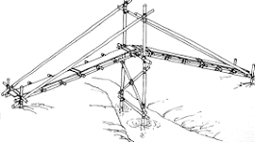
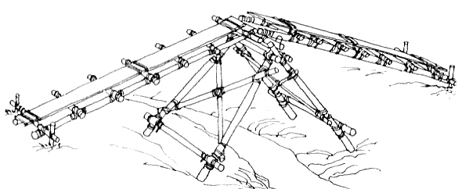
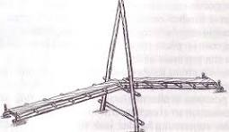
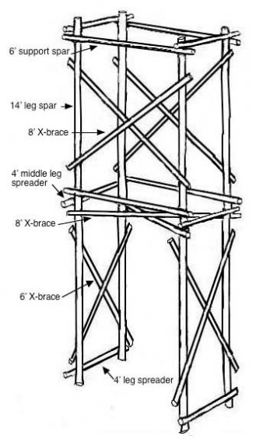
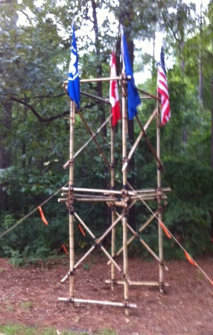
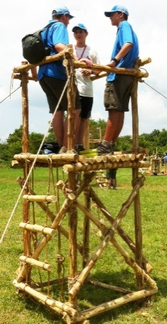
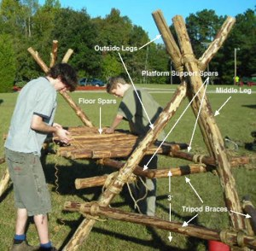
9. Working in a group, (or individually with the help of your counselor) build a full size pioneering structure, using one of the following designs in the Pioneering merit badge pamphlet:
Double A-Frame Monkey Bridge
Single A-Frame Bridge
Single Trestle Bridge
Single Lock Bridge
4x4 Square Climbing Tower
Four Flag Gateway Tower
Double Tripod Chippewa Kitchen
Another type of structure approved in advance by your counselor
Carefully plan the project, assembling and organizing all the materials, referring to the points under Safe Pioneering, and complying with the height restrictions in the Guide to Safe Scouting.
Single Trestle Bridge
Single A-Frame Bridge
Single Lock Bridge
https://scoutpioneering.com/2013/02/05/single-lock-bridge/
Double Tripod Chippewa Kitchen
Four Flag Gateway Tower
https://pioneeringmeritbadge.org/double-tripod-chippewa-kitchen-2/
4x4 Square Climbing Tower
https://pioneeringmeritbadge.org/4-x-4-square-tower/

