Slide 1

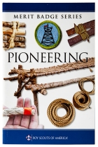
Pioneering Merit Badge
Merit Badge Counselor: Mr. Robert Bertrand
https://pioneeringmeritbadge.org/
https://pioneeringmeritbadge.org/new-proposed-requirements/

Slide 2
1. Do the following:
(a) Explain to your counselor the most likely hazards you might encounter while participating in pioneering activities and what you should do to anticipate, help prevent, mitigate, and respond to these hazards.
(b) Discuss the prevention of, and first-aid treatment for, injuries and conditions that could occur while working on pioneering projects, including rope splinters, rope burns, cuts, scratches, insect bites and stings, hypothermia, dehydration, heat exhaustion, heatstroke, sunburn, and falls.
2. Do the following:
(a) Demonstrate the West Country method of whipping a rope.
(b) Demonstrate how to tie a rope tackle and the following knots: clove hitch formed as two half hitches, clove hitch on a bight, butterfly knot, round turn with two half hitches, and rolling hitch.
(c) Demonstrate and explain when to use the following lashings: square, diagonal, round, shear, tripod, and floor lashing.
3. Do the following:
(a) Using square and tripod lashings from requirement 2(c), build a Tripod Wash Station (or with your counselor's permission, another camp gadget of your own design).
(b) Using rolling hitches or round turns with two half hitches, and round lashings from requirements 2(b) and 2(c), build a 15-foot Scout Stave Flagpole (or with your counselor's permission, another camp gadget of your own design)
(c) Using shear, square, and floor lashings, clove hitches on a bight, and rope tackles from requirements 2(b) and 2(c), build a Simple Camp Table (or with your counselor's permission, another camp gadget of your own design).
4. Explain the differences between synthetic ropes and natural-fiber ropes. Discuss which types of rope are suitable for pioneering work and why. Include the following in your discussion: breaking strength, safe working loads, and the care and storage of rope.
5. Explain the uses for the back splice, eye splice, and short splice. View a demonstration on forming each splice.
6. Using a rope-making device or machine, make a rope at least 6 feet long consisting of three strands, each having three yarns. Whip the ends.
7. Explain the importance of effectively anchoring a pioneering project. Describe to your counselor the 3-2-1 anchoring system and the log-and-stake anchoring system.
8. Describe the lashings that are used when building a trestle, how the poles are positioned, and how X braces contribute to the overall structural integrity of a pioneering project.
9. Working in a group, (or individually with the help of your counselor) build a full size pioneering structure, using one of the following designs in the Pioneering merit badge pamphlet: Double A-Frame Monkey Bridge
Single A-Frame Bridge
Single Trestle Bridge
Single Lock Bridge
4x4 Square Climbing Tower
Four Flag Gateway Tower
Double Tripod Chippewa Kitchen

Slide 3
1. Do the following:
(a) Explain to your counselor the most likely hazards you might encounter while participating in pioneering activities and what you should do to anticipate, help prevent, mitigate, and respond to these hazards.

Slide 4
Most Likely Hazards & What To Do
1. Falls
Anticipate: Working on structures, uneven ground, trip hazards (rope ends, tools).
Prevent: Only one person on bridges at a time; keep work areas clear; inspect structures before climbing; stay off ropes when adjusting.
Mitigate: Have spotters; use stable footing for structures; keep structures under 6 feet unless supervised.
Respond: Check for injuries (sprains, head injuries); apply first aid; call for help if serious; use basic first aid for scrapes.
2. Rope Issues (Splinters, Burns, Knots Failures)
Anticipate: Rough rope, friction from movement, incorrect knots.
Prevent: Wear gloves; inspect ropes for fraying; learn and practice proper knots (like clove hitch, square knot, taut-line hitch).
Mitigate: Have first-aid kit ready; stop if a knot slips.
Respond: Treat rope burns (cool water, bandage); remove splinters carefully; re-tie knots correctly.
3. Structural Failure
Anticipate: Weak lashings, improper pole selection, overloading, unfinished inspection.
Prevent: Get counselor approval; use correct lashings (frapping); ensure poles are sound; build to safe heights (under 6ft for basic).
Mitigate: "Heel in" legs for stability; use bracing; stop building if unsure.
Respond: Evacuate area; assess damage; provide first aid for injuries.
4. Environmental Factors
Anticipate: Sun, heat, cold, insects.
Prevent: Stay hydrated; wear hats/layers; use insect repellent; take breaks in shade.
Mitigate: Know signs of heat exhaustion/stroke, hypothermia, sunburn.
Respond: Move to cool/warm area; cool down/warm up; rehydrate; apply sunscreen/bug spray; treat bites.
5. Tool & Material Injuries (Cuts, Punctures)
Anticipate: Using mallets, knives, sharp pole ends.
Prevent: Use safety glasses; carry/handle tools safely; don't use dull tools; keep tools stored.
Mitigate: Have gloves and a well-stocked first-aid kit.
Respond: Clean and dress cuts/scratches; apply pressure to bleeding.
General Approach:
Anticipate: Conduct a risk assessment (what could go wrong?).
Prevent: Training, proper gear, safe procedures.
Mitigate: First Aid, clear zones, extra caution.
Respond: Emergency Plan, communication, immediate first aid
1. Do the following:
(a) Explain to your counselor the most likely hazards you might encounter while participating in pioneering activities and what you should do to anticipate, help prevent, mitigate, and respond to these hazards.

Slide 5
(b) Discuss the prevention of, and first-aid treatment for:
- injuries and conditions that could occur while working on pioneering projects, including rope splinters, rope burns, cuts, scratches, insect bites and stings, hypothermia, dehydration, heat exhaustion, heatstroke, sunburn, and falls.

Slide 6
1. (b) Discuss the prevention of, and first-aid treatment for, injuries and conditions that could occur while working on pioneering projects, including rope splinters, rope burns, cuts, scratches, insect bites and stings, hypothermia, dehydration, heat exhaustion, heatstroke, sunburn, and falls.
Pioneering projects require focus on prevention (gloves, water, shade, layers, tool safety) and prompt first aid (clean wounds, cool burns/heat illness, remove stingers/splinters, seek emergency care for severe heatstroke/shock) to handle common issues like rope splinters, burns, cuts, insect bites, heat/cold emergencies, and falls, emphasizing quick cooling for heatstroke and stabilizing fall victims.
Prevention & First Aid : Rope Splinters & Burns
Prevention: Wear thick gloves, inspect ropes for fraying, use proper knots to avoid rope sliding.
First Aid:
  Splinter: Wash area, use tweezers to pull out, apply antiseptic.
  Burn: Cool with running water (not ice), apply loose, sterile dressing; see doctor for blisters.
Cuts & Scratches
Prevention: Careful tool use, long sleeves/pants.
First Aid: Wash with soap & water, apply antiseptic/ointment (if no allergies), cover with bandage.
Insect Bites & Stings
Prevention: Repellent, seal food, avoid bright colors.
First Aid: Scrape stinger out (don't squeeze), wash area, cold compress; watch for severe reactions (breathing issues, swelling) and call emergency services.
Heat-Related Illnesses: Prevention: Drink water, take breaks, wear light clothing.
Dehydration: Cool down in shade, small sips of water.
Heat Exhaustion: Move to cool place, loosen clothes, cool cloths, water/sports drink; monitor for improvement.
Heatstroke (Emergency!): Call 911. Move to cool, douse with cold water (ice packs to neck, armpits, groin), remove clothes, fan; do NOT give fluids if unconscious.
Sunburn: Prevention: Sunscreen, hats, shade.
First Aid: Get out of sun, cool compresses, aloe vera, drink fluids.
Falls: Prevention: Secure lashings, no horseplay, good footing.
First Aid: Don't move if spine injury suspected; stabilize head/neck if needed, treat for shock (keep calm, warm), call 911.
General Safety: Always have a first-aid kit, know first aid basics, and never leave an injured person alone.

Slide 7
2. Do the following:
(a) Demonstrate the West Country method of whipping a rope: https://www.youtube.com/watch?v=Z8kH6EybMSw&t=9s
butterfly knot, https://www.youtube.com/watch?v=q0KPxnj3Rck
(b) Demonstrate how to tie a rope tackle and the following knots: https://scoutpioneering.com/videos/pioneering-knots/rope-tackle/
clove hitch formed as two half hitches, https://www.youtube.com/watch?v=LFH1L3lfciA
clove hitch on a bight, https://pioneeringmeritbadge.org/clove-hitch-on-a-bight/
butterfly knot, https://www.youtube.com/watch?v=q0KPxnj3Rck
round turn with two half hitches, https://scoutpioneering.com/videos/pioneering-knots/roundturn-with-two-half-hitches/
rolling hitch. https://www.youtube.com/watch?v=O0vGxZ5KQ-s
(c) Demonstrate and explain when to use the following lashings:
square, https://pioneeringmeritbadge.org/square-lashing/
diagonal, https://scoutpioneering.com/videos/lashing-videos/diagonal-lashing/
round, https://www.youtube.com/watch?v=tDGSiQhmwBs
shear, https://www.youtube.com/watch?v=iwZjTdw9il0
tripod, https://www.youtube.com/watch?v=DB1g69AaMy8
floor lashing. https://scoutpioneering.com/videos/lashing-videos/floor-lashing/
.

Slide 8
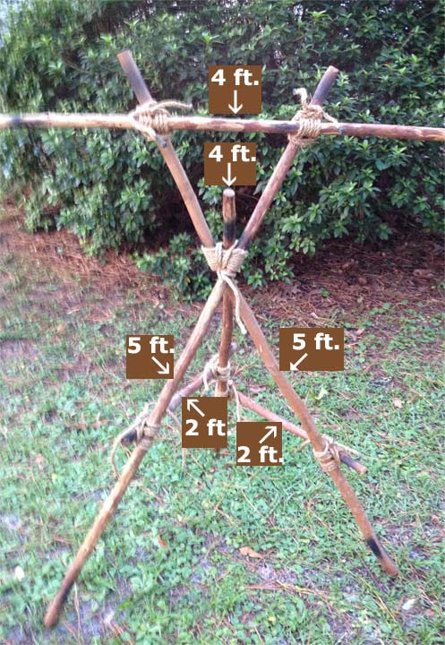
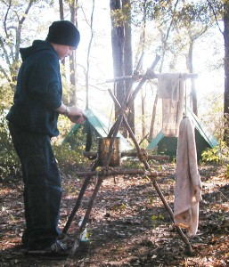
3. Do the following:
(a) Using square and tripod lashings from requirement 2(c), build a Tripod Wash Station https://pioneeringmeritbadge.org/hand-washing-station/

Slide 9
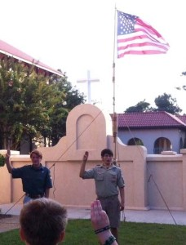
3. Do the following:
(b) Using rolling hitches or round turns with two half hitches, and round lashings from requirements 2(b) and 2(c), build a 15-foot Scout Stave Flagpole https://pioneeringmeritbadge.org/simple-flagpole/
Flags engender pride! Flying ‘em high is great for Scout spirit, and making a flagpole is really easy. For a simple 15-foot flagpole, here’s all you’ll need:
four 5-foot Scout Staves
six 6-foot lashing ropes
three 20-foot guy lines
three sturdy stakes
one small mallet
one flag with grommets and two short cords to tie it on

Slide 10
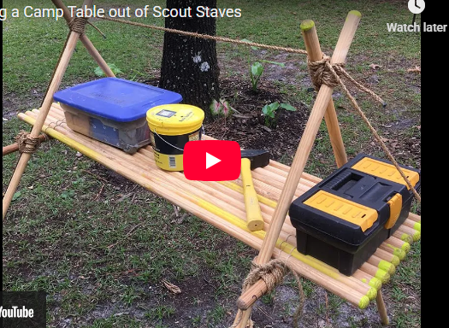
3. Do the following:
(c) Using shear, square, and floor lashings, clove hitches on a bight, and rope tackles from requirements 2(b) and 2(c), build a Simple Camp Table https://pioneeringmeritbadge.org/simple-camp-table/
Here’s a sample of the materials you can use:
four strong sticks about 6-feet long for the A-frame legs (5-foot Scout Saves can also be used)
two shorter sticks, about 2 to 3 feet long, to join the legs and support the platform
six 10-foot lashing ropes
one 20-foot lashing rope to secure the table
two sturdy stakes
one mallet
twelve 5-foot Scout Staves or similar poles for the platform
binder twine

Slide 11
4. Explain the differences between synthetic ropes and natural-fiber ropes.

Slide 12
4. Explain the differences between synthetic ropes and natural-fiber ropes.
Discuss which types of rope are suitable for pioneering work and why.
Include the following in your discussion: breaking strength, safe working loads, and the care and storage of rope.
https://pioneeringmeritbadge.org/rope/
The primary differences between natural-fiber and synthetic ropes lie in their composition, strength, durability, and resistance to environmental factors.
Synthetic ropes are generally stronger and more durable, while natural ropes offer superior grip, a classic look, and biodegradability.
Material Composition
Natural-fiber ropes are made from materials that are grown or harvested from plants, such as manila (abacá), sisal, jute, and cotton. These are natural polymers that can be consumed by microorganisms.
Synthetic ropes are man-made from chemical polymers through industrial processes. Common materials include nylon, polyester, and polypropylene. These materials are essentially plastic-based.
These guides compare synthetic ropes, known for their superior strength and weather resistance, with natural-fiber ropes, prized for their grip and eco-friendliness.
Manila Rope (Natural Fiber)
Why: It's the traditional standard for good reason: excellent grip, good strength-to-size, and low stretch, making it ideal for lashing, knots, and tackles where stability is key.
Polypropylene (Synthetic)
Why: Lightweight, strong (twice as strong as manila), and inexpensive, making it great for practice and heavy-strain applications like anchor strops, but its higher stretch needs to be accounted for.
Sisal (Natural Fiber)
Why: A good, affordable option for general pioneering and practice, but be aware it tightens when wet and loosens when dry, affecting structure integrity.
What to Look For
Low Stretch (for Stability): Crucial for structures and rope tackles to prevent sagging and failure, favoring Manila.
Good Grip & Handling: Essential for tying secure knots and tight lashings.
Strength-to-Size Ratio: Provides sufficient load-bearing capacity without being overly bulky.
Key Considerations
Knots & Lashings: Manila excels in both; polypropylene is good but slippery (needs extra tucks).
Heavy Strain (e.g., Anchor Strops): Polyprpylene's strength shines, but its stretch must be managed.
Practice: Polypropylene offers an inexpensive, colorful way to practice knots.
Preparation: All rope ends should be whipped (tied off) to prevent fraying; plastic ropes need melting first.

Slide 13
4. (continued) Include the following in your discussion:
rope breaking strength,
safe working loads, and the
care and storage of rope

Slide 14
4. (continued) Include the following in your discussion: rope breaking strength, safe working loads, and the care and storage of rope
Understanding rope is crucial:
Breaking Strength is the point of failure (use manufacturer data!), while
Safe Working Load (SWL) is much lower (around 10-20% of breaking strength) to prevent sudden snaps;
Care involves avoiding sun/moisture, keeping ropes clean, and whipping ends;
Storage means coiling properly, keeping dry, and checking often to ensure safe, reliable structures. Manila is great for lashings, while synthetic ropes (like polypropylene) offer high strength but stretch, requiring consideration for heavy loads.
Breaking Strength & Safe Working Load (SWL)
  Breaking Strength (BS): The maximum load a new, perfect rope can withstand before it breaks. Always check manufacturer specs, as it varies by rope type, diameter, and quality.
  Safe Working Load (SWL): The maximum load the rope should ever carry in a real project, typically 10-20% of the breaking strength.
  Key Concept: Never use a rope near its breaking strength. Knots can reduce rope strength by 20-50% (e.g., overhand knot reduces strength by 50%).
  Rope Types for Pioneering
  Manila: Traditional, good for lashing due to its grip and low stretch (natural fiber).
  Polypropylene: Stronger than manila, lightweight, floats, but stretches significantly under load (use for anchor strops, heavy strain).
  Nylon: Very strong and elastic (stretches), good for shock absorption but not ideal for static structural work.
  Care & Storage
  Inspection: Before and after use, check for fraying, cuts, chemical spots, and discoloration (especially from sunlight for synthetics).
  Cleaning: Brush off dirt; wash gently with mild soap and water if necessary, then dry thoroughly.
  Whipping/Fusing: End of all ropes should be whipped (bound with twine) or fused (melted for synthetics) to prevent unraveling.
  Storage: Coil ropes neatly (don't leave knots in them!), keep in a dry, well-ventilated area, away from chemicals and direct sunlight.
  Handling: Wear gloves to prevent rope burns/splinters, use both hands, and don't work in wet conditions.
  By understanding these principles, Scouts ensure their pioneering projects are strong, safe, and last longer, a core skill for the badge.

Slide 15
5. Explain the uses for the back splice, eye splice, and short splice. View a demonstration on forming each splice.
Back splices
Eye splices
Short Spice

Slide 16
5. Explain the uses for the back splice, eye splice, and short splice. View a demonstration on forming each splice.
Rope splices create strong, permanent rope ends: an
Eye Splice forms a secure loop (like for attaching to an eyebolt), a
Back Splice finishes the end to prevent fraying (instead of whipping), and a
Short Splice joins two ropes of similar size for a continuous length, often to repair a bad section. Splicing is superior to knots as it retains much more of the rope's original strength.
https://troopleader.scouting.org/rank-advancement-skills/pioneering/splices/
You can view demonstrations via video links from scout pioneering scout pioneering and scout pioneering scout pioneering for eye and back splices, and YouTube for a splicing https://www.youtube.com/watch?v=76xdhCx88yo
6. Using a rope-making device or machine, make a rope at least 6 feet long consisting of three strands, each having three yarns. Whip the ends.

Slide 17
7a. Explain the importance of effectively anchoring a pioneering project.

Slide 18
7a. Explain the importance of effectively anchoring a pioneering project.
7b. Describe to your counselor the 3-2-1 anchoring system.
.
Effective anchoring is crucial for pioneering projects because it ensures the safety, stability, and integrity of the structure.
Without secure anchoring, external forces like wind, the weight of the structure itself (dead load), or people using the project could cause it to shift, collapse, or become unsafe, leading to accidents or property damage.
Anchors transfer the load from the structure safely into the ground, providing a stable base when natural anchors (like trees or large rocks) are not available in the right location

Slide 19
7b. Describe to your counselor the 3-2-1 anchoring system.
.
The 3-2-1 Anchoring System
The 3-2-1 anchor is a strong and relatively simple system made of a series of pioneering stakes driven into the ground. This system is used when a strong holding point is needed for guy lines or other support ropes.
Construction steps:
Three stakes: Drive three pioneering stakes (typically 2.5 inches in diameter and 24 to 30 inches long) into the ground at a 20° angle, leaning away from the direction of the strain.
Two stakes: Drive two more stakes into the ground about 24 inches (2 feet) behind the first set, also at a 20° angle.
One stake: Drive a single stake into the ground about 12 inches (1 foot) behind the two-stake set, maintaining the same angle.
Connect and tighten: Use rope or binder twine to connect the top of the three-stake set to the bottom of the two-stake set. A small stick is then used as a tourniquet to twist the rope tightly, and the stick is secured against the ground to prevent unwinding.
Final connection: Repeat the process between the two-stake set and the single stake to hold the entire configuration tightly in place.
The main guy line from the pioneering project is attached as low to the ground as possible on the single, rearmost stake.
7c. Describe log-and-stake anchoring system.

Slide 20
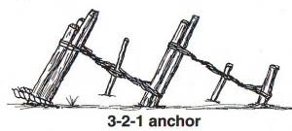
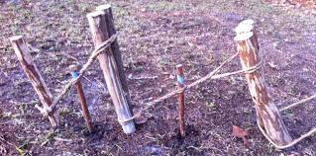

Slide 21

7c. Describe log-and-stake anchoring system.
.
The Log-and-Stake Anchoring System
The log-and-stake anchor is another method that provides considerable holding power, often used when the ground is softer or a heavier strain is anticipated.
Construction steps:
Place the log: A log (4 to 6 inches in diameter) is placed in a shallow trench, perpendicular to the direction of the pull of the guyline.
Front stakes: Drive four large stakes into the ground immediately in front of the log to prevent it from rolling forward.
Rear stakes: Drive a second row of stakes about 24 inches (2 feet) behind the front stakes.
Connect and tighten: The front stakes are anchored to the rear stakes with a tourniquet made of rope or binder twine, similar to the 3-2-1 system, to create a secure, buried anchor point.
Attach the line: The main guyline is then tied directly to the log or attached using a rope grommet around the log

Slide 22
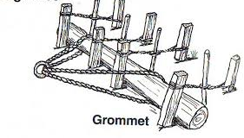
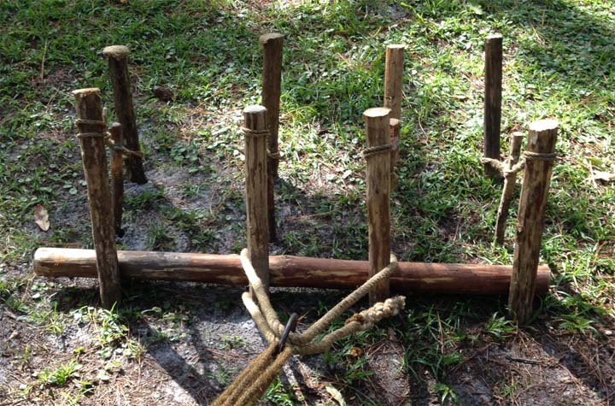

Slide 23
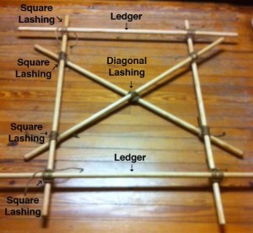
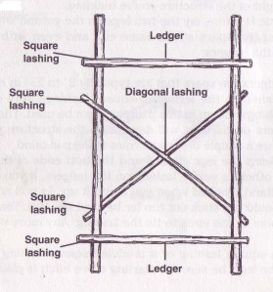
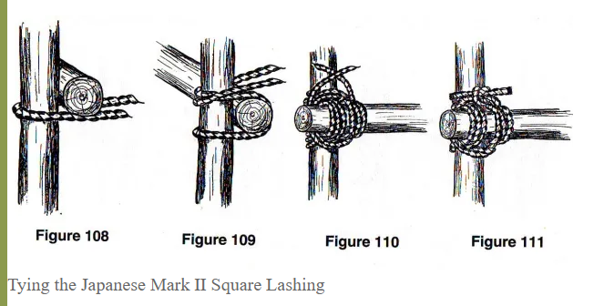
8. Describe the lashings that are used when building a trestle, how the poles are positioned, and how X braces contribute to the overall structural integrity of a pioneering project

Slide 24
8. Describe the lashings that are used when building a trestle, how the poles are positioned, and how X braces contribute to the overall structural integrity of a pioneering project
In a boy scout pioneering project, a trestle is a fundamental structural component that uses square lashings and diagonal lashings.
The X-braces, formed by diagonal spars, create triangular structures that provide crucial stability and prevent the trestle from swaying or twisting….
Lashings Used…..

Slide 25
8. Describe the lashings that are used when building a trestle, how the poles are positioned, and how X braces contribute to the overall structural integrity of a pioneering project
In a boy scout pioneering project, a trestle is a fundamental structural component that uses square lashings and diagonal lashings. The X-braces, formed by diagonal spars, create triangular structures that provide crucial stability and prevent the trestle from swaying or twisting….
Lashings Used
Square Lashings: These are used to join the two ledgers (horizontal spars) to the two legs (vertical spars) at a 90-degree angle. A total of four square lashings are typically used for each trestle. The starting clove hitch for the lashing is often tied on the leg just below where the ledger will rest, which helps support the ledger's weight.
Diagonal Lashing: This is used to "spring" the two cross braces together where they intersect in the middle, as they are intentionally positioned slightly apart when their ends are lashed to the legs. The lashing begins with a timber hitch, includes three wraps in each direction diagonally across the "X", two frapping turns, and is finished with a clove hitch. The primary purpose is to pull the crossed spars tightly together, adding significant rigidity to the structure
Pole Positioning

Slide 26
8. Describe the lashings that are used when building a trestle, how the poles are positioned, and how X braces contribute to the overall structural integrity of a pioneering project
In a boy scout pioneering project, a trestle is a fundamental structural component that uses square lashings and diagonal lashings. The X-braces, formed by diagonal spars, create triangular structures that provide crucial stability and prevent the trestle from swaying or twisting….
Lashings Used
Square Lashings: These are used to join the two ledgers (horizontal spars) to the two legs (vertical spars) at a 90-degree angle. A total of four square lashings are typically used for each trestle. The starting clove hitch for the lashing is often tied on the leg just below where the ledger will rest, which helps support the ledger's weight.
Diagonal Lashing: This is used to "spring" the two cross braces together where they intersect in the middle, as they are intentionally positioned slightly apart when their ends are lashed to the legs. The lashing begins with a timber hitch, includes three wraps in each direction diagonally across the "X", two frapping turns, and is finished with a clove hitch. The primary purpose is to pull the crossed spars tightly together, adding significant rigidity to the structure
Pole Positioning
Legs and Ledgers: Two long spars for the legs are laid on the ground parallel to each other. Shorter spars, called ledgers, are placed horizontally across the legs (at the top and bottom) and secured with square lashings.
Cross Braces (X-braces): The frame is then flipped over. One cross brace is lashed to the back side of both legs. The second cross brace is added so one end is on the same side as the first (the back), but its other end is on the opposite side (the front, with the ledgers). This intentional positioning ensures a gap where the two braces cross in the center, which allows the diagonal lashing to effectively pull them together and add tension.
Finalizing the Trestle: The structure is then stood upright, adjusted so the legs are parallel and the top ledger is level with the ground. The diagonal lashing is then applied at the center intersection to pull the cross braces together
Contribution of X-Braces to Structural Integrity

Slide 27
8. Describe the lashings that are used when building a trestle, how the poles are positioned, and how X braces contribute to the overall structural integrity of a pioneering project
In a boy scout pioneering project, a trestle is a fundamental structural component that uses square lashings and diagonal lashings. The X-braces, formed by diagonal spars, create triangular structures that provide crucial stability and prevent the trestle from swaying or twisting….
Lashings Used
Square Lashings: These are used to join the two ledgers (horizontal spars) to the two legs (vertical spars) at a 90-degree angle. A total of four square lashings are typically used for each trestle. The starting clove hitch for the lashing is often tied on the leg just below where the ledger will rest, which helps support the ledger's weight.
Diagonal Lashing: This is used to "spring" the two cross braces together where they intersect in the middle, as they are intentionally positioned slightly apart when their ends are lashed to the legs. The lashing begins with a timber hitch, includes three wraps in each direction diagonally across the "X", two frapping turns, and is finished with a clove hitch. The primary purpose is to pull the crossed spars tightly together, adding significant rigidity to the structure
Pole Positioning
Legs and Ledgers: Two long spars for the legs are laid on the ground parallel to each other. Shorter spars, called ledgers, are placed horizontally across the legs (at the top and bottom) and secured with square lashings.
Cross Braces (X-braces): The frame is then flipped over. One cross brace is lashed to the back side of both legs. The second cross brace is added so one end is on the same side as the first (the back), but its other end is on the opposite side (the front, with the ledgers). This intentional positioning ensures a gap where the two braces cross in the center, which allows the diagonal lashing to effectively pull them together and add tension.
Finalizing the Trestle: The structure is then stood upright, adjusted so the legs are parallel and the top ledger is level with the ground. The diagonal lashing is then applied at the center intersection to pull the cross braces together
Contribution of X-Braces to Structural Integrity
The X-braces are a critical engineering element in pioneering and general construction:
Forming Triangles: When installed and diagonally lashed, the X-braces divide the rectangular frame into four stable triangles. Triangles are inherently rigid shapes in engineering, as their angles are fixed, preventing the structure from deforming under pressure.
Resisting Lateral Forces (Racking): The main function of the X-bracing is to resist racking, which is the side-to-side or twisting motion caused by lateral forces like wind, current (if in water), or general movement.
Distributing Stress: The braces help distribute forces evenly throughout the frame, preventing stress from concentrating on single points or lashings.
Adding Rigidity and Stability: The combination of square-lashed ledgers and diagonally-lashed X-braces makes the trestle a very strong and stable unit capable of supporting heavy downward loads without collapsing or losing its shape.

Slide 28
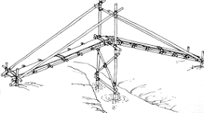
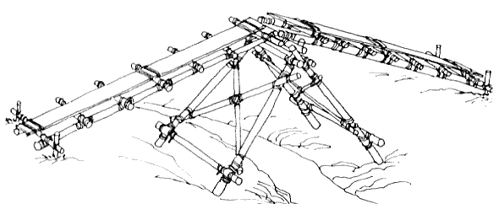
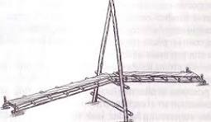
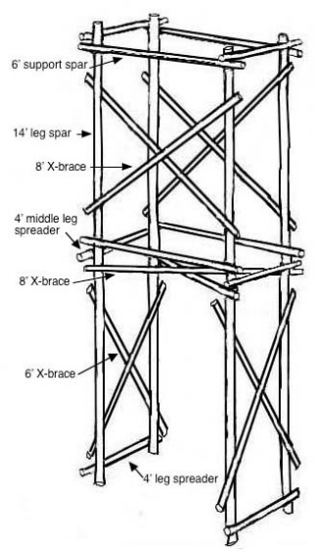
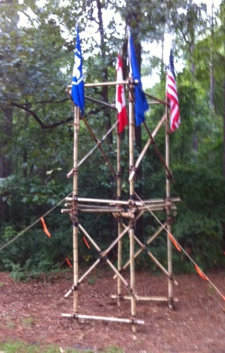
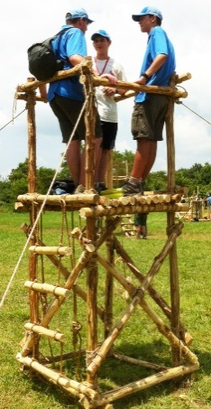
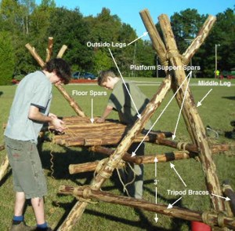
9. Working in a group, (or individually with the help of your counselor) build a full size pioneering structure, using one of the following designs in the Pioneering merit badge pamphlet:
Double A-Frame Monkey Bridge
Single A-Frame Bridge
Single Trestle Bridge
Single Lock Bridge
4x4 Square Climbing Tower
Four Flag Gateway Tower
Double Tripod Chippewa Kitchen
Another type of structure approved in advance by your counselor
Carefully plan the project, assembling and organizing all the materials, referring to the points under Safe Pioneering, and complying with the height restrictions in the Guide to Safe Scouting.
Single Trestle Bridge
Single A-Frame Bridge
Single Lock Bridge
https://scoutpioneering.com/2013/02/05/single-lock-bridge/
Double Tripod Chippewa Kitchen
Four Flag Gateway Tower
https://pioneeringmeritbadge.org/double-tripod-chippewa-kitchen-2/
4x4 Square Climbing Tower
https://pioneeringmeritbadge.org/4-x-4-square-tower/

Slide 29
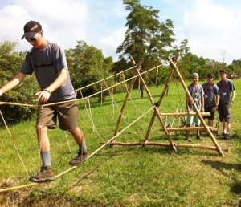
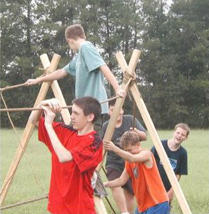
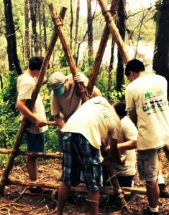
9. Working in a group, (or individually with the help of your counselor) build a full size pioneering structure, using one of the following designs in the Pioneering merit badge pamphlet:
Double A-Frame Monkey Bridge

Slide 30
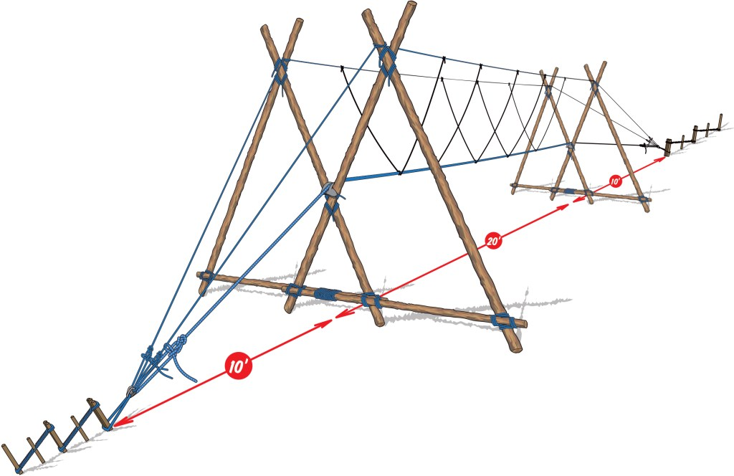
https://scoutpioneering.com/2019/12/24/double-a-frame-monkey-bridge-as-presented-in-scouting-magazine/

