Slide 1

Swimming Merit Badge
Merit Badge Counselor: Mr. Robert Bertrand

Slide 2
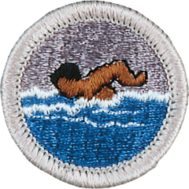
1. Do the following:
(a) Review with your counselor how Scouting America's Safe Swim Defense guidelines anticipates and deals with common drowning situations such as unfenced residential pools, non-swimmers entering deep water, risky behaviors, medical impairment in the water, drop-offs, cold water, murky water, river currents, rip currents, and surf.
(b) Discuss the prevention and treatment of health concerns that could occur while swimming, including hypothermia, dehydration, sunburn, heat exhaustion, heatstroke, muscle cramps, hyperventilation, spinal injury, stings and bites, and cuts and scrapes.
2. Before doing the following requirements, successfully complete the Scouting America swimmer test, found in the Swimming merit badge pamphlet.
3. Correctly perform the following strokes:
(a) Demonstrate the front crawl or the trudgen using good form.
(b) Demonstrate the back crawl using good form.
(c) Demonstrate the sidestroke using good form.
(d) Demonstrate the breaststroke using good form.
(e) Demonstrate the elementary backstroke using good form.
4. Swim continuously for 150 yards in a strong manner using each of the following strokes in any order; front crawl or trudgen (25 yards); back crawl (25 yards); sidestroke (25 yards); breaststroke (25 yards); and elementary backstroke (50 yards).
5. Do the following:
(a) Demonstrate water rescue methods by reaching with your arm or leg, by reaching with a suitable object, and by throwing lines and objects. Explain why swimming rescues should not be attempted when a reaching or throwing rescue is possible, and explain why and how a rescue swimmer should avoid contact with the victim.
(b) With a helper and a practice victim, show a line rescue both as tender and as rescuer. The practice victim should be approximately 30 feet from shore in deep water.
6. Do the following:
(a) Float face-up in a resting position for at least three minutes with minimal movement.
(b) Demonstrate survival floating for at least five minutes.
(c) While wearing a properly fitted U.S. Coast Guard-approved life jacket, demonstrate the HELP and huddle positions. Explain their purposes.
(d) Explain why swimming or survival floating will hasten the onset of hypothermia in cold water.
7. In water over your head, but not to exceed 10 feet, do the following:
(a) Use the feet first method of surface diving and bring an object up from the bottom.
(b) Do a headfirst surface dive (pike or tuck), and bring the object up again.
(c) Do a headfirst surface dive to a depth of at least 5 feet and swim underwater for three strokes. Come to the surface, take a breath, and repeat the sequence twice.
8. Following the guidelines set in the Scouting America Safe Swim Defense guidelines, in water at least 7 feet deep, show a standing headfirst dive from a dock or pool deck. Show a long shallow dive, also from the dock or pool deck.
9. Explain the health benefits of regular aerobic exercise, and discuss why swimming is favored as both fitness and therapeutic exercise

Slide 3
1. Do the following:
(a) Review with your counselor how Scouting America's Safe Swim Defense guidelines anticipates and deals with common drowning situations such as: unfenced residential pools, non-swimmers entering deep water, risky behaviors, medical impairment in the water, drop-offs, cold water, murky water, river currents, rip currents, and surf.
(b) Discuss the prevention and treatment of health concerns that could occur while swimming, including hypothermia, dehydration, sunburn, heat exhaustion, heatstroke, muscle cramps, hyperventilation, spinal injury, stings and bites, and cuts and scrapes.

Slide 4
2. Before doing the following requirements, successfully complete the Scouting America swimmer test, found in the Swimming merit badge pamphlet.
Detailed Requirements of the Swimmer Test:
Jump: Enter water over your head, feet first.
Swim Strong: Level off and swim 75 yards using one or more of these strokes:
  Sidestroke
  Breaststroke
  Trudgen
  Crawl (Front Crawl)
Swim Easy: Swim 25 yards using an easy, resting backstroke.
Continuous Swim: Complete the entire 100 yards (75 strong + 25 backstroke) in one continuous swim, including at least one sharp turn.
Rest: After the swim, rest by floating.
Purpose & Context:
Safety: The test ensures Scouts have basic competency to enjoy water activities safely, governed by Scouting America's Safe Swim Defense principles.
Classification: It helps classify swimmers as Learners, Swimmers, or Strong Swimmers for appropriate supervision.
Prerequisite: Passing this test is often a prerequisite for earning the Swimming Merit Badge and participating in other aquatic adventures.
You can find the official details and related requirements in the Swimming Merit Badge Pamphlet or on the official Scouting America website.

Slide 5
3. Correctly perform the following strokes:
(a) Demonstrate the front crawl or the trudgen using good form.
(b) Demonstrate the back crawl using good form.
(c) Demonstrate the sidestroke using good form.
(d) Demonstrate the breaststroke using good form.
(e) Demonstrate the elementary backstroke using good form.

Slide 6
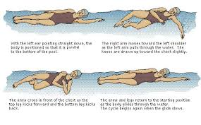
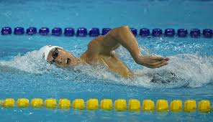
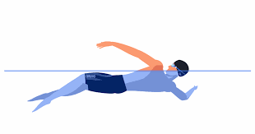
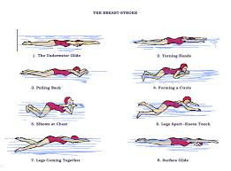
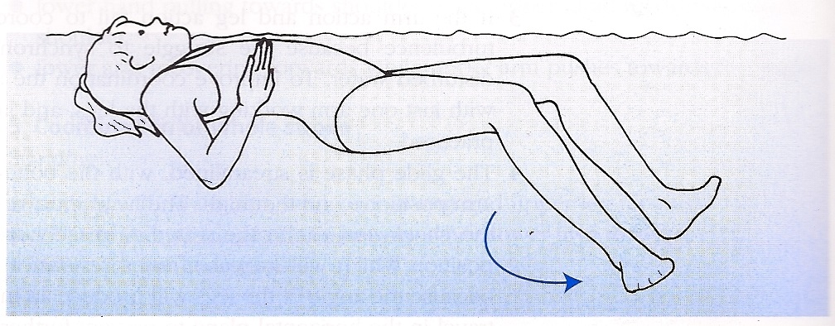
4. Swim continuously for 150 yards in a strong manner using each of the following strokes in any order;
  front crawl or trudgen (25 yards);
  back crawl(25 yards);
  sidestroke (25 yards);
  breaststroke (25 yards); and
  elementary backstroke (50 yards).
back crawl
front crawl
sidestroke
breaststroke
elementary backstroke

Slide 7
5. Do the following:
(a) Demonstrate water rescue methods by reaching with your arm or leg, by:
reaching with a suitable object, and
by throwing lines and objects.
Explain why swimming rescues should not be attempted when a reaching or throwing rescue is possible, and
explain why and how a rescue swimmer should avoid contact with the victim.
(b) With a helper and a practice victim, show a line rescue both as tender and as rescuer. The practice victim should be approximately 30 feet from shore in deep water.

Slide 8
6. Do the following:
(a) Float face-up in a resting position for at least three minutes with minimal movement.
(b) Demonstrate survival floating for at least five minutes.
(c) While wearing a properly fitted U.S. Coast Guard-approved life jacket, demonstrate the HELP and huddle positions. Explain their purposes.
(d) Explain why swimming or survival floating will hasten the onset of hypothermia in cold water.

Slide 9
7. In water over your head, but not to exceed 10 feet, do the following:
(a) Use the feet first method of surface diving and bring an object up from the bottom.
(b) Do a headfirst surface dive (pike or tuck), and bring the object up again.
(c) Do a headfirst surface dive to a depth of at least 5 feet and swim underwater for three strokes. Come to the surface, take a breath, and repeat the sequence twice.

Slide 10
8. Following the guidelines set in the Scouting America Safe Swim Defense guidelines, in water at least 7 feet deep:
(1) show a standing headfirst dive from a dock or pool deck.
(2) Show a long shallow dive, also from the dock or pool deck.

Slide 11
9. Explain the health benefits of regular aerobic exercise, and discuss why swimming is favored as both fitness and therapeutic exercise

Slide 12
End of Swim Testing

Slide 13
1. Do the following:
(a) Review with your counselor how Scouting America's Safe Swim Defense guidelines anticipates and deals with common drowning situations such as: unfenced residential pools, non-swimmers entering deep water, risky behaviors, medical impairment in the water, drop-offs, cold water, murky water, river currents, rip currents, and surf.
Scouting America's Safe Swim Defense guidelines anticipate and mitigate common drowning situations by implementing eight key points. These guidelines apply to any swimming activity, including at residential pools, lakes, rivers, and oceans.
Here is how the guidelines address the specific situations:
General Principles
The core principles that apply across all situations are:
Qualified Supervision: All activities require a trained, conscientious adult supervisor (age 21+) committed to the Safe Swim Defense points.
Buddy System: Every participant is paired with a buddy, and buddies must stay together, monitor each other, and alert safety personnel if assistance is needed.
Ability Groups: All participants are classified as swimmers, beginners, or nonswimmers by a standardized test, and swimming areas are marked accordingly.
Safe Area: The swimming area is inspected and made safe for the activity.
Response Personnel: A trained rescue team is on alert and ready to respond to emergencies.
Lookout: A designated lookout continuously monitors the swim, identifies risks, and monitors environmental conditions.
Personal Health Review: Health histories are reviewed to identify any restrictions.
Discipline: All participants understand and follow the established rules and procedures.
Specific Situations
Unfenced residential pools: Safe Swim Defense guidelines apply to all pools, including backyard, hotel, and apartment pools. While local ordinances may require fencing (typically at least 4 feet high with self-latching gates), the Scouting program relies on the eight points (especially qualified supervision and the buddy system) in any approved activity.
Non-swimmers entering deep water: Participants are classified by a swim test. Non-swimmer areas are defined by buoy lines and contain water of standing depth (not more than 3.5 feet deep), preventing access to deep water.
Risky behaviors: The "Discipline" point emphasizes that rules are effective only when followed. Specific risky behaviors, like breath-holding contests, are explicitly prohibited because they can lead to loss of consciousness and drowning.
Medical impairment in the water: The "Personal Health Review" identifies potential health issues beforehand. The buddy system ensures that a sudden medical event (like a seizure or heart issue) is noticed immediately by the buddy, who alerts the safety team.
Drop-offs: Abrupt changes in depth (drop-offs) are not allowed in the non-swimmer area. The "Safe Area" point requires careful inspection of the bottom conditions, with underwater hazards marked with floats.
Cold water: The guidelines for "Personal Health Review" cover conditions like hypothermia. In cold water situations, survival floating techniques or specific positions like HELP (Heat Escape Lessening Position) and the huddle position are taught, and participants learn why swimming will hasten the onset of hypothermia. Swimming in extremely cold water may also require life jackets and different supervision procedures.
Murky water: Underwater swimming and diving are prohibited in turbid (murky) water. Maximum water depth in murky water is limited to 8 feet to ensure visibility for supervisors and rescue personnel. Only surface swimming is permitted in turbid water.
River currents: For activities in flowing water, "Safety Afloat" guidelines are typically used in conjunction with Safe Swim Defense. This might require all participants to wear properly fitted, U.S. Coast Guard-approved life jackets. Swimming is not allowed during high flow or flood conditions. Winds and currents are considered during planning and rescue operations.
Rip currents: The "Safe Area" point involves checking for environmental conditions like rip currents, which are part of planning and assessing risk. Safety personnel are trained to recognize and respond to these hazards, and the lookout monitors for changing conditions.

Slide 14
1. Do the following:
b) Discuss the prevention and treatment of health concerns that could occur while swimming, including hypothermia, dehydration, sunburn, heat exhaustion, heatstroke, muscle cramps, hyperventilation, spinal injury, stings and bites, and cuts and scrapes.
Swimming safety involves preventing heat/cold issues (hydration, shade, layers), sun exposure (sunscreen, hats), muscle problems (stretching, electrolytes), and emergencies (never diving shallow, safe entry, buddy system), with treatments like cooling for heat, rehydrating for cramps, warmth for hypothermia, and immediate medical help for severe cases like spinal injury or stroke, always prioritizing safety with proper training and awareness.
Heat-Related Illnesses (Dehydration, Exhaustion, Stroke)
Prevention: Drink water and electrolytes (sports drinks) before, during, and after swimming; avoid peak sun (10 am-4 pm).
Treatment: Move to cool shade, loosen clothes, apply cool wet cloths, fan, give cool fluids (if conscious), call 911 for heatstroke (hot skin, loss of consciousness).
Sunburn
Prevention: Use SPF 15+ waterproof sunscreen, reapply every 2 hours, wear hats/sunglasses, seek shade.
Treatment: Cool baths, aloe vera, moisturizers, pain relievers, avoid further sun.
Hypothermia
Prevention: Wear wetsuits in cold water, take breaks, stay dry, avoid long exposure.
Treatment: Move to warmth, remove wet clothes, wrap in dry blankets, give warm (not hot) fluids.
Muscle Cramps
Prevention: Stay hydrated with electrolytes, warm-up/stretch before swimming.
Treatment: Stop activity, gently stretch/massage muscle, rehydrate with water/electrolytes.
Hyperventilation
Prevention: Don't force deep breaths before diving; control breathing.
Treatment: Slow down breathing, focus on exhaling, get to safety (surface).
Spinal Injury
Prevention: Never dive into shallow water or unfamiliar water; enter feet first.
Treatment: Call 911 immediately. Keep victim still, support head/neck; do not move unless necessary for rescue.
Stings & Bites
Prevention: Use insect repellent, avoid known sting areas (wasps, jellyfish); wear protective clothing.
Treatment: Remove stinger (scrape, don't squeeze), clean area, apply cold pack; carry epinephrine if allergic.
Cuts & Scrapes
Prevention: Watch for sharp objects in pools/beaches; wear water shoes.
Treatment: Clean with soap/water, apply antibiotic ointment, cover with waterproof bandage.
General Safety
Swim with a buddy, know your limits, and learn basic water rescue

Slide 15
2. Before doing the following requirements, successfully complete the Scouting America swimmer test, found in the Swimming merit badge pamphlet.
Detailed Requirements of the Swimmer Test:
Jump: Enter water over your head, feet first.
Swim Strong: Level off and swim 75 yards using one or more of these strokes:
  Sidestroke
  Breaststroke
  Trudgen
  Crawl (Front Crawl)
Swim Easy: Swim 25 yards using an easy, resting backstroke.
Continuous Swim: Complete the entire 100 yards (75 strong + 25 backstroke) in one continuous swim, including at least one sharp turn.
Rest: After the swim, rest by floating.
Purpose & Context:
Safety: The test ensures Scouts have basic competency to enjoy water activities safely, governed by Scouting America's Safe Swim Defense principles.
Classification: It helps classify swimmers as Learners, Swimmers, or Strong Swimmers for appropriate supervision.
Prerequisite: Passing this test is often a prerequisite for earning the Swimming Merit Badge and participating in other aquatic adventures.
You can find the official details and related requirements in the Swimming Merit Badge Pamphlet or on the official Scouting America website.

Slide 16
3. Correctly perform the following strokes:
(a) Demonstrate the front crawl or the trudgen using good form.
(b) Demonstrate the back crawl using good form.
(c) Demonstrate the sidestroke using good form.
(d) Demonstrate the breaststroke using good form.
(e) Demonstrate the elementary backstroke using good form.
(a) Front Crawl or Trudgen
Front Crawl
  Body Position: Maintain a horizontal, streamlined position, looking down and slightly forward, with the head in neutral alignment with the spine.
  Arm Movement: Use alternating overarm strokes. The hand enters the water pinky-first in front of the shoulder, extends fully, and pulls the water back past the hip with a high elbow catch.
  Leg Movement: Use a continuous, short, and fast flutter kick, originating from the hips with relaxed ankles and pointed toes.
  Breathing: Roll the head to the side during the arm recovery phase, taking a quick breath into the small air pocket created by forward momentum, with one goggle in and one out of the water.
(b) Back Crawl
Body Position: Lie on your back, flat on the water's surface, with ears in the water and eyes looking up. Your head should be still and aligned with your spine.
Arm Movement: Arms move in alternation. Lead with the thumb as the arm exits the water, lifting it straight up. The little finger enters the water first behind the shoulder line, then the arm pulls through the water toward the thigh.
Leg Movement: Use a continuous, short, and fast flutter kick, driven from the hips.
(c) Sidestroke
Body Position: Lie on one side, keeping the body flat and streamlined. The bottom arm is extended forward, the top arm rests near the hip or chest.
Arm Movement: The bottom (lead) arm pulls down and back in a sweeping motion, while the top (trailing) arm slides forward from the hip to meet the lead hand near the chest before both extend in a glide.
Leg Movement: Use a smooth scissor kick. The top leg moves forward and the bottom leg moves backward, then they snap together forcefully for propulsion and glide.
(d) Breaststroke
Specific search results were not available for detailed breaststroke form, so general knowledge is used.
Body Position: The body is generally prone and streamlined. The head is typically lifted for a breath on each stroke cycle, causing hips to dip slightly.
Arm Movement: Both arms pull simultaneously from an extended position in front of the head in an outward, downward, and backward sweep (the "pull") before recovering back to the chest and extending forward.
Leg Movement: Use a coordinated frog kick (or whip kick). The legs bend at the knees, the feet turn outward, and the legs sweep backward and together to generate propulsion.
(e) Elementary Backstroke
Body Position: Lie on your back, flat on the surface of the water, with your head and spine in neutral alignment.
Arm Movement: The arms move in unison: Start with arms at the sides, slide hands up along the body to the armpits, extend arms out to the sides (forming a 'T' shape), and then sweep them down to the sides in a large circle back to the starting position.
Leg Movement: A reverse breaststroke kick is used simultaneously with the arm sweep. Legs are drawn up, then kicked outward and snapped together.
Coordination: The arms recover as the legs prepare to kick (knees bent), and the arms perform the powerful sweep as the legs snap together, followed by a glide

Slide 17
4. Swim continuously for 150 yards in a strong manner using each of the following strokes in any order;
  front crawl or trudgen (25 yards);
  back crawl(25 yards);
  sidestroke (25 yards);
  breaststroke (25 yards); and
  elementary backstroke (50 yards).
back crawl
front crawl
sidestroke
breaststroke
elementary backstroke

Slide 18
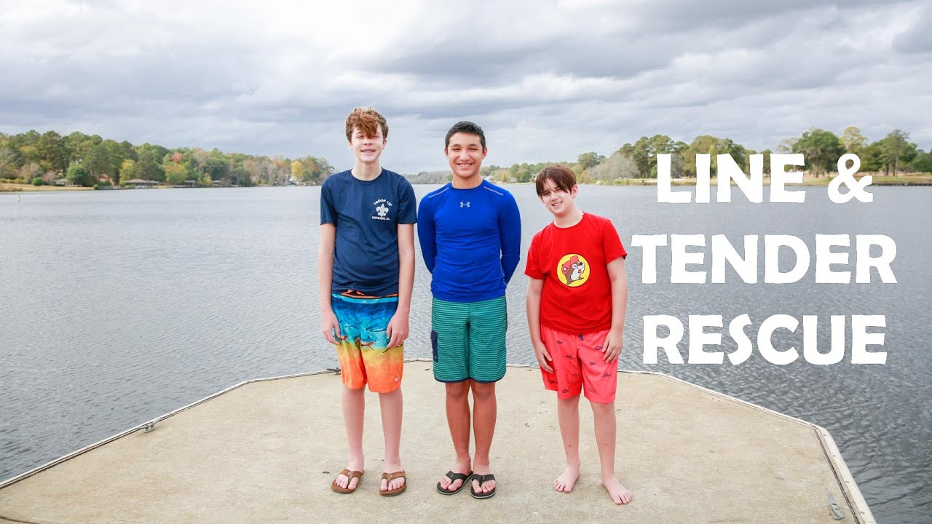
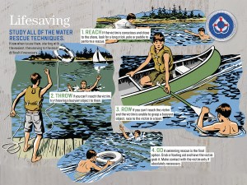
5. Do the following:
(a) Demonstrate water rescue methods by:
  reaching with your arm or leg,
  by reaching with a suitable object, and
  by throwing lines and objects.
  Explain why swimming rescues should not be attempted when a reaching or throwing rescue is possible, and explain why and how a rescue swimmer should avoid contact with the victim.
(b) With a helper and a practice victim, show a line rescue both as tender and as rescuer. The practice victim should be approximately 30 feet from shore in deep water.

Slide 19
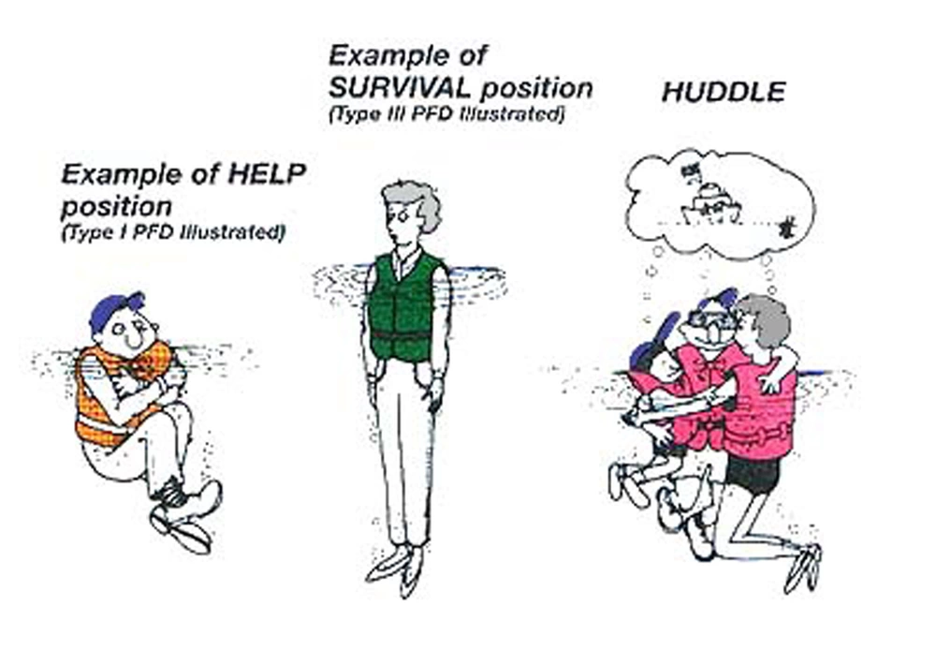
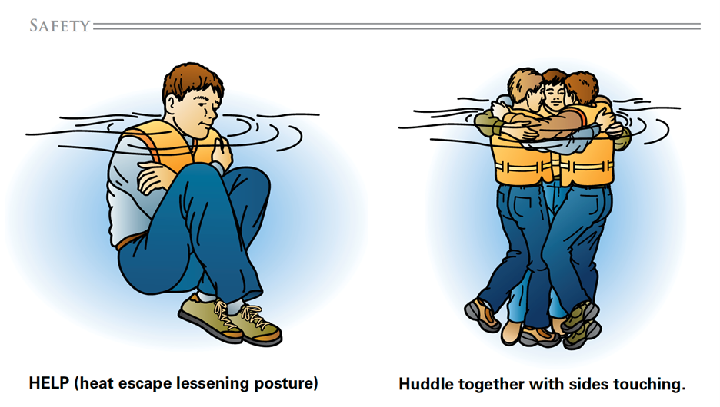
6. Do the following:
(a) Float face-up in a resting position for at least three minutes with minimal movement.
(b) Demonstrate survival floating for at least five minutes.
(c) While wearing a properly fitted U.S. Coast Guard-approved life jacket, demonstrate the HELP and huddle positions. Explain their purposes.
(d) Explain why swimming or survival floating will hasten the onset of hypothermia in cold water.

Slide 20
7. In water over your head, but not to exceed 10 feet, do the following:
(a) Use the feet first method of surface diving and bring an object up from the bottom.
(b) Do a headfirst surface dive (pike or tuck), and bring the object up again.
(c) Do a headfirst surface dive to a depth of at least 5 feet and swim underwater for three strokes. Come to the surface, take a breath, and repeat the sequence twice.

Slide 21
8. Following the guidelines set in the Scouting America Safe Swim Defense guidelines, in water at least 7 feet deep, show a standing headfirst dive from a dock or pool deck. Show a long shallow dive, also from the dock or pool deck.

Slide 22
9. Explain the health benefits of regular aerobic exercise, and discuss why swimming is favored as both fitness and therapeutic exercise
Frequent aerobic exercise can lead to many health benefits such as increased stamina, decreased stress, and an overall boost to your vitality. However, many types of physical activity can strain or otherwise harm your body. Swimming provides a great option for regular exercise, as being in the water means that your joints do not bear the burden of your weight! This reduces the likelihood of any accidental strains.

