Slide 1
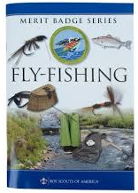

West Virginia
High Adventure Fly Fishing
Scout-Friendly 3-Day Camping & Guided Fishing Plan (May)

Slide 2
Scheme of Maneuver
Who: Tenderfoot or higher Scout
What: Guided Fly fishing in WV + Rustic independent Camping
When: May 2026 or Fall 2026; 3-days; 2-nights of Camping
Where: WV; Elk Spring area
Why: Adventure and world-class Fly fishing: 3-days; 2-nights of Camping
Cost: ~$400 or less

Slide 3
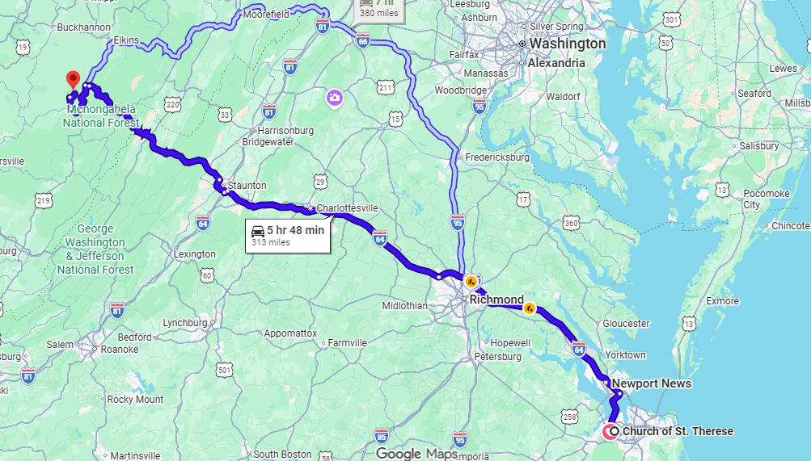
6-hour drive from Scout - Church

Slide 4
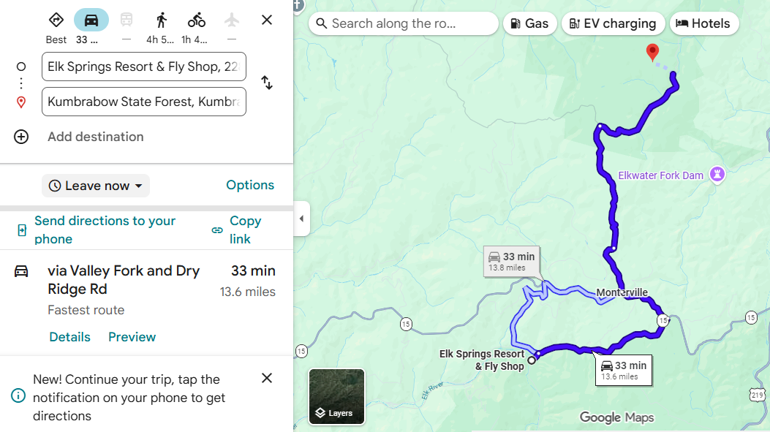
Elk Spring Guided Fishing

Slide 5
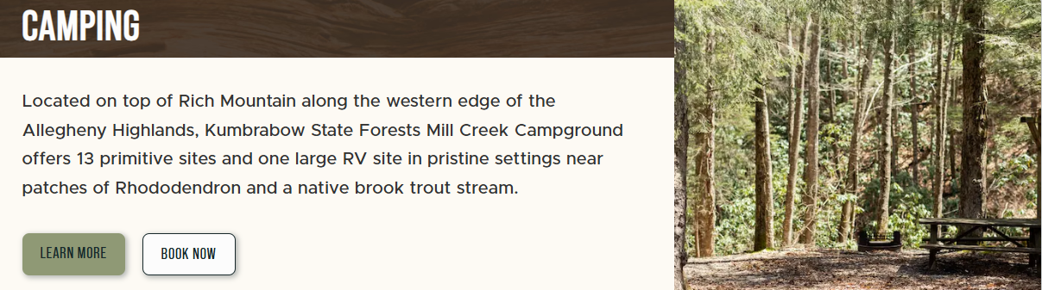
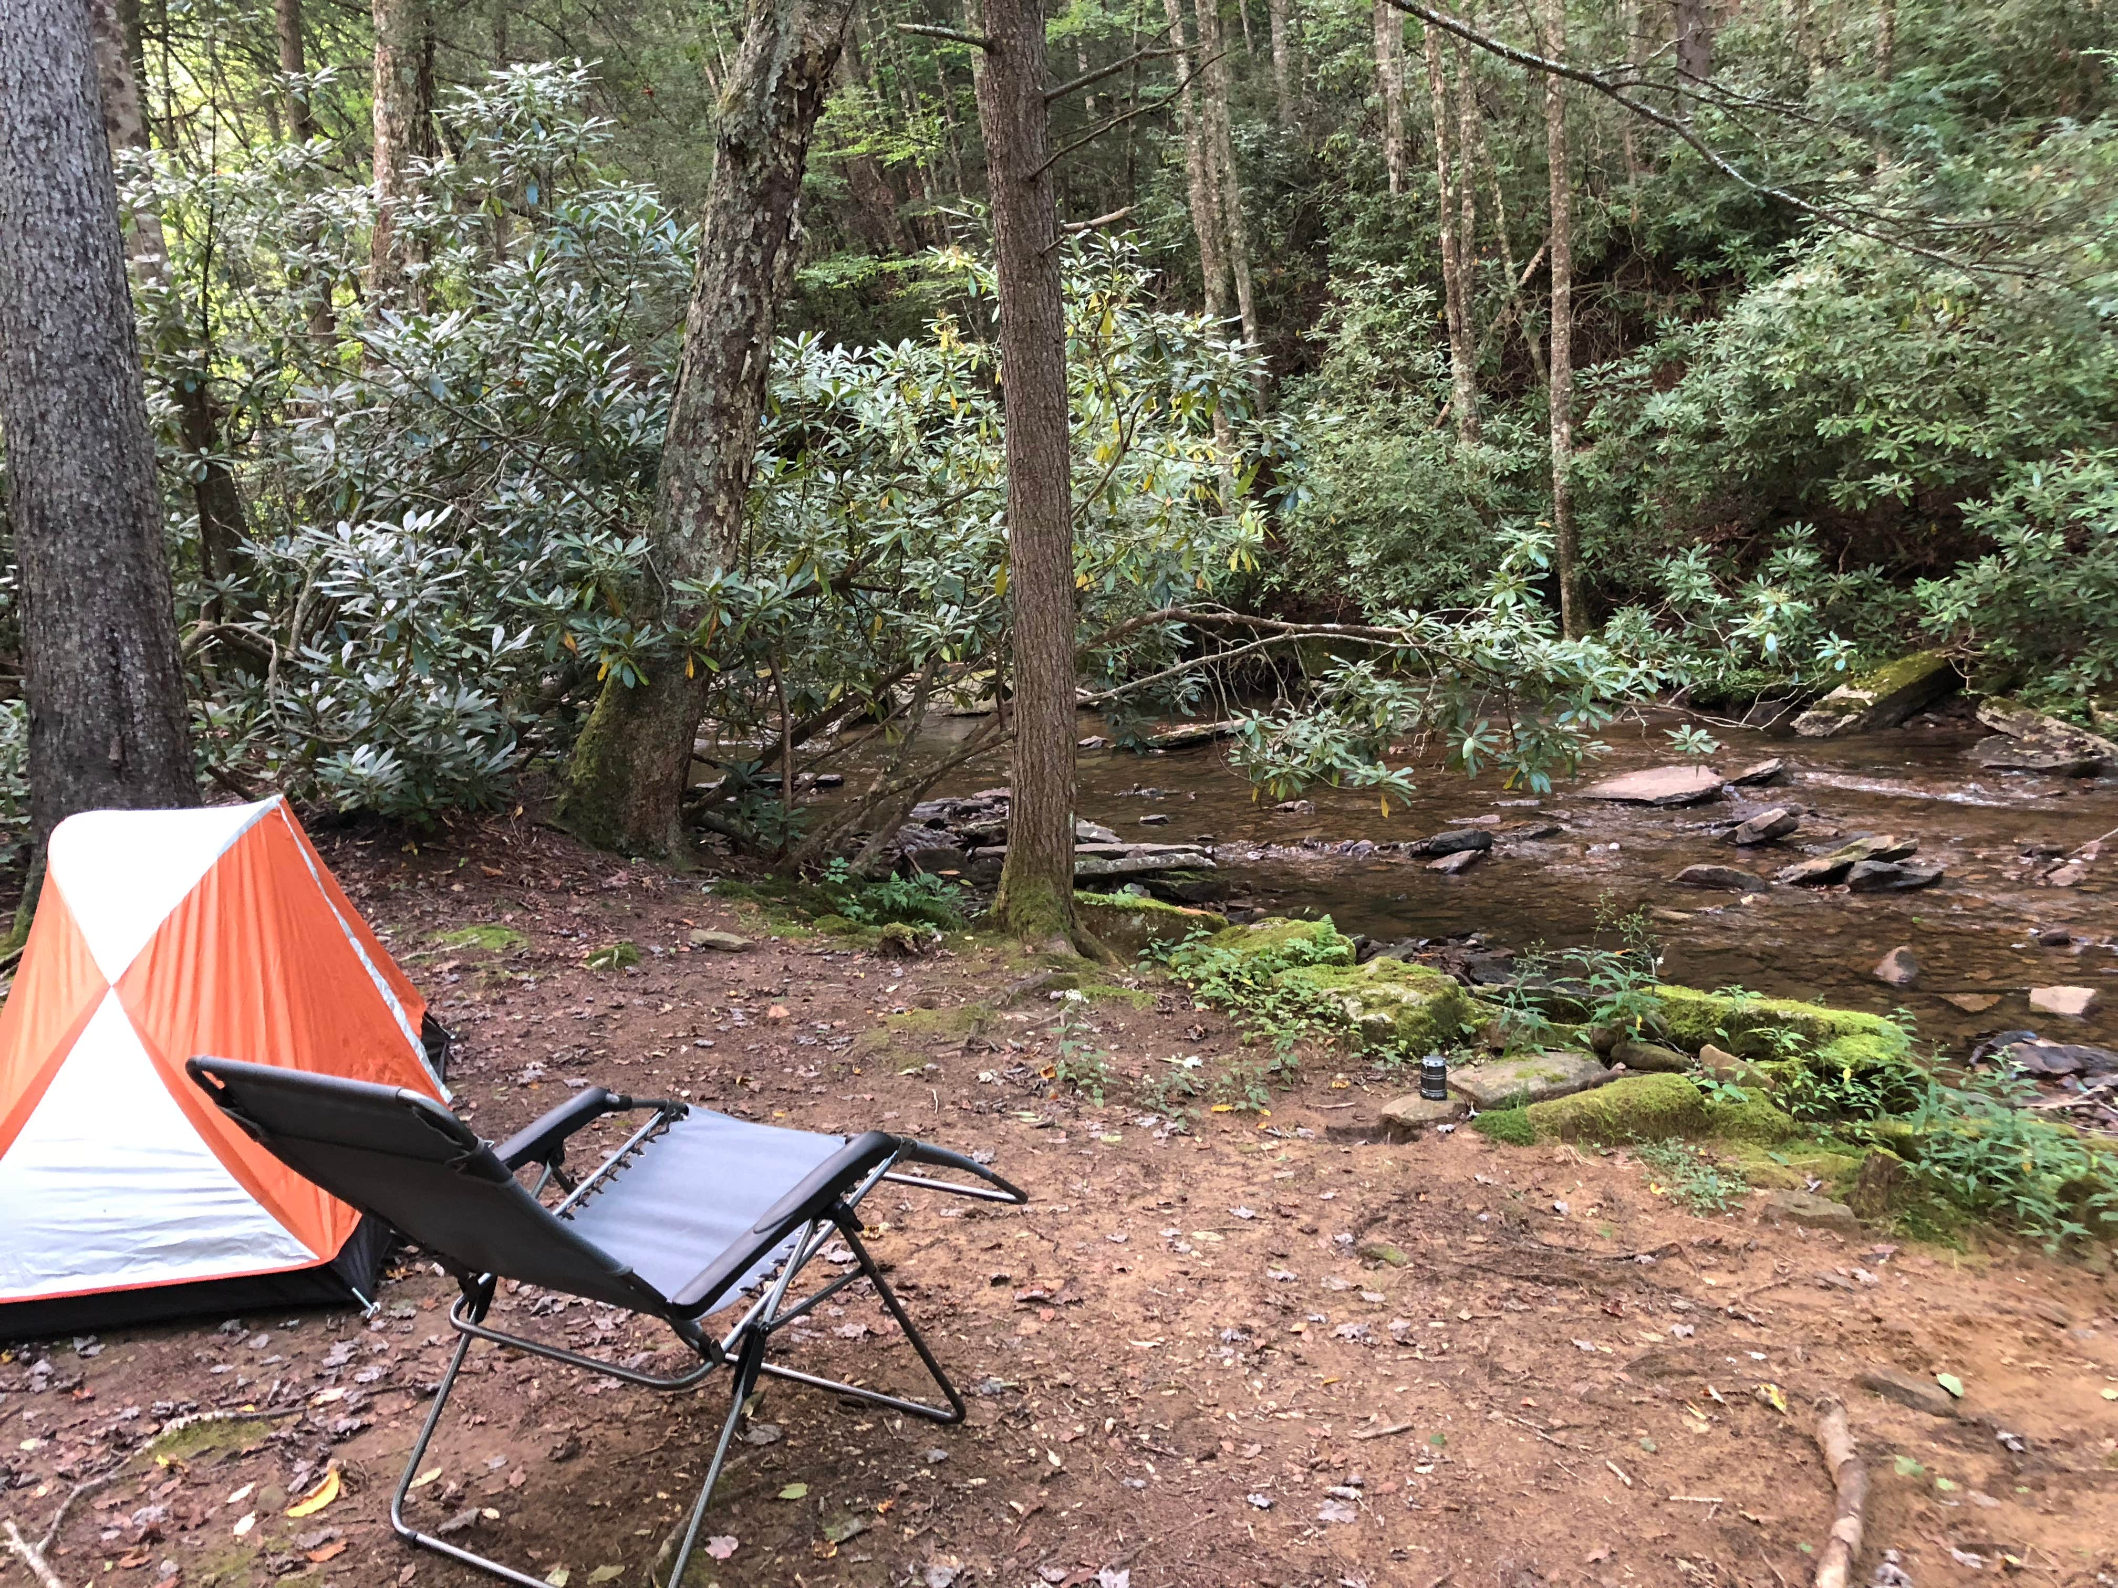

Slide 6
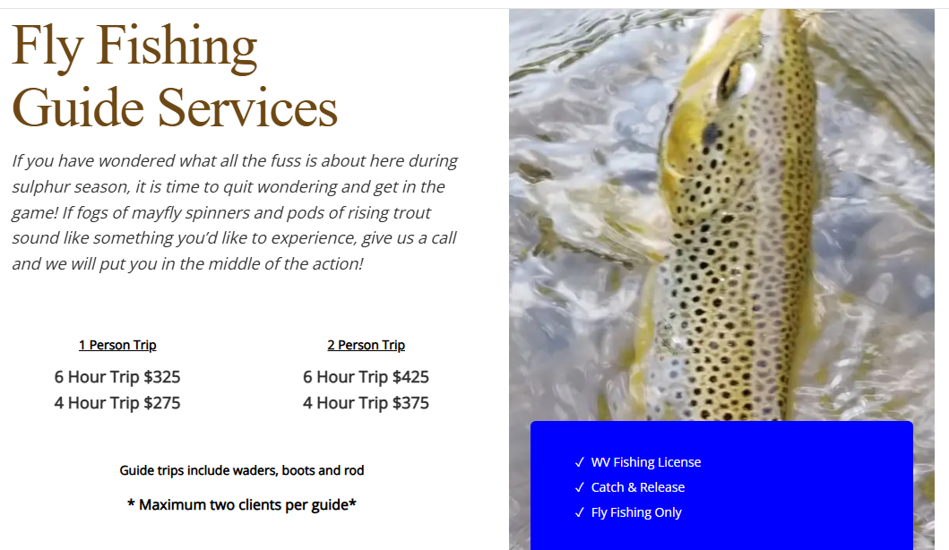

Slide 7
Estimated Budget (Per Person)
Guided Trip (1 day): $250
Fishing License: ~$25
Individual Food: $75
Gas/Travel Share: $35
Estimated Total: <$400 for 3.5 day event

Slide 8
Scout Gear Checklist
Fly rod & reel (5wt recommended)
Waders & boots
Fly box (mayflies, caddis, nymphs)
Rain jacket & layers
Camp tent & sleeping bag
Headlamp & water bottle
Fishing license

Slide 9
Why This Trip is Great for Scouts
A lifetime Adventure of fly fishing
Builds outdoor skills & confidence
Teaches conservation & river ethics
Encourages teamwork & responsibility
Combines camping, fishing & hiking adventure
Creates memories and leadership growth

