Slide 1
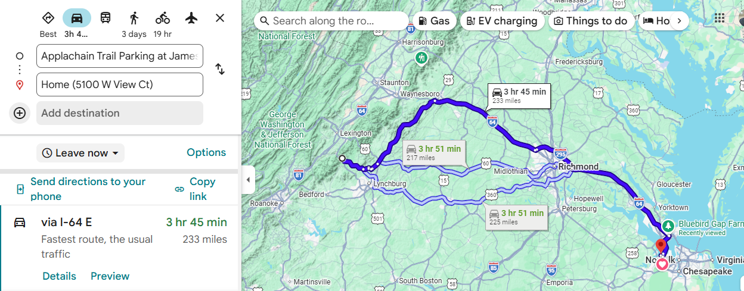

Slide 2
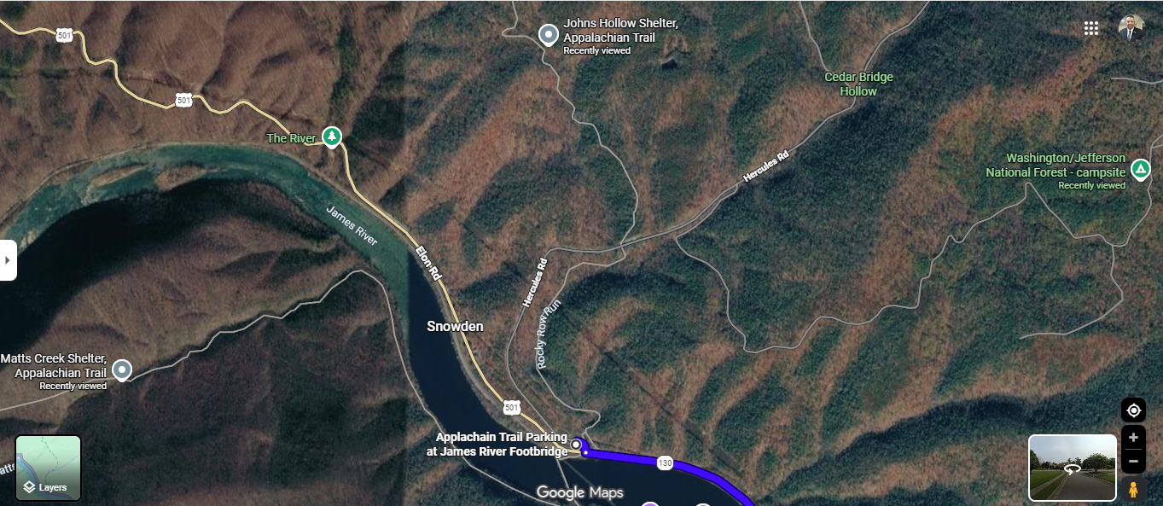
Option B
Sheppe Pond
Option C
Option A
Sheppe Pond
Options |  | Length | Water | Land Nav | Terrain
B | Sheppe Pond | 1.5 | Yes (pond) | Yes | Hills
C | Camp site | 3.0 | UNKN | Yes | Tougher hills
A | Matt Creek | 3.0 | Yes (creek) | some | Flat walk

Slide 3
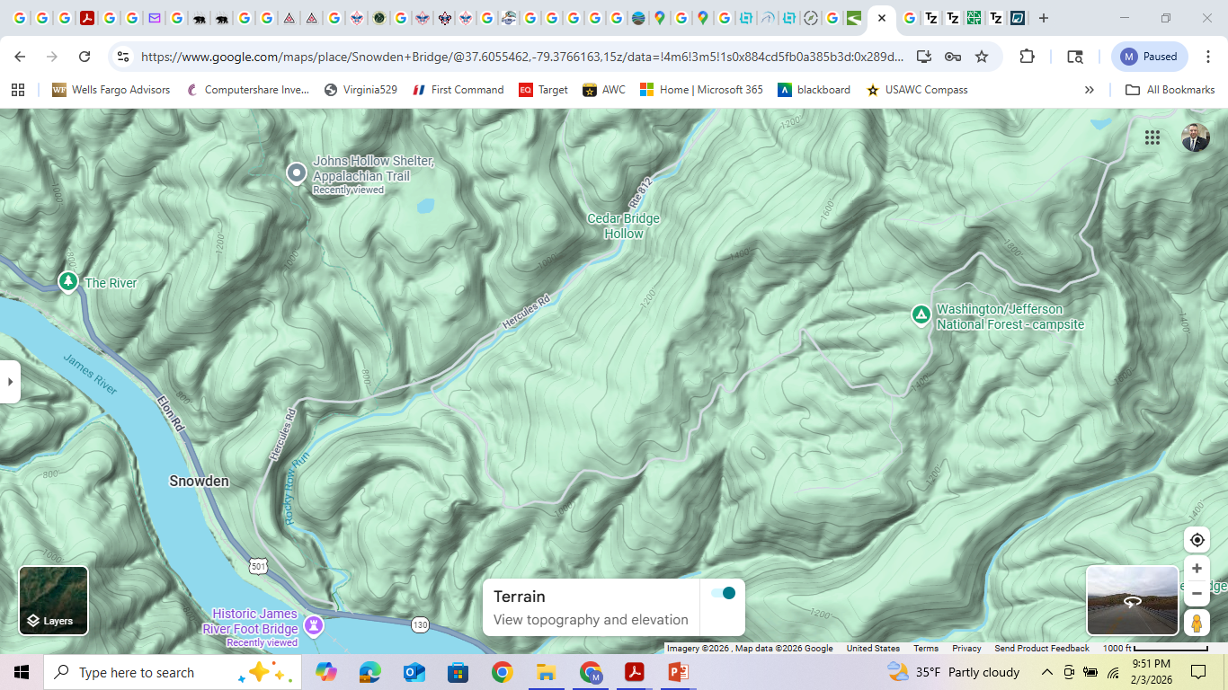

Slide 4
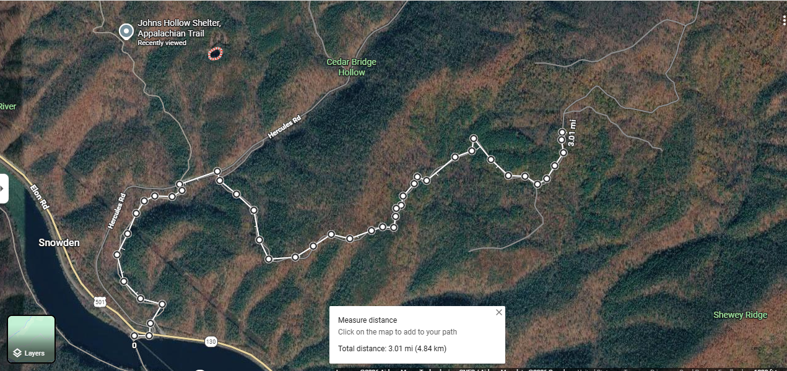

Slide 5
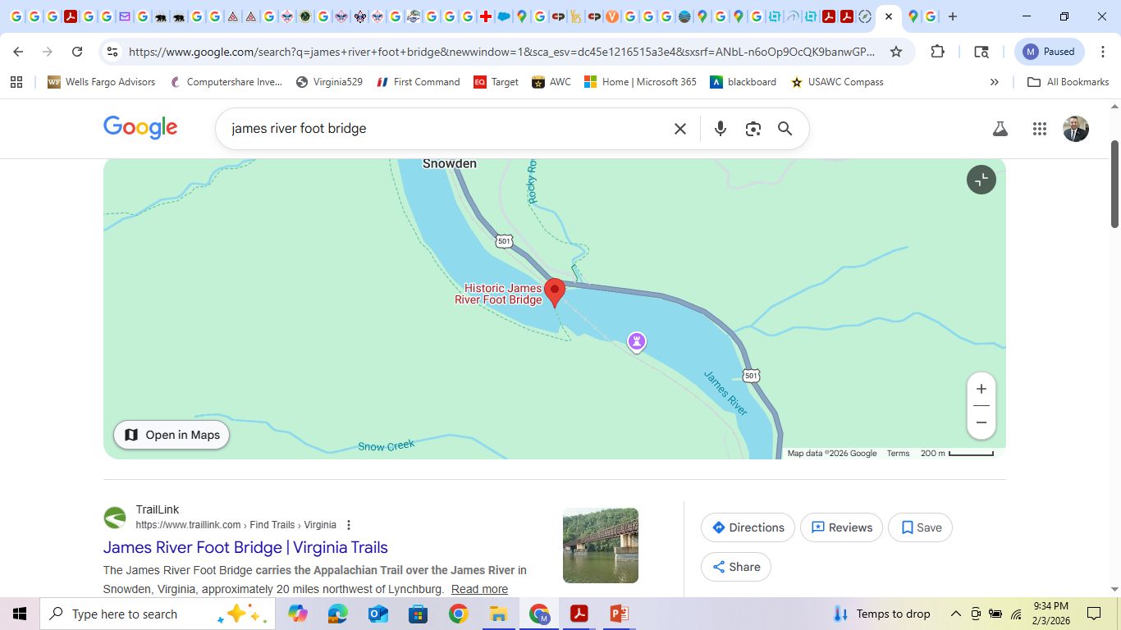

Slide 6
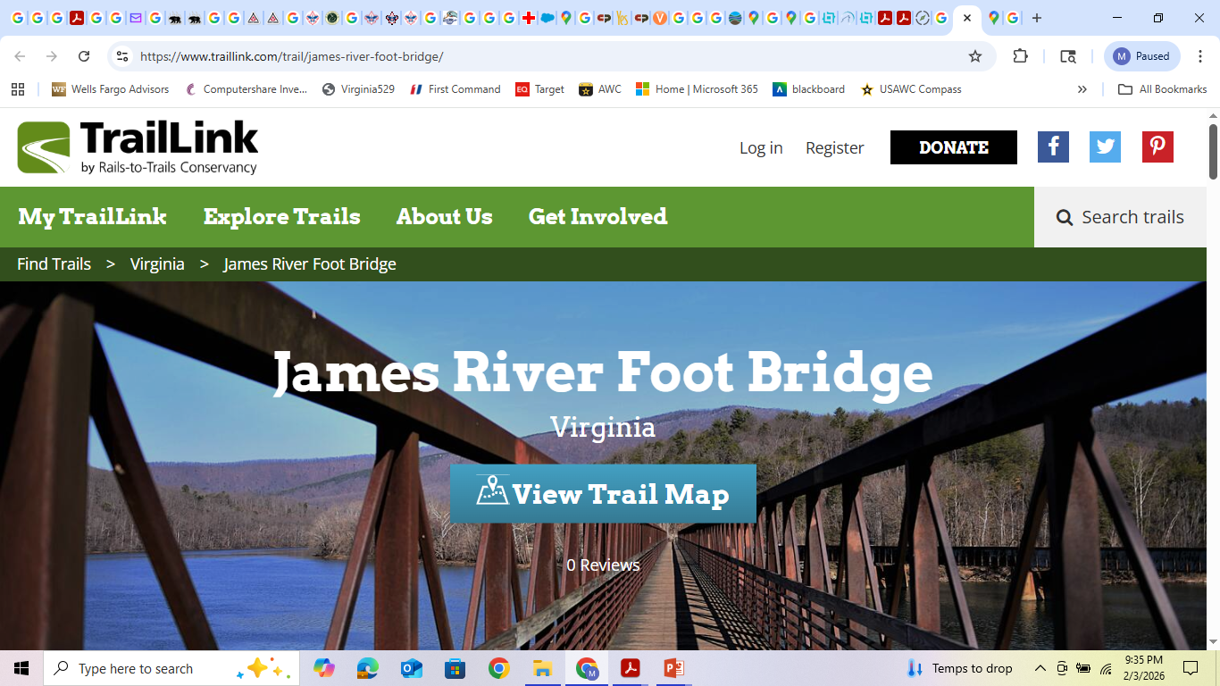
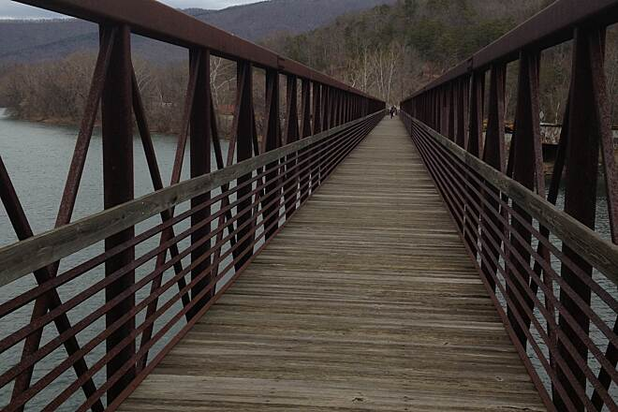
https://www.traillink.com/trail/james-river-foot-bridge/

Slide 7
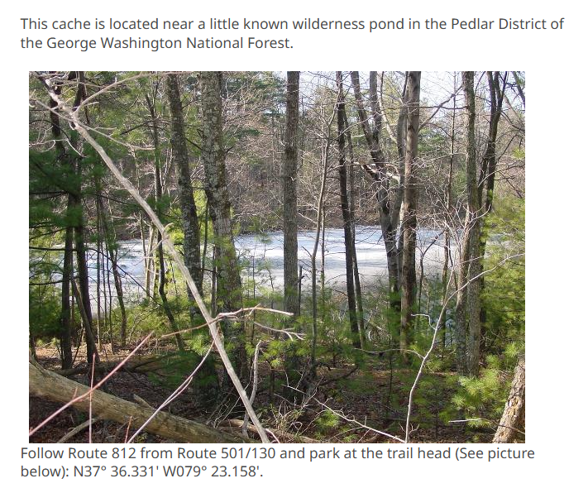

Slide 8
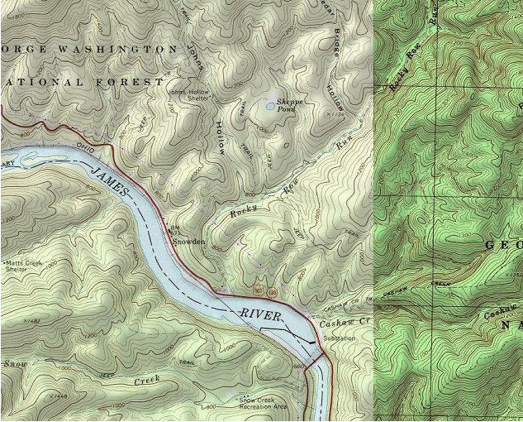

Slide 9
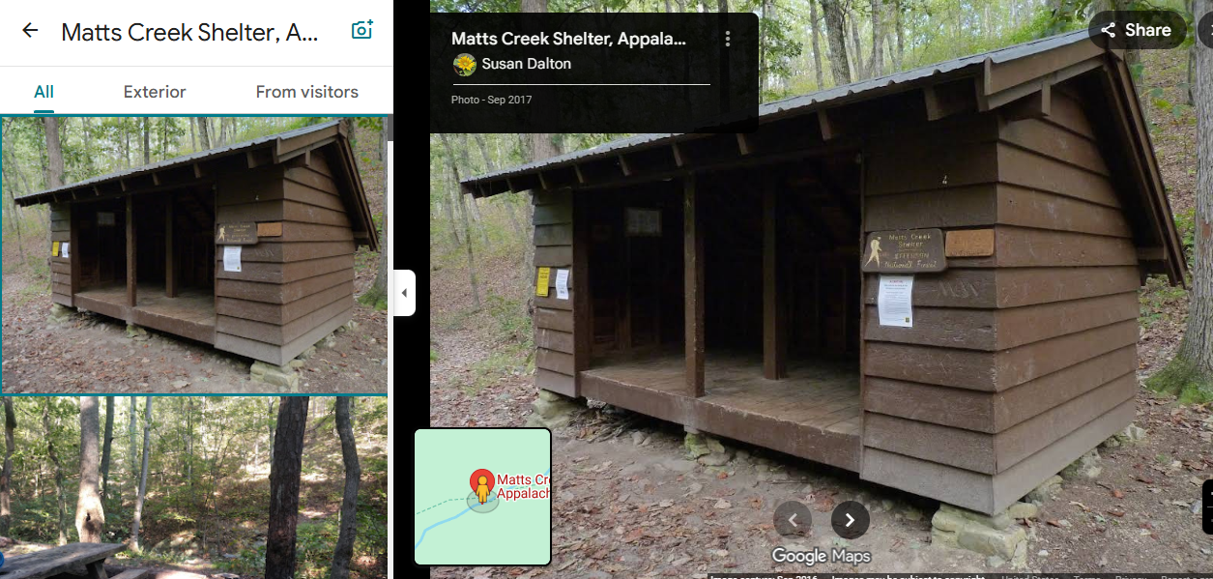

Slide 10
