Slide 1
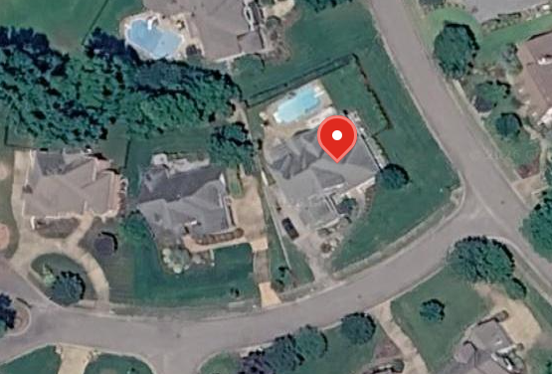

Alternate Meeting place
Primary Meeting place
First Class Scout Ryan Bertrand; Troop 259

