Slide 1
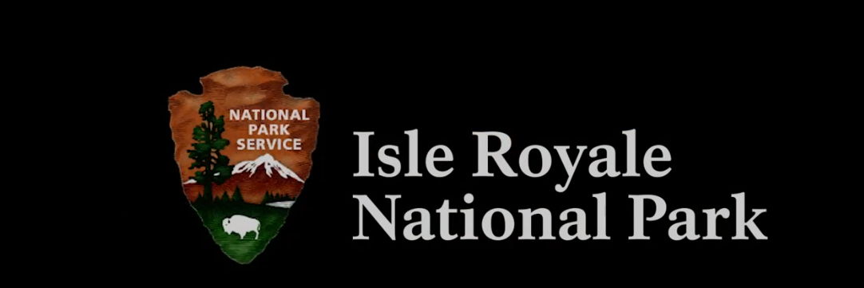
www.nps.gov/isro/

Slide 3
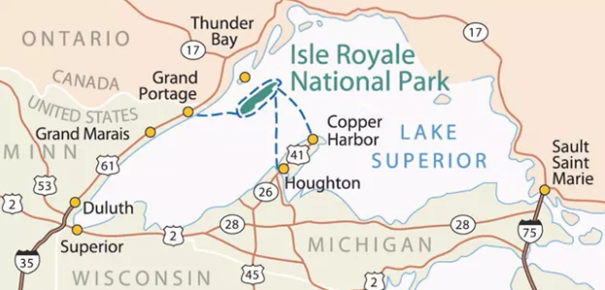

Slide 4
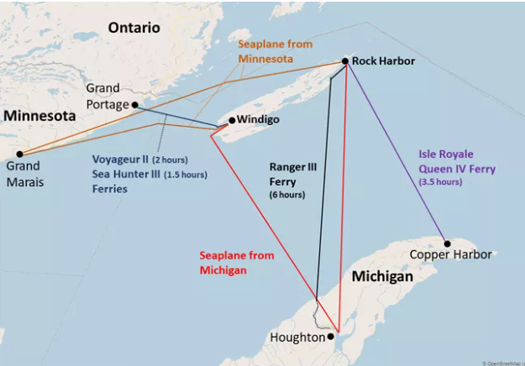
ADVON:
Arrive 24x hours prior in Grand Portage; rent van
Drive from GP to Thunder Bay and P/U MB / Scouts
RON in Canada for fun, meet local scouts
Drive to GP, deliver scouts to marina
Return Van to Rental; taxi to marina
Catch ferry;

Slide 5
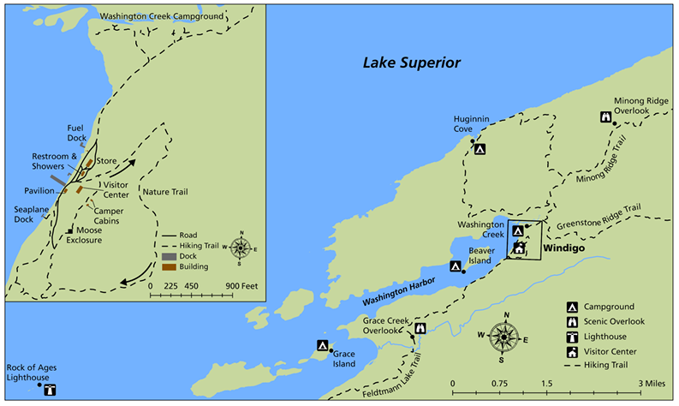

Slide 6
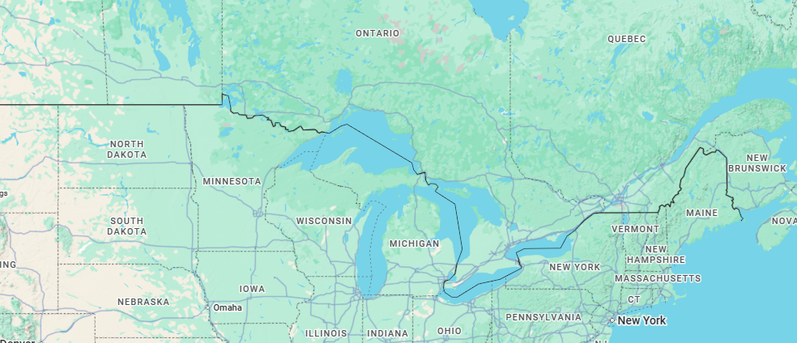

Slide 7
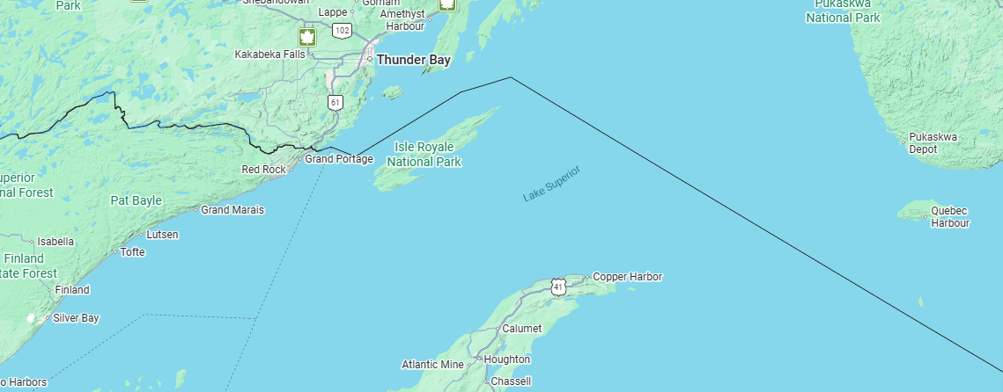
CANADA
United States

Slide 8
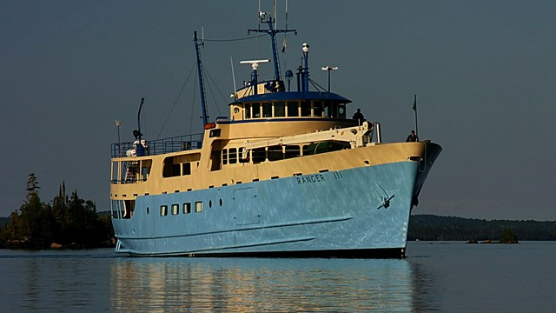
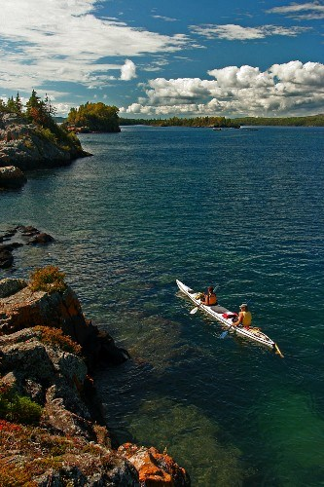

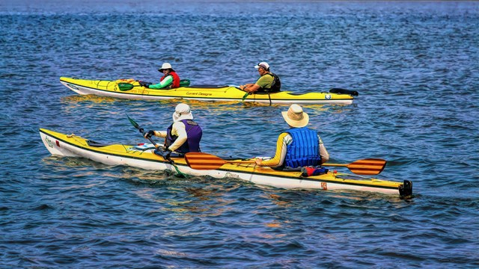

Slide 9
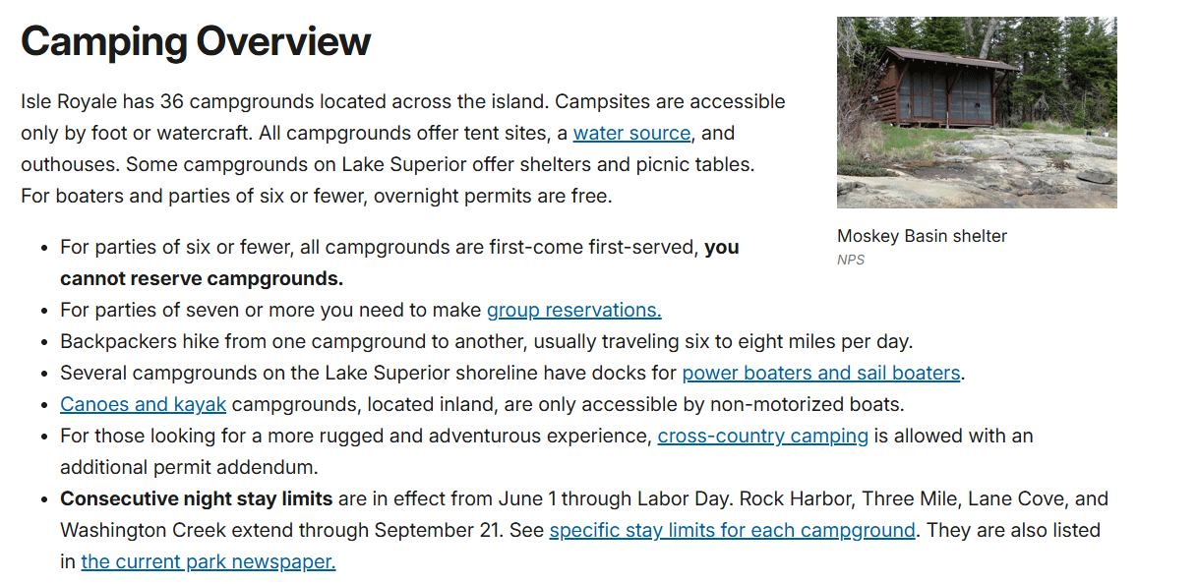

Slide 10
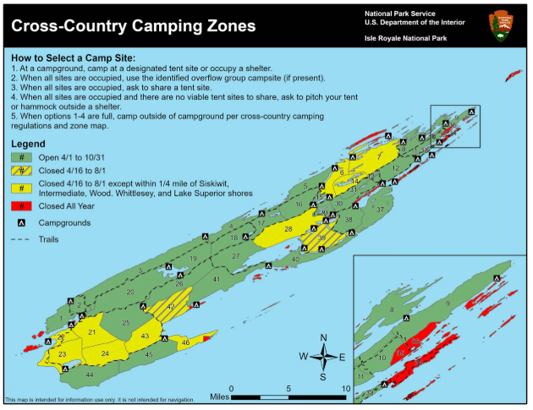

Slide 11
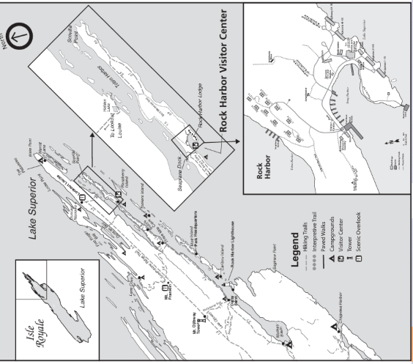
Isle Royale is only one of two island National Parks. It is designated a wilderness park and as such, 99% of the island is preserved as wilderness. One-percent of the park is developed. This is Rock Harbor, the main entrance, where the Isle Royale Queen IV embarks at the northeast end. This area features the charming Rock Harbor Lodge, the Lodge's popular duplex cottages, and other amenities, such as a gift shop, the Lodge Dining Room, the Greenstone Grill, the Lodge General Store, and the NPS Visitors Center. Washington Harbor, which is at the other end of the island features a snack bar and Visitors Center. Visit Captain Ben's Visiting Isle Royale Blog,which has an introduction to Isle Royale National Park and lots of information on what to do and see on Isle Royale.

Slide 12
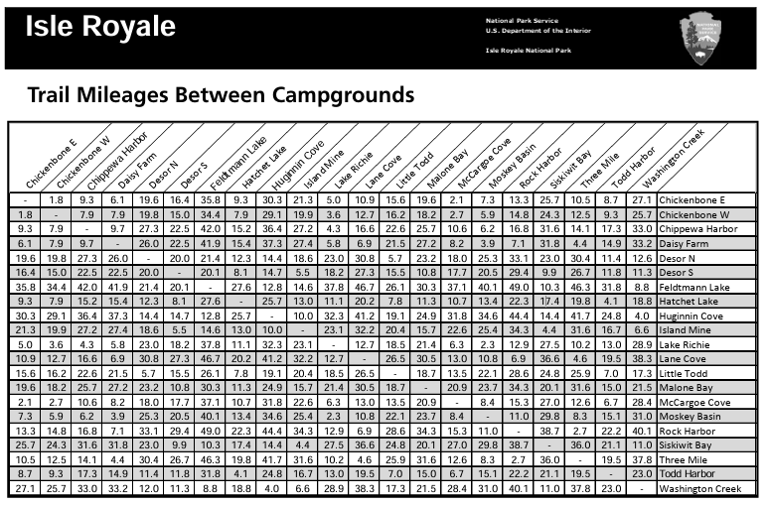

Slide 13

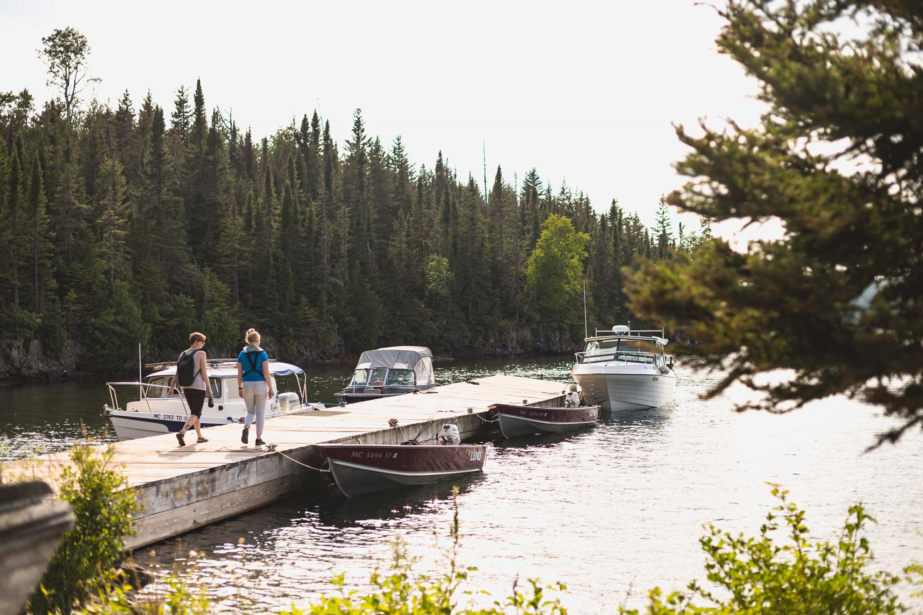
Fishing Charter
Our fishing charters are a great way to see the island, all while catching dinner. Rock Harbor Lodge offers half-day fishing charters for up to four guests. Our captains are very experienced and passionate about fishing. The fishing charter comes fully equipped with everything you’ll need to catch fish and stay safe, aboard an inspected 24' charter boat operated by a U.S.C.G licensed captain. You will primarily be trolling for Lake Superior Lake Trout, as well as salmon.

Slide 14
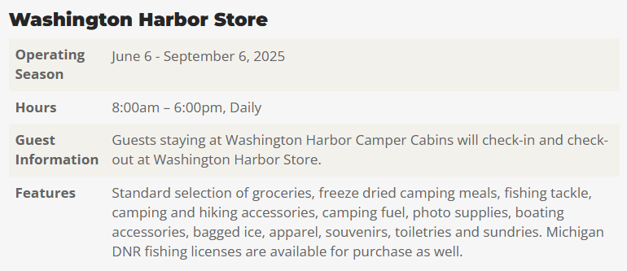
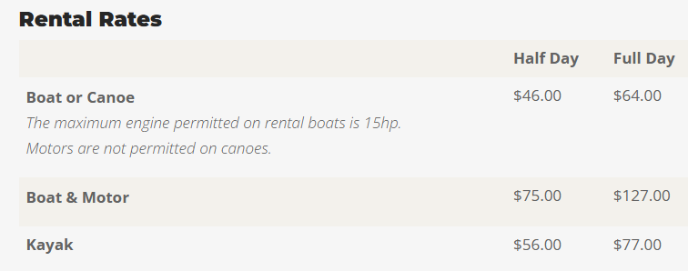
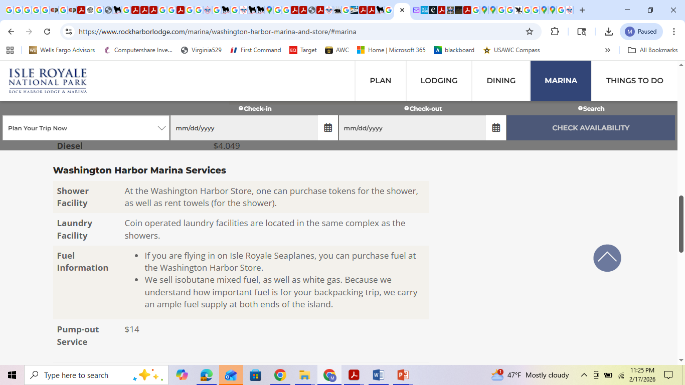
At the southwestern end of Isle Royale is Washington Harbor, only 22 miles from the Minnesota shore. Secluded Washington Harbor welcomes boating and trout fishermen. It is easily accessible by boat service from Grand Portage via the Wenonah, which offers daily service to Washington Harbor. Also, the Voyageur offers visitors a scenic ride around the island from Washington Harbor to Rock Harbor Lodge
Washington Harbor will not overnight rental Kayak
You can rent a canoe ahead of time for overnight trips. Call 906.337.4993 for availability.

Slide 15
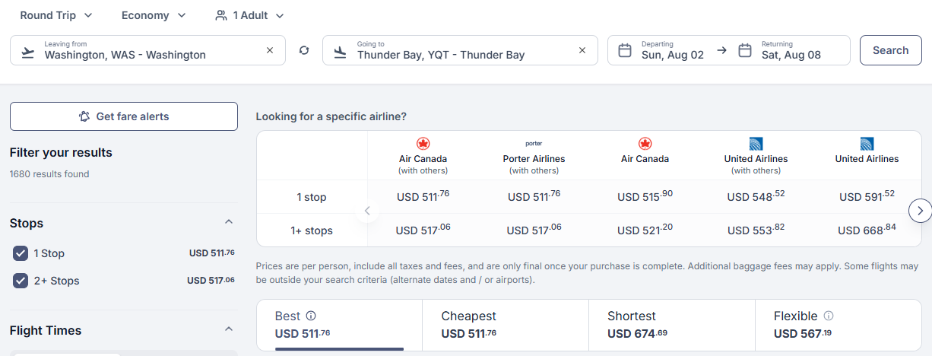

Slide 16
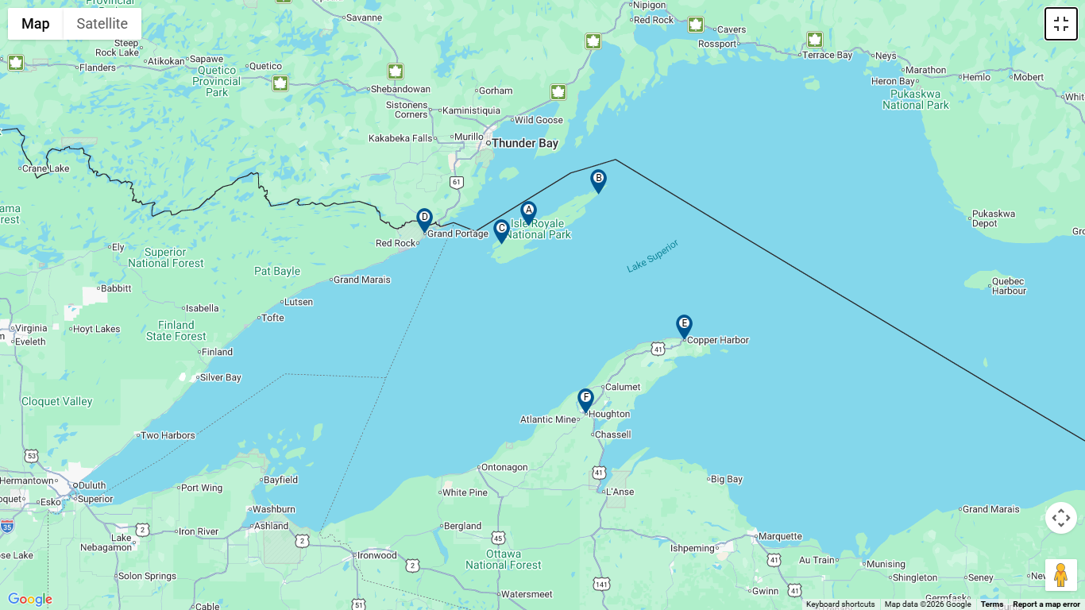
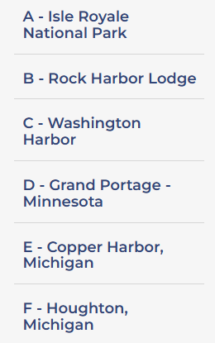

Slide 17
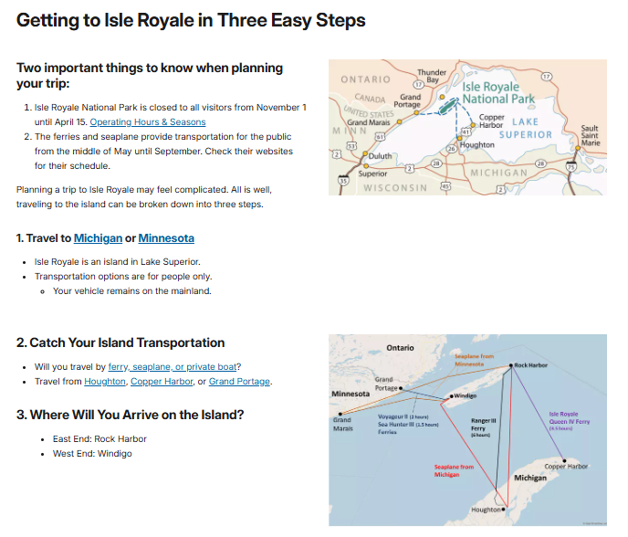

Slide 18
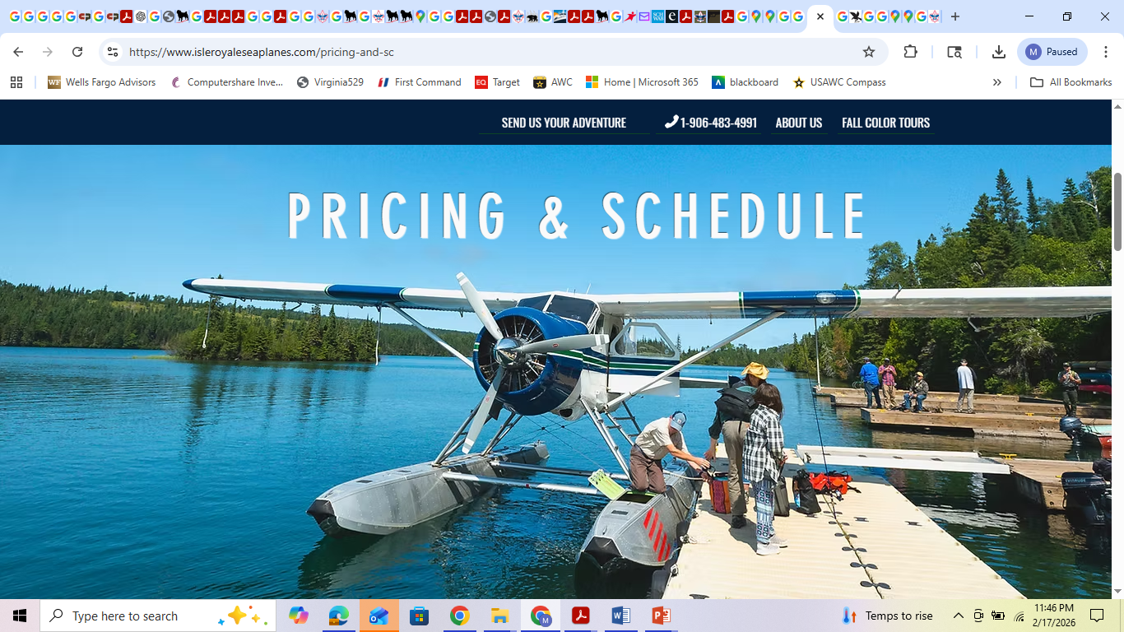
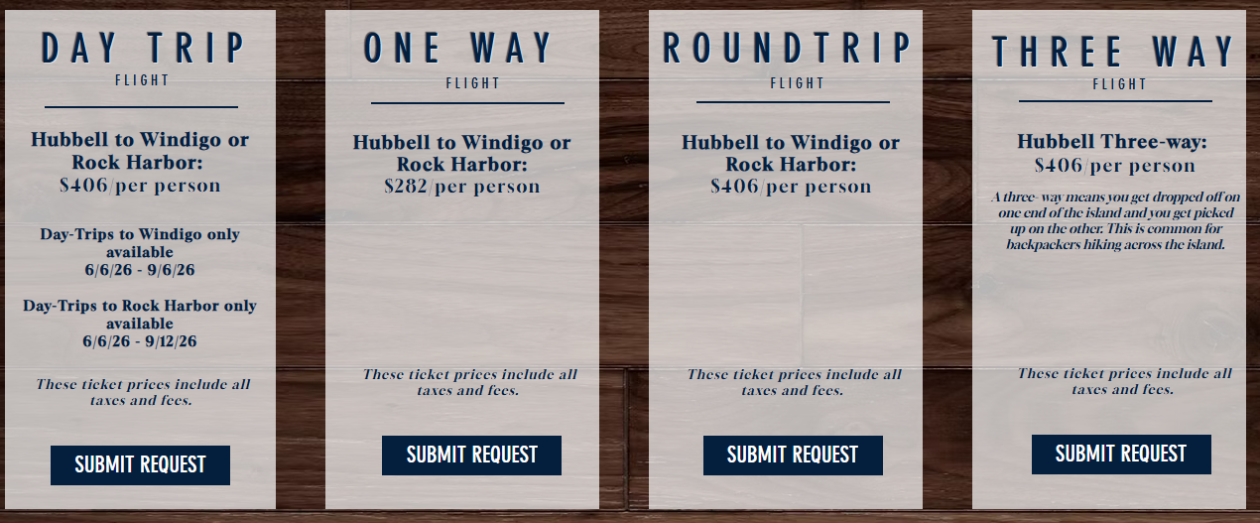
ISLE ROYALE SEAPLANES
Isle Royale Seaplanes
Isle Royale Seaplane Base
26998 W. 16th Street
Hubbell, MI 49934​
906-483-4991
info@isleroyaleseaplanes.com
$282
$406
$406
$406

