Slide 1
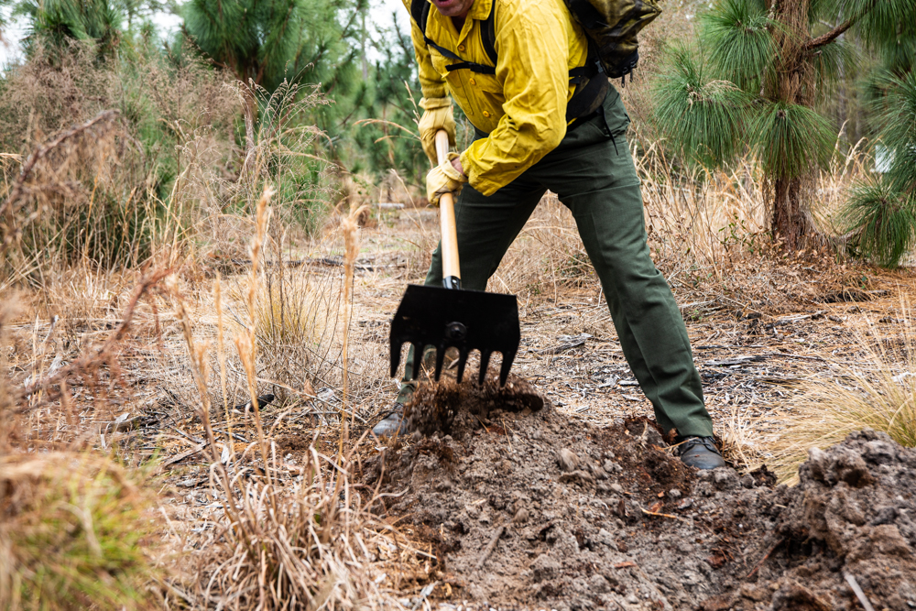

Paul Bunyan Award Requirements
Study the Scouts BSA Handbook and the Camping merit badge pamphlet, and demonstrate to your Scoutmaster or other qualified person the following:
Explain the most likely hazards you may encounter while using woods tools listed in requirement 5 and what you should do to (a) anticipate, (b) help prevent, manage, and (c) respond to these hazards.
Show that you know first aid for injuries that could occur while using woods tools.
Earn the Totin’ Chip.
Help a Scout or patrol earn the Totin’ Chip and demonstrate to them the value of proper woods-tools use.
Be familiar with the (a) proper and safe use, (b) maintenance and (c) storage of woods tools including:
  Axe
  Hatchet
  Loppers
  McLeod
  Pulaski
  Saw
  Shovel
  Pick Axe
  PryBar
Demonstrate proper use of four of the tools listed in requirement 5.
With unit (a) leader approval and supervision, (b) using woods tools, (c) spend at least two hours doing one of the following conservation-oriented projects:
  Clear trails or fire lanes for two hours.
  Trim a downed tree, cut into four-foot lengths, and stack; make a brush with branches.
  Build a natural retaining wall or irrigation way to aid in a planned conservation effort.

Slide 2
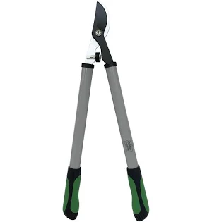
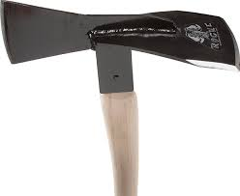
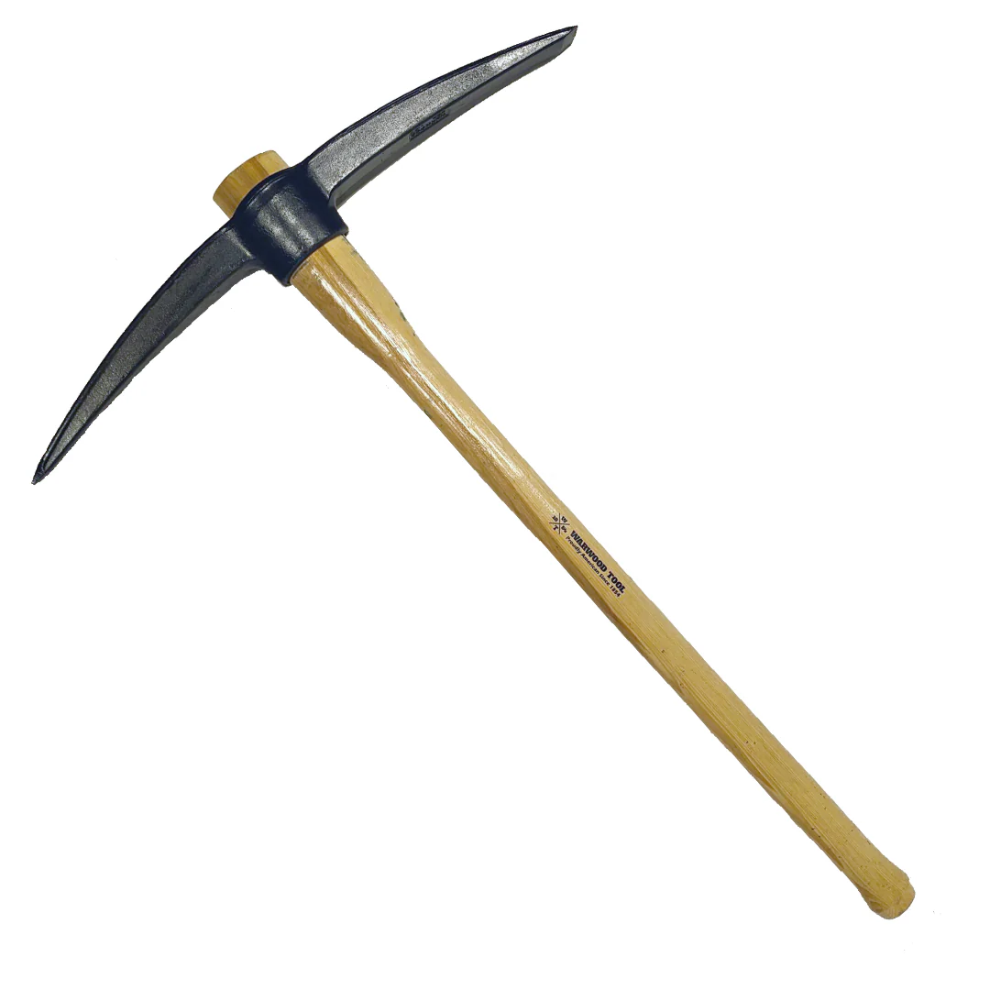
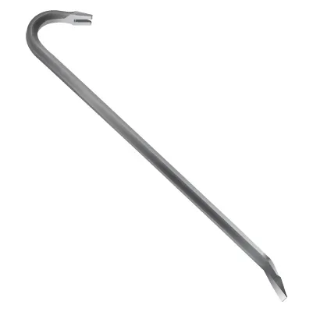
Paul Bunyan Award Requirements
Be familiar with the (a) proper and safe use, (b) maintenance and (c) storage of woods tools including:
  Axe
  Hatchet
  Loppers
  McLeod
  Pulaski
  Saw
  Shovel
  Pick Axe
  PryBar

Slide 3
General Rules for All Woods Tools 🌲
Get trained first and use tools only with permission and supervision.
Wear PPE: sturdy shoes/boots, gloves when appropriate, eye protection for cutting tools.
Establish a safety circle (tool-length + arm’s length).
Carry tools correctly (point down, blade covered).
Never horse around or leave tools unattended.
Inspect before use; stop if damaged.
PICK AXE
Proper Use
Used for breaking hard ground or rock.
Swing with controlled motion.
Ensure solid footing.
Maintenance
Clean after use.
Check head is tight.
Light oil on metal.
Storage
Cover point.
Store securely and dry.
AXE
Proper Use
Used for chopping or splitting wood on a solid chopping block.
Swing only when others are outside your safety circle.
Chop away from your body; kneel when splitting for control.
Maintenance
Keep blade sharp and rust-free.
Tighten loose handles; sand splinters.
Lightly oil the blade after use.
Storage
Use a sheath.
Store dry, blade down or hung securely.
PRY BAR
Proper Use
Used for lifting or levering, not striking.
Apply steady pressure.
Keep hands and feet clear.
Maintenance
Clean dirt and debris.
Inspect for bends or cracks.
Light oil to prevent rust.
Storage
Store flat or hanging.
Keep dry and organized.

Slide 4
HATCHET
Proper Use
For small wood splitting and light chopping.
Can be used one-handed with controlled swings.
Never chop wood held in the air.
Maintenance
Same as an axe: clean, sharpen, oil.
Check handle for cracks.
Storage
Blade cover on.
Store dry and out of reach.
LOPPERS
Proper Use
Used for cutting branches, not twisting or prying.
Cut one branch at a time.
Watch finger placement near blades.
Maintenance
Clean sap from blades.
Oil pivot points.
Sharpen blades if dull.
Storage
Store closed and locked if possible.
Hang or lay flat in a dry area.
SAW (Hand or Bow Saw)
Proper Use
Use for cutting branches or logs, not twisting.
Cut with smooth strokes.
Secure wood before cutting.
Maintenance
Keep blade clean and dry.
Light oil to prevent rust.
Replace dull or bent blades.
Storage
Blade cover on.
Store hanging or flat.
McLEOD
(Common trail and fire tool)
Proper Use
Used for raking, scraping, and smoothing soil.
Swing low and controlled.
Never throw or toss.
Maintenance
Clean dirt off metal.
Check handle tightness.
Light oil on metal edges.
Storage
Store flat or hanging.
Keep dry to prevent rust.
PULASKI
(Axe + hoe combo tool)
Proper Use
Used for digging, chopping roots, and trail work.
Be aware of both cutting edges.
Maintain extra spacing around users.
Maintenance
Sharpen both edges carefully.
Clean after use; oil metal.
Inspect handle frequently.
Storage
Use blade guards.
Store dry and secured.
SHOVEL
Proper Use
Used for digging and moving soil.
Lift with legs, not back.
Don’t strike rocks or pry sideways.
Maintenance
Clean dirt after use.
Sharpen edge lightly if needed.
Oil metal; check handle.
Storage
Store upright or hanging.
Keep dry.

Slide 5
Paul Bunyan Award
Explain the most likely hazards you may encounter while using woods tools listed in requirement 5 and what you should do to anticipate, help prevent, manage, and respond to these hazards.
Show that you know first aid for injuries that could occur while using woods tools.
Earn the Totin’ Chip.
Help a Scout or patrol earn the Totin’ Chip,and demonstrate to them the value of proper woods-tools use.
Be familiar with the proper and safe use, maintenance and storage of woods tools including:
  Axe
  Hatchet
  Loppers
  McLeod
  Pulaski
  Saw
  Shovel
  Pick Axe
  Prybar
Demonstrate proper use of four of the tools listed in requirement 5.
With unit (a) leader approval and supervision, (2) using woods tools, (3) spend at least two hours doing one of the following conservation-oriented projects:
  Clear trails or fire lanes for two hours.
  Trim a downed tree, cut into four-foot lengths, and stack; make a brush with branches.
  Build a natural retaining wall or irrigation way to aid in a planned conservation effort.
Scout: ____________________________ Date: ____________________ Counselor Name _____________________Date: _____________________

Slide 6

Totin’ Chip Requirements
This certification grants a Scout the right to carry and use woods tools. The Scout must show their Scout leader, or someone designated by their leader, that the Scout understands their responsibility to do the following:
Read and understand woods tools use and safety rules from the Scouts BSA handbooks.
Demonstrate proper handling, care, and use of the pocketknife, ax, and saw.
Use knife, ax, and saw as tools, not playthings.
Respect all safety rules to protect others.
Respect property. Cut living and dead trees only with permission and good reason.
Subscribe to the Outdoor Code.
Scout: ____________________________ Date: ____________________ Counselor Name _____________________Date: _____________________

Slide 7
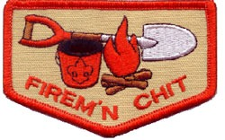
Firem’n Chit Requirements
This certification grants a Scout the right to carry fire-lighting devices (matches, lighters, etc.) to build campfires. The Scout must show their Scout leader, or someone designated by their leader, an understanding of the responsibility to do the following:
I have read and understand use and safety rules from the Scouts BSA Handbook.
I will build a campfire only when necessary and when I have the necessary permits (regulations vary by locality).
I will minimize campfire impacts or use existing fire lays consistent with the principles of Leave No Trace. I will check to see that all flammable material is cleared at least 5 feet in all directions from fire (total 10 feet).
I will safely use and store fire-starting materials.
I will see that fire is always attended to.
I will make sure that water and/or a shovel is readily available. I will promptly report any wildfire to the proper authorities.
I will use the cold-out test to make sure the fire is cold out and will make sure the fire lay is cleaned before I leave it.
I follow the Outdoor Code, the Guide to Safe Scouting, and the principles of Leave No Trace and Tread Lightly!
Scout: ____________________________ Date: ____________________ Counselor Name _____________________Date: _____________________

Slide 8
Leave No Trace Seven Principles
These principles aim to minimize impact on natural, undeveloped areas:
Plan and Prepare: Research the area, pack properly, and know regulations.
Travel and Camp on Durable Surfaces: Stick to trails, campsites, and avoid fragile vegetation.
Dispose of Waste Properly: Pack it in, pack it out. Human waste should be in 6-8-inch-deep cat holes 200 feet from water.
Leave What You Find: Preserve the past and present by leaving rocks, plants, and artifacts.
Minimize Campfire Impacts: Use stoves for cooking or keep fires small and in designated areas.
Respect Wildlife: Observe from a distance; never feed or approach animals.
Be Considerate of Other Visitors: Yield to others, keep noise levels low, and respect Indigenous lands.
Tread Lightly! Principles
Focused on minimizing impact from mechanized/motorized travel, the T.R.E.A.D. principles include:
T - Travel Responsibly: Stay on designated roads and trails.
R - Respect the Rights of Others: Respect private property and other trail users.
E - Educate Yourself: Know regulations and check weather/trail conditions.
A - Avoid Sensitive Areas: Steer clear of meadows, lakeshores, and wetlands.
D - Do Your Part: Pack out trash, minimize fire impact, and restore areas.
Outdoor Code for Scouts BSA
As an American, I will do my best to —
Be clean in my outdoor manners.
  I will treat the outdoors as a heritage. I will take care of it for myself and others. I will keep my trash and garbage out of lakes, streams, fields, woods, and roadways.
Be careful with fire.
  I will prevent wildfire. I will build my fires only when and where they are permitted and appropriate. When I have finished using a fire, I will make sure it is cold out. I will leave a clean fire ring or remove all evidence of my fire.
Be considerate in the outdoors.
  I will treat the land and other land users with respect. I will follow the principles of outdoor ethics for all outdoor activities.
Be conservation-minded.
  I will learn about and practice good conservation of soil, waters, forests, minerals, grasslands, wildlife and energy. I will urge others to do the same.

Slide 9

James M. Stewart Good Citizenship Award
Registered Scouts can earn the James M. Stewart Good Citizenship Award by completing all of the following requirements:
Take the Jimmy Stewart Museum quiz
Write an essay of at least 500 words on the importance of citizenship in Scouting
Perform a good citizenship project in the community in honor of James M. Stewart
Learn more and order award materials at the official site.
https://jimmy.org/scouts-bsa/

Slide 10
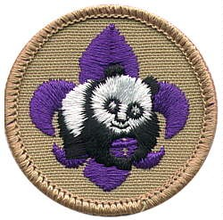



Scouts are eligible to receive the World Conservation Award after completing the requirements for the following merit badges: Environmental Science, Citizenship in the World, and either Soil and Water Conservation or Fish and Wildlife Management.
The International Scouter’s Award encourages Scouters to broaden their involvement in Scouting through participation in world Scouting activities and recognizes Scouters for their contributions to world Scouting.
Award Presentation: The International Spirit Award is a unique and special recognition. The award can be earned by Cub Scouts, Scouts BSA, Sea Scouts, Venturers, and Adult Leaders. Those who earn this award have demonstrated a commitment to learning about and engaging with different cultures and countries through exciting experiences. Experiences include attending a World Scout Jamboree or an event held in another country, visiting a Sount unit abroad, hosting International Scouts in the U.S. at a Council camp, participating in Jamboree on the Air/Jamboree on the Internet, earning the Interpreter Strip, and sharing cultural traditions from another country with U.S. Scouts.
Interpreter Strip Requirements
Carrying on a five-minute conversation in this language.
Translating a two-minute speech or address.
Writing a letter in the language (does not apply for sign language).
Translating 200 words from the written word.

Slide 11
Climbing and Rappelling
The requirements applicable to climbing and rappelling listed in National Camp Accreditation Program (NCAP), apply to district and council activities.
Climbing activities in which the participant’s feet are more than 6 feet off the ground must be top-rope belayed.
All rappelling activities must be properly belayed (NCAP standard PS-206).
Climb On Safely (www.scouting.org/outdoor-programs/COPE/) applies to climbing activities operated by a unit.
Scouting America units conducting their own climbing activities must follow the requirements set forth in Climb On Safely.
Leaders who supervise unit climbing activities must have current Climb On Safely training (available at my.scouting.org).
Cub Scouts and Webelos Scouts can do the following:
Participate in bouldering (climbing on boulders or bouldering walls) no higher than the climber’s shoulder height with adults (or camp staff with adult supervision) who are trained to provide spotting for bouldering activities.
In addition, Webelos Scouts can:
Rappel with a trained adult belayer and backup. In addition, Scouts BSA members can:
Belay with supervision and a backup.
In addition, older Scouts BSA members (age 13 and older), Sea Scouts, and Venturers may participate in lead climbing, and snow and ice climbing, subject to the following:
All participants must be at least 13 years old.
Qualified instructors must have training from a nationally recognized organization that trains climbing instructors in the appropriate special activity. Note: Scouting America National Camping School does not train climbing directors and instructors in lead climbing, or snow and ice climbing.
Lead climbing without a top-rope belay is prohibited as part of a unit, council, or district activity.
Units may conduct activities involving lead climbing with adult supervision and qualified instructors.

Slide 12
COPE Activities
Challenging Outdoor Personal Experience (COPE) activities are defined as low or high challenge course activities, including but not limited to those listed in Chapter 20: Low-Course Activities or Chapter 21: High-Course Activities in Belay On (www.scouting.org/outdoor-programs/cope/). They are to be used only in conjunction with council or district activities that meet the current NCAP standards.
Units may participate in age-appropriate initiative games. These are group challenge activities that do not involve constructed facilities, such as Blind Square, Couples Tag, Hoops Around the Circle, and Traffic Jam. See Chapter 3: Warm-Ups and Initiative Games in Belay On. Units shall not construct low- or high-course elements, including zip lines.
Individual participation is based on the judgment of the COPE director or Level II instructor for facilities operated by districts and councils, and jointly by the facility operator/owner and unit leader for commercial facilities. Cub Scout units may not participate in COPE, zip line, canopy tour, or aerial adventure park activities unless those activities are specifically designed for Cub Scout-age youth participation, such as climbing facilities or obstacle courses. Refer to the age-appropriate guidelines chart in the Guide to Safe Scouting.

Slide 13
“High Adventure is what we do here.”
High adventure is not about extreme activities.
It is about developing capable, confident young American Citizen Leaders.

Slide 14
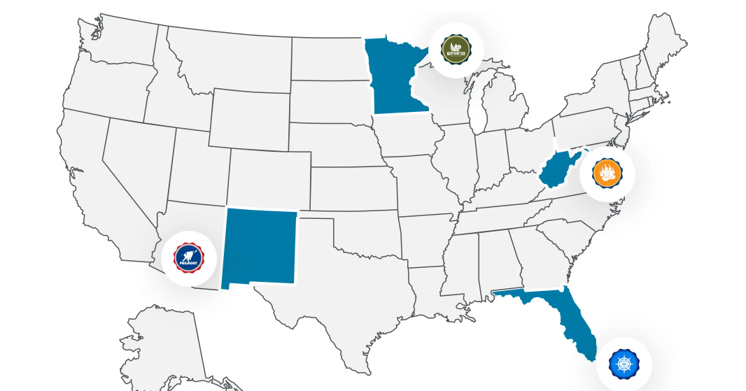




Northern Tier
Philmont Scout
Ranch
Summit Bechtel
Reserve
Summer Camp 2028
Summer Camp 2027
Sea Base

Slide 15
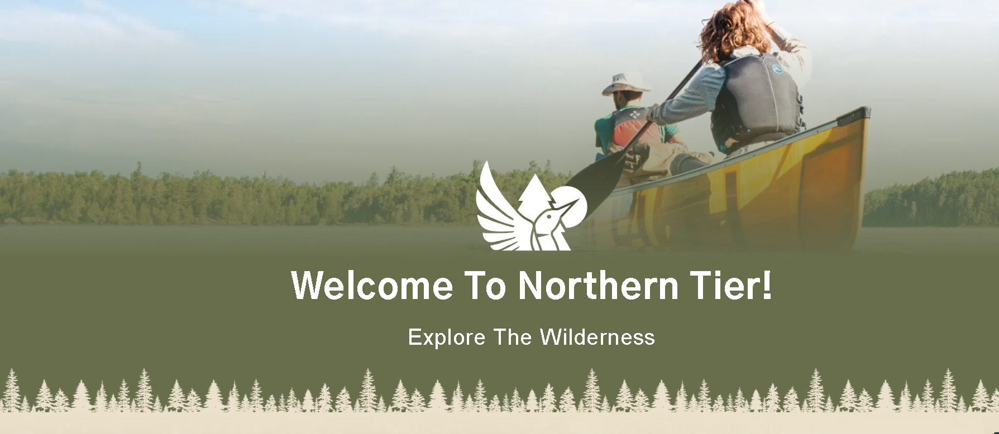
Northern Tier is the premier high adventure for wilderness canoeing and winter camping offered by Scouting America, providing a unique experience in the rugged wilderness of the Great North American Canoe Country. Our programs are renowned for their challenging and rewarding wilderness canoeing and winter camping expeditions.

Slide 16
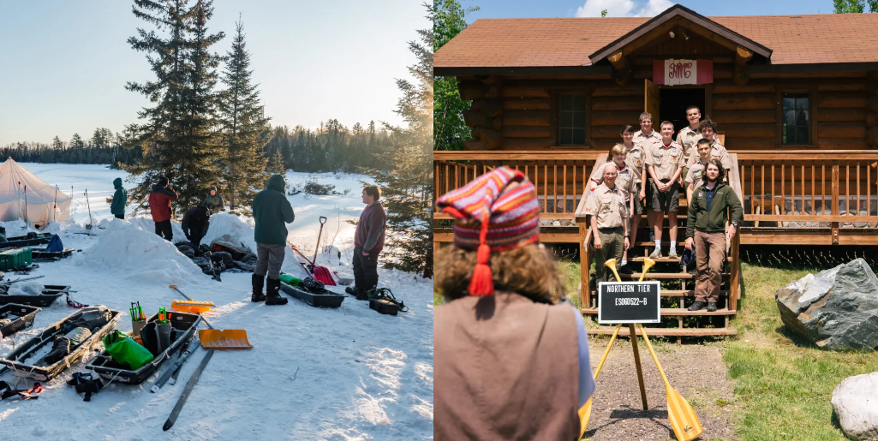

Ely, MN Base: Charles L. Sommers Canoe Base

Slide 17
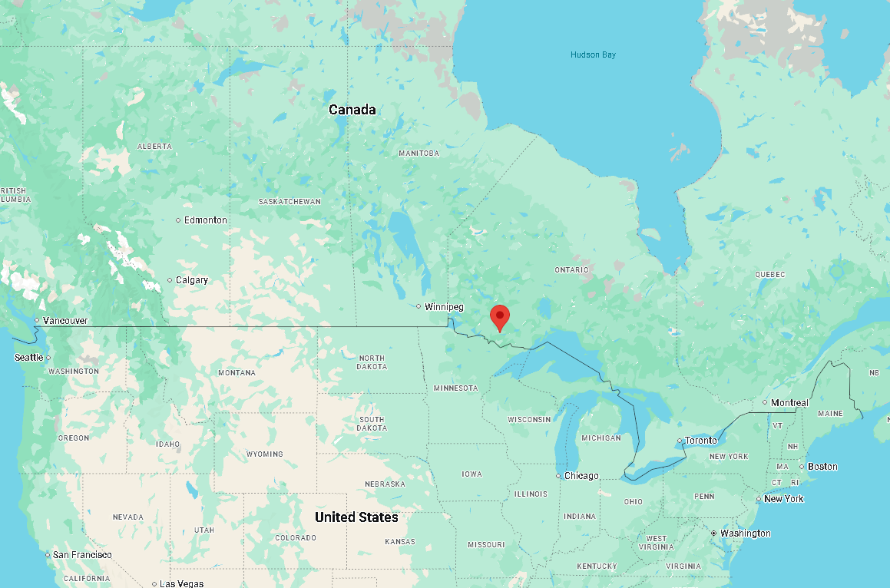

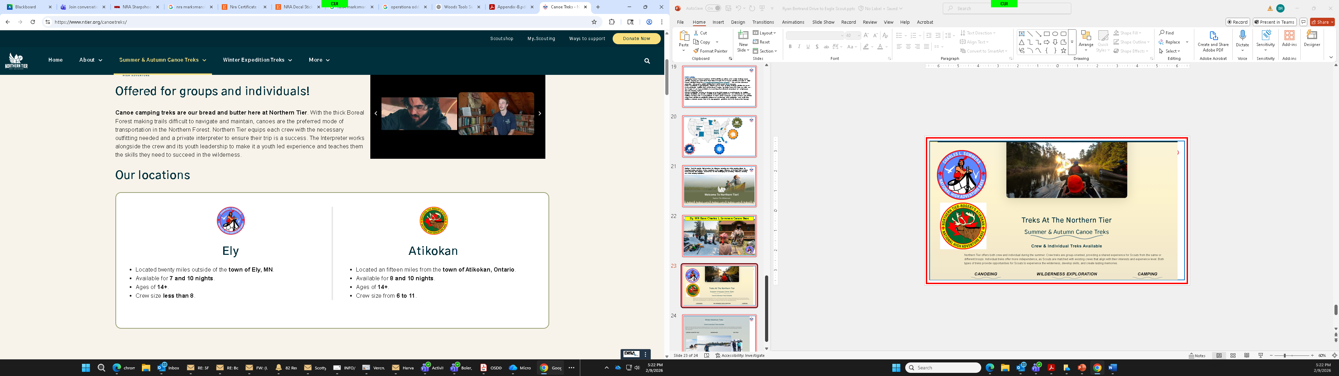

Slide 18




Slide 19
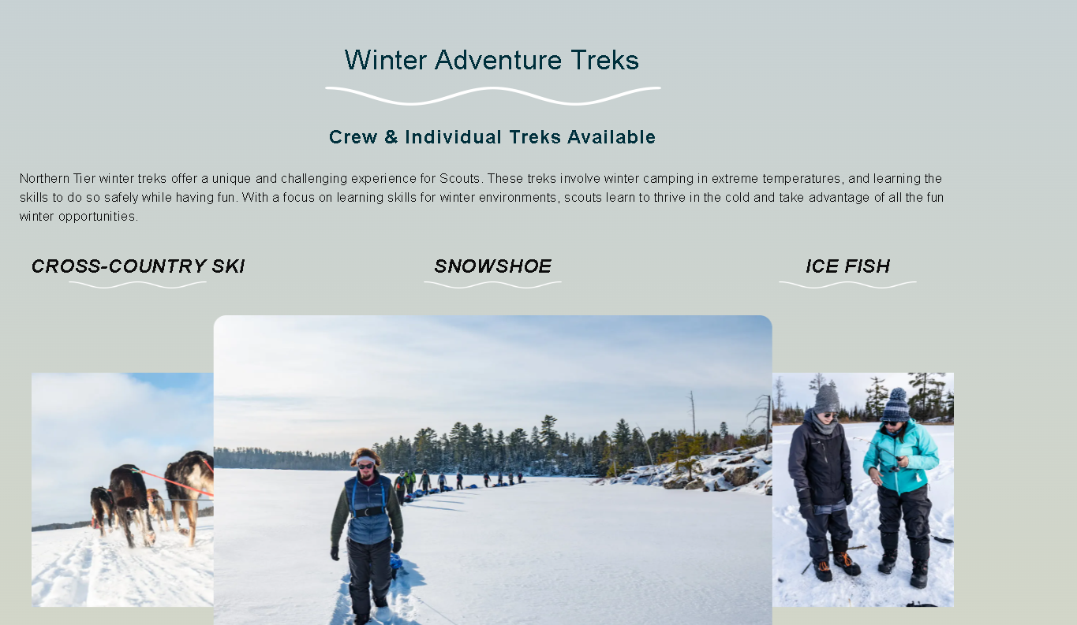

Slide 20
🛶 Northern Tier (MN / Canada)
Theme: Canoe wilderness
Fun Factor: 🔥🔥🔥🔥
Physical Challenge: 🔥🔥🔥🔥
Adventure Type: Portage expedition
Hardship Level: Moderate–High
✔ Remote and quiet
✔ True self-reliance
✔ Tight crew bonding
✖ Bugs and wet feet
Best for: Authentic wilderness experience.
🏔️ Philmont (New Mexico)
Theme: Mountain expedition
Fun Factor: 🔥🔥🔥🔥
Physical Challenge: 🔥🔥🔥🔥🔥
Adventure Type: 50–100 mile backpack trek
Hardship Level: High
✔ Summit achievements
✔ Deep personal growth
✔ Classic rite of passage
✖ Altitude and grind
Best for: “I conquered something big.”
🏝️ Sea Base (Florida / Caribbean)
Theme: Ocean adventure
Fun Factor: 🔥🔥🔥🔥🔥
Physical Challenge: 🔥🔥
Adventure Type: Sailing, snorkeling, scuba
Hardship Level: Low–Moderate
✔ Tropical
✔ High excitement
✔ Daily “wow” moments
✖ Less wilderness hardship
Best for: Pure fun and team bonding.
🧗 Summit Bechtel Reserve (WV)
Theme: Extreme adventure park
Fun Factor: 🔥🔥🔥🔥🔥
Physical Challenge: 🔥🔥🔥
Adventure Type: Zip lines, climbing, BMX, whitewater
✔ Fast-paced
✔ High variety
✔ Big adrenaline
✖ Less “expedition” feel
Best for: High-energy Scouts who want action every day.
🥾 Raven Rock (Regional HA Style)
Theme: Rugged backpacking / survival
Fun Factor: 🔥🔥🔥
Physical Challenge: 🔥🔥🔥
Adventure Type: Backpacking, fieldcraft
✔ Intimate experience
✔ Lower cost
✔ Customizable
✖ Less national prestige
Best for: Building skills before national bases.
If You’re Planning a Troop Pipeline:
Age 13–14 → Summit or Raven Rock
Age 15–16 → Sea Base
Age 16–17 → Northern Tier
Age 17–18 → Philmont (capstone)
If you’d like, I can now:
Rank by retention impact
Rank by leadership development
Rank by adult workload
Or help you build a 4-year high adventure plan**

Slide 21
🧭 4-Year High Adventure Pipeline (Ages 13–17)
Year 1 (Age 13–14) —
Summit Bechtel or Regional HA (Raven Rock Style)
Theme: Confidence & Skills Foundation
Goal: Hook them early
Why Here?
High energy
Fast-paced success experiences
Lower endurance barrier
Strong group bonding
Focus Skills
Basic backpacking
Physical conditioning habits
Outdoor cooking
Youth-led decision making
Leadership Development
First exposure to real crew structure
Patrol leaders get real authority
Introduce expedition planning concepts
Year 2 (Age 14–15) —
Sea Base
Theme: Teamwork & Shared Responsibility
Goal: Deep bonding experience
Why Here?
Less physical than Philmont
Requires tight teamwork
Memorable “wow” factor
Focus Skills
Crew discipline
Duty rosters
Shared hardship
Marine/environmental awareness
Leadership Development
Rotating crew leadership afloat
Accountability in confined environment
Year 3 (Age 15–16) — Northern Tier
Theme: Self-Reliance & Expedition Mindset
Goal: True wilderness competence
Why Here?
Stronger physical demand
Requires maturity
Less external structure
Focus Skills
Navigation
Risk management
Expedition pacing
Environmental resilience
Leadership Development
Youth-led navigation decisions
Risk / crisis management ownership
Year 4 (Age 16–17) — Philmont
Theme: Capstone Challenge
Goal: Rite of passage
Why Here?
Highest endurance challenge
Leadership crucible
Symbolic accomplishment
Focus Skills
Advanced trek planning
Conflict resolution under fatigue
Strategic pacing
Emotional resilience
Leadership Development
Crew leader fully youth-driven
Strategic decision-making
Mentorship of younger Scouts

Slide 22
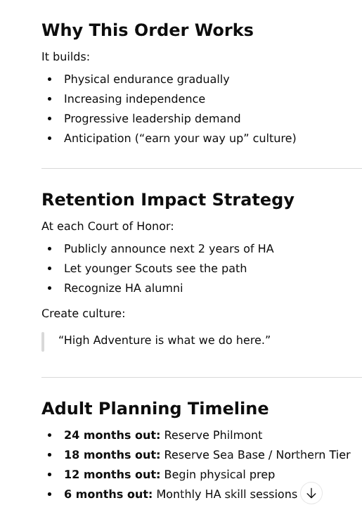
“High Adventure is what we do here.”

Slide 24
Base | Pure Fun | Challenge | Wilderness | Adrenaline | Prestige
Sea Base | ⭐⭐⭐⭐⭐ | ⭐⭐ | ⭐⭐ | ⭐⭐⭐ | ⭐⭐⭐⭐
Philmont | ⭐⭐⭐⭐ | ⭐⭐⭐⭐⭐ | ⭐⭐⭐⭐ | ⭐⭐ | ⭐⭐⭐⭐⭐
Northern Tier | ⭐⭐⭐⭐ | ⭐⭐⭐⭐ | ⭐⭐⭐⭐⭐ | ⭐ | ⭐⭐⭐⭐
Summit | ⭐⭐⭐⭐⭐ | ⭐⭐⭐ | ⭐ | ⭐⭐⭐⭐⭐ | ⭐⭐⭐⭐
Raven Rock | ⭐⭐⭐ | ⭐⭐⭐ | ⭐⭐⭐ | ⭐ | ⭐⭐
3
1
2
$
$
$
$
4
1
1
$
$
2
$
5
$
$
2
1
2
1
1
2
$
4
$
$
Higher is Better

Slide 25
Troop 4-Year High Adventure Vision
Building confidence, leadership, and resilience through progressive high adventure.
Not just trips — intentional youth development.

Slide 26
Why High Adventure?
• Increases retention through age 17
• Builds grit and confidence
• Develops real youth leadership
• Creates lifelong memories

Slide 27
Year 1: Regional HA / Summit (Age 13–14)
Focus: Confidence & Skills
• Backpacking basics
• Crew teamwork
• Physical conditioning habits
• Youth-led structure introduction

Slide 28
Year 2: Sea Base (Age 14–15)
Focus: Team Responsibility
• Sailing & marine skills
• Duty rosters & accountability
• High bonding experience

Slide 29
Year 3: Northern Tier (Age 15–16)
Focus: Expedition Mindset
• Canoeing & portaging
• Navigation ownership
• Wilderness self-reliance

Slide 30
Year 4: Philmont (Age 16–17)
Capstone Challenge
• 50–100 mile trek
• High altitude endurance
• Youth-led crew leadership
• Rite of passage experience

Slide 31
Safety & Risk Management
• BSA National Standards
• Certified base staff
• Two-deep leadership
• Medical screening
• Progressive training & shakedowns

Slide 32
4-Year Budget Overview (Per Scout)
Year 1: $600–$900
Year 2: $1,800–$2,400
Year 3: $1,700–$2,300
Year 4: $2,000–$2,800
Estimated 4-Year Total: $6,100–$8,400
(Includes travel, base fees, gear, food)

Slide 33
Cost Management Plan
• 18–24 month notice
• Monthly payment plans
• Fundraising options
• Transparent cost tracking
• No surprise deadlines

Slide 34
What We Ask of Parents
• Encourage participation
• Support preparation
• Communicate early
• Trust the youth-led model
High Adventure builds capable young adults.

Slide 35
High Adventure Parent FAQ
Is high adventure safe? Yes. All trips follow BSA national standards, certified base staff supervision, medical screening, and two-deep leadership policies.
Why start at age 13? Early exposure builds confidence and skills progressively before more demanding expeditions.
What if my Scout is not athletic? Conditioning is gradual. Preparation weekends help every Scout build capability safely.
How are costs managed? We provide 18–24 month notice, payment plans, and fundraising opportunities.
What if my Scout cannot attend one year? Participation is encouraged but flexible. Scouts can rejoin the pipeline the following year.
How does this build leadership? Each year increases youth decision-making responsibility and crew leadership ownership.
What is the long-term benefit? Scouts finish the program with resilience, confidence, and real expedition experience.

